Slide 1
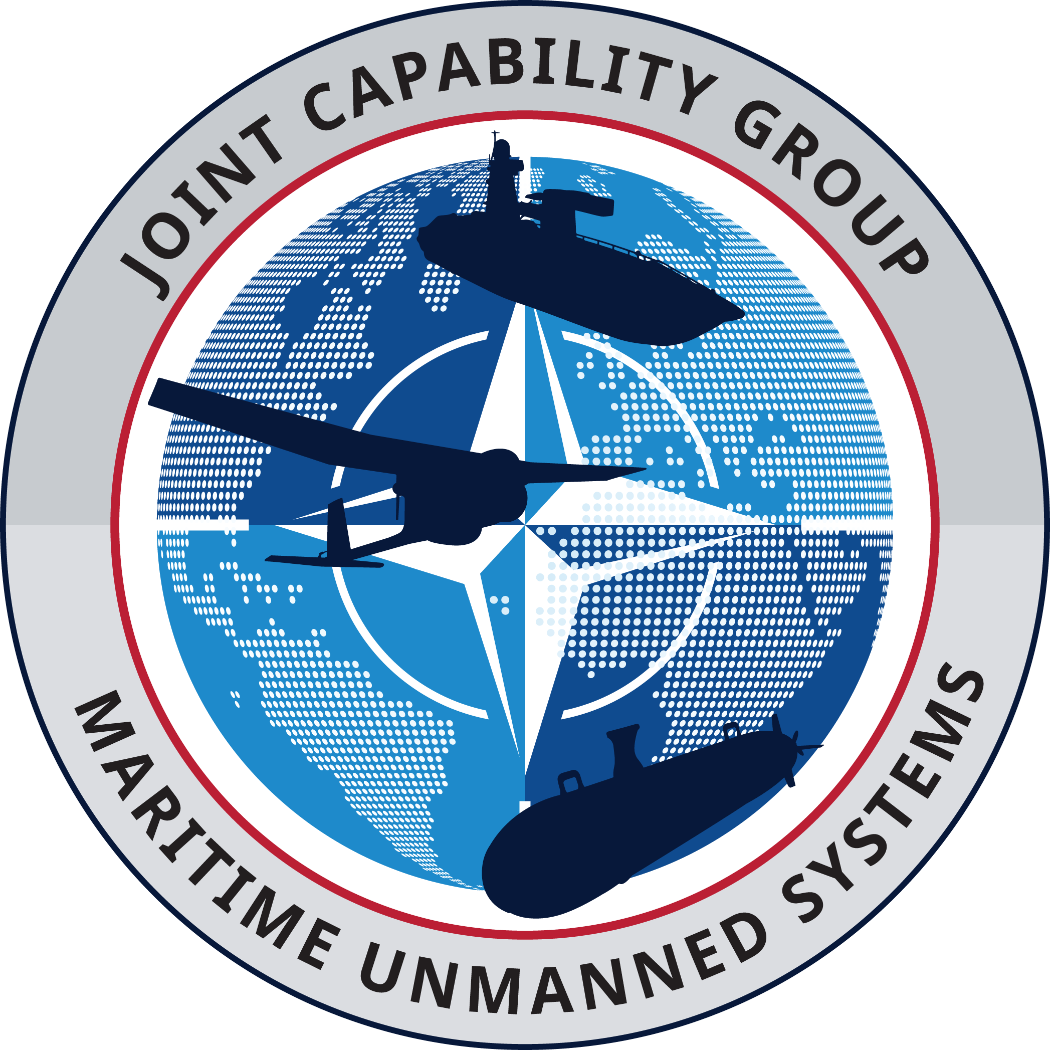
Joint Capability Group Maritime Unmanned Systems FATHOMWERX Intro
JCGMUS Mission: Accelerate, through multi-national cooperation and innovation, the delivery of Alliance and Partners’ maritime capabilities across the DOTMLPFI spectrum, via exploitation of Maritime Unmanned Systems, and contribute to the resolution of maritime capability shortfalls to maintain battle-winning advantage. Members: BEL, CAN, DNK, DEU, ESP, EST, FRA, GBR, GRC, ITA, NLD, POL, PRT, ROU, SWE, TUR, USA Partners: AUS, NZ
Dr Craig P Sawyer
Chair, NATO JCGMUS
DISTRIBUTION STATEMENT A. Approved for public release; distribution unlimited

Slide 2
So what?
Stop by and discuss
Interoperability to Interchangeability
International Standards
NATO Alliance’s MUS Operational Experimentation Forum
REPMUS 24
REPMUS/DYMS 25
How to evolve, and apply your efforts towards critical NATO challenges
Digital Ocean – all-domain allied of seabed to space data
Anti Submarine Barrier – Allied sensors to provide deployable sensor nets
Critical Undersea Infrastructure Protection – Prevention of attacks on seabed infrastructure
Accelerate, through multi-national cooperation and innovation, the delivery of Alliance and Partners’ maritime capabilities across the DOTMLPFI spectrum, via exploitation of Maritime Unmanned Systems, and contribute to the resolution of maritime capability shortfalls to maintain battle-winning advantage.
DISTRIBUTION STATEMENT A. Approved for public release; distribution unlimited

