Slide 1
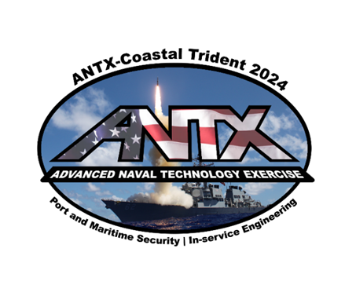
ANTX-Coastal Trident
Welcome and Program Overview
Brendan Applegate
Lead for Fleet Experimentation and Exercises
NSWC Port Hueneme Division
Office of the Chief Technology Officer

Slide 2
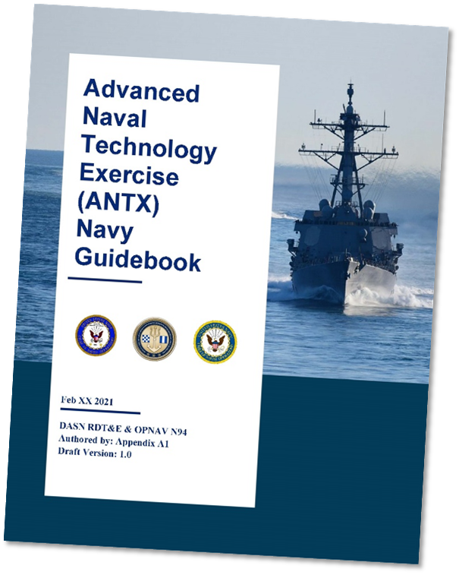
Background… What is ANTX?
“With a rapidly changing threat environment, our National Defense Strategy and other guiding strategic documentation identify a need to adapt quickly and rapidly to take advantage of technical innovations.”
Technologists need an understanding of the operational challenges
Warfighters need an understanding of developing technological opportunities
The Navy uses focused experimentation and exercise programs to maintain awareness of the leading edge and create opportunities for engagement

Slide 3
Background… What is ANTX?
ANTX was established to accelerate the identification of high-value opportunities for the Navy, larger joint force, and interagency partners
Assessment is based on observation of ANTX activities, with the objective of facilitating progress in one of the following potential engagement areas:
Disruptive opportunity exploration (demonstration or experiment)
Transition into a formal fleet experiment or exercise
Transition into a collaborative S&T project (CRADA)
Transition into a new NR&DE maturation project (NISE project)
Transition into an existing program of record
Some projects will not warrant recommendations to these transition pathways

Slide 4
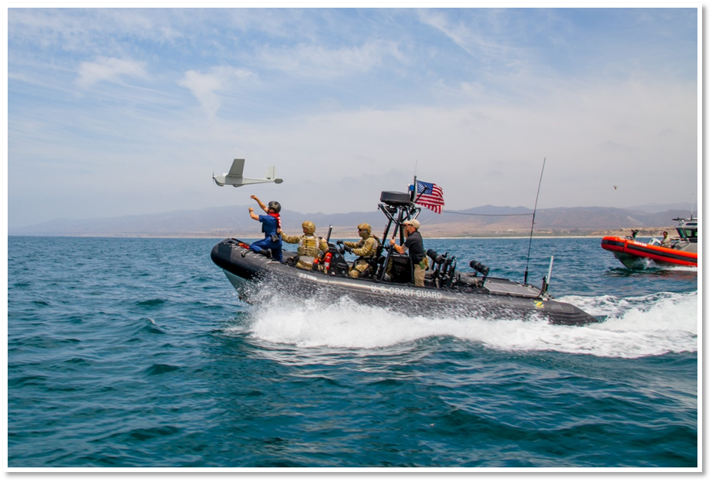
Background… What is ANTX?
Think…
“demonstration”
“experiment”
“exploratory exercise”
“what is possible?”
“will this work?”
“can it do what they say it does?”
Stop short of …
“how would we?”
“how well does this?”
ANTX was established to accelerate the identification of high-value opportunities for the Navy, larger joint force, and interagency partners
Assessment is based on observation of ANTX activities, with the objective of facilitating progress in one of the following potential engagement areas:
Disruptive opportunity exploration (demonstration or experiment)
Transition into a formal fleet experiment or exercise
Transition into a collaborative S&T project (CRADA)
Transition into a new NR&DE maturation project (NISE project)
Transition into an existing program of record
Some projects will not warrant recommendations to these transition pathways
Coastal Trident 2015

Slide 5
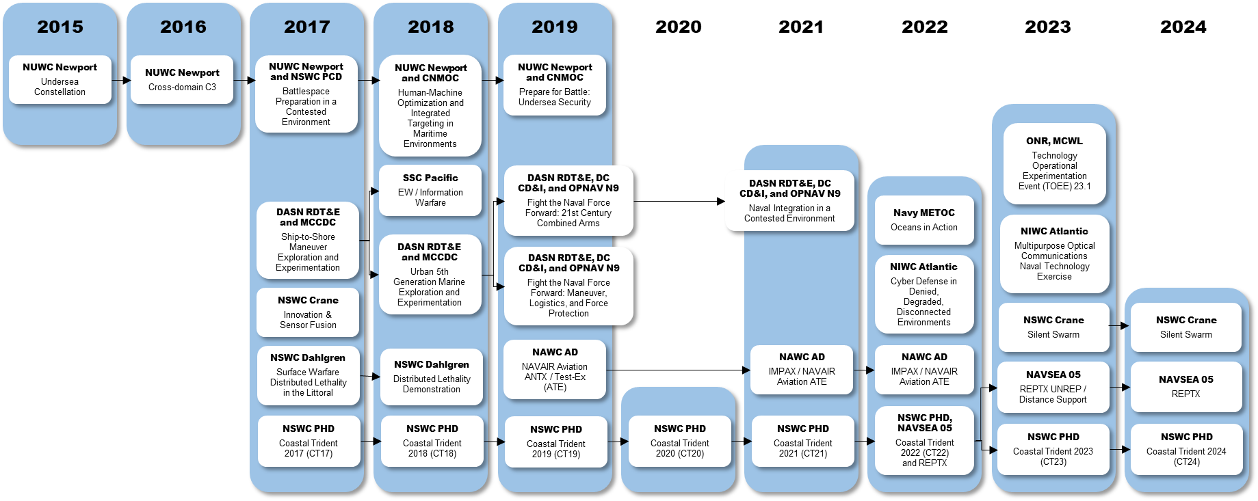
Background… What is ANTX?
ANTX-Coastal Trident leverages the body of knowledge developed as a port and maritime security program conducted since 2007
NPS
Coastal Trident 2015 (CT15)
NPS
Coastal Trident 2016 (CT16)

Slide 6
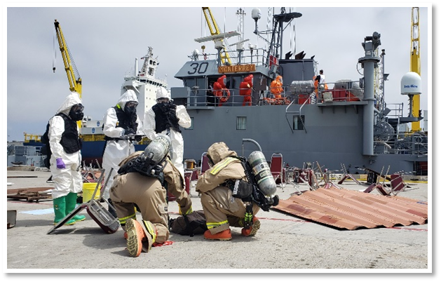
Alignment with Coastal Trident
Coastal Trident is an operational research program conducted annually to address threats to port and maritime security
Reinforce federal, state, local government, and private sector strategic partnerships in port and maritime domains
Strengthen existing capabilities to support safe and effective port and maritime operations
Explore CONEMP and accelerate access to developing and transitional technologies
Coastal Trident is designed to meet the needs of a wide variety of stakeholders and emphasizes a “whole of society” strategy for port and maritime security
Coastal Trident 2019

Slide 7
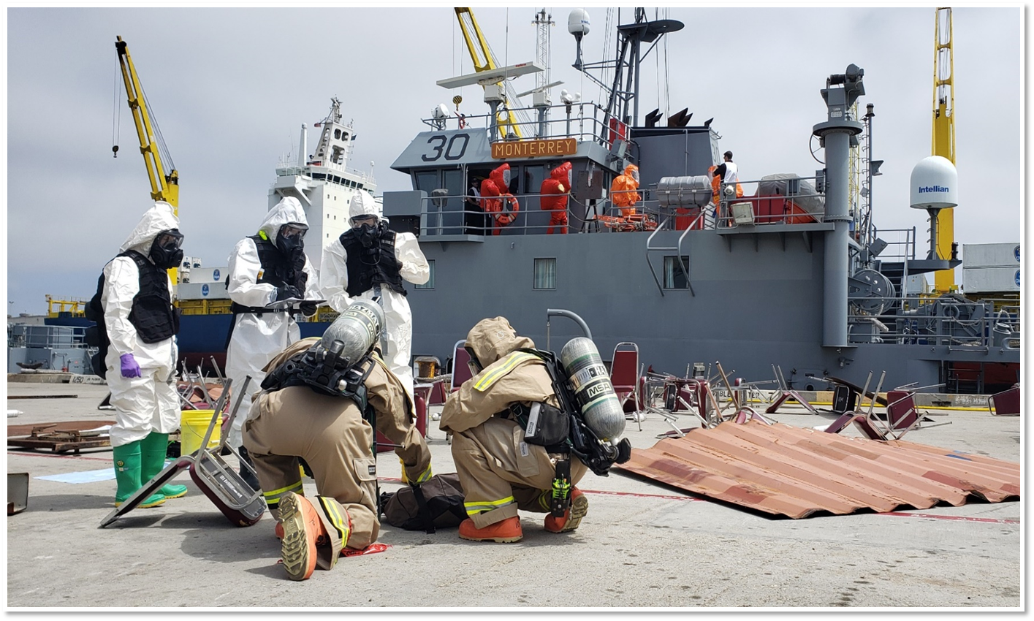
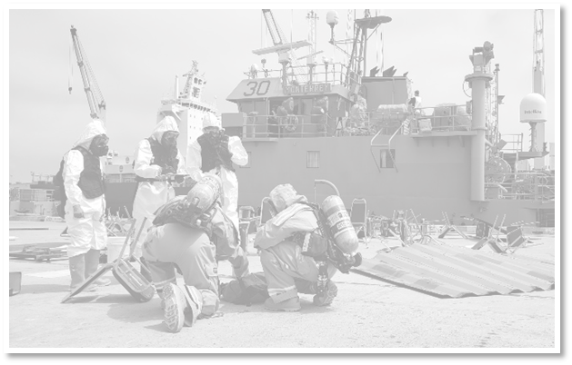
Alignment with Coastal Trident
County Bomb Squad
City Fire HAZMAT
Coastal Trident is an operational research program conducted annually to address threats to port and maritime security
Reinforce federal, state, local government, and private sector strategic partnerships in port and maritime domains
FBI HAZMAT
Army Ship
Strengthen existing capabilities to support safe and effective port and maritime operations
Explore CONEMP and accelerate access to developing and transitional technologies
Coastal Trident is designed to meet the needs of a wide variety of stakeholders and emphasizes a “whole of society” strategy for port and maritime security
County Fire HAZMAT
Commercial Port

Slide 8
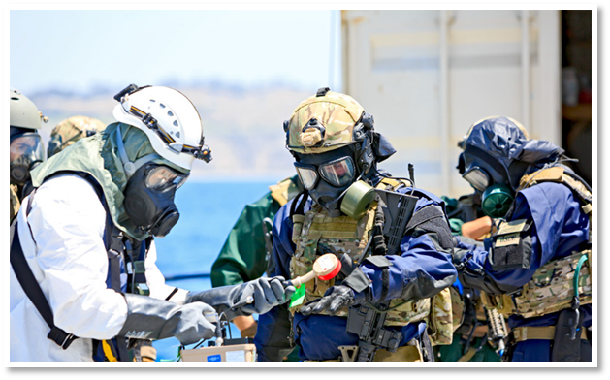
Alignment with Coastal Trident
ANTX is aligned with Coastal Trident to provide access to unique resources not otherwise accessible to experimenters
Scenario-based, operationally relevant test environments
SMEs and representative end users from Navy and interagency partners
Alignment with Coastal Trident maximizes feedback
and expands awareness of technical solutions
Examine novel CONEMP and CONOPS
Acknowledge multi-agency nature of port and maritime security operations
Facilitate engagement, collaboration, and innovation
Coastal Trident 2014

Slide 9
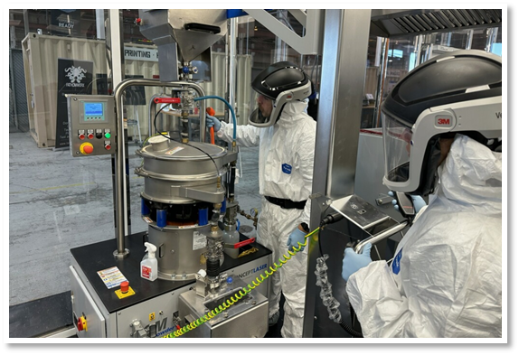
Alignment with FATHOMWERX
The NavalX Ventura Tech Bridge, or “FATHOMWERX,” supports a regional ecosystem to innovate, collaborate, and accelerate adoption of technologies
FATHOMWERX stakeholders provide unique venues for prototyping, demonstration, and experimentation to small businesses and low-TRL technologies targeting operational gaps and challenges
NSWC Port Hueneme Division
NAWC Weapons Division-Point Mugu
NAVFAC Engineering and Expeditionary Warfare Center
NUWC Keyport-Det San Diego
Port of Hueneme
EDC-Ventura County and Matter Labs (PIA partner)

Slide 10
Alignment with FATHOMWERX
Alignment of ANTX with FATHOMWERX expands access to technology developers and innovators that might not be engaged with the Navy through traditional acquisition pathways
ANTX serves as a key vehicle in the “Scan” and “Validate” phases of the NavalX innovation pipeline
ANTX facilitates low barrier-to-entry demonstration and engagement of capabilities early in the development cycle

Slide 11
Program Design… Modularity
ANTX-Coastal Trident is conducted as a series of technical demonstrations, field experiments, discussion-based and operations-based exercises
A modular construct facilitates control over project interactions and limits program risk
Go where the resources are
Limit impact of real-world operational commitments
Limit impacts of technical delays or project cancellations
Allow project teams to concurrently leverage program resources
Establish a training environment that allows failure
Compartmentalize projects to preserve security

Slide 12
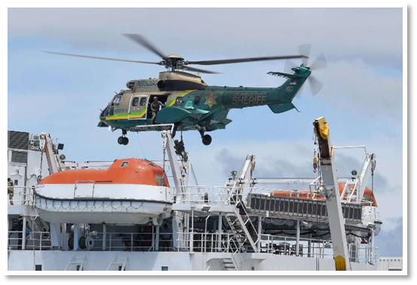
Program Design… Modularity
Under its modular design, ANTX-Coastal Trident projects are organized administratively where there is a common focus
Modular alignment assists the planning team in coordinating reviews/approvals and communicating program scope
Operationally, projects are “plugged-and-played” where participants, scenarios, supporting resources are common, or OPSEC/INFOSEC is a factor
Sponsored projects and operational stakeholder priorities drive the operational environments
Technical demonstrations and field experiments may leverage these environments in parallel or integrate at the discretion of operational stakeholders
Coastal Trident 2019

Slide 13
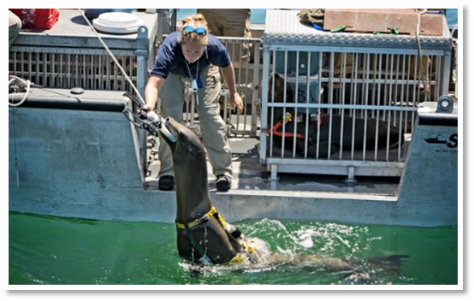
ANTX-CT24 Administrative Construct
Historical numbers for ANTX-CT
2018: 33 projects proposed
2019: 30 projects proposed
2020: 35 projects proposed
2021: 56 projects proposed
2022: 74 projects proposed
2023: 71 projects proposed
2024: 82 projects proposed
Module 1: Port and Maritime Incident Response
5 projects
Module 2: Port Security and Critical Infrastructure
Protection
3 projects
Module 3: Asymmetric Threat Detection and Domain
Awareness
15 projects
Module 4: Maintenance and Sustainment of Fleet
and Expeditionary Operations
16 projects
Module 5: Unmanned Systems Applications
15 projects
Module 6: Unmanned Systems Countermeasures
5 projects
Module 7: Decision Support and Information
Dominance
9 projects
Module 8: Maritime Communications and Data Links
14 projects
Coastal Trident 2013

Slide 14
ANTX-CT24 Administrative Construct
Module 1: Port and Maritime Incident Response
5 projects
Module 1:
1.1: LASD FTX, maritime tactical operations in a cargo vessel hijacking scenario
1.2: MCMGRU 3 TTX, interagency command and control in a homeland defense scenario
1.3: NSWC PH FE, continuity of fleet support operations in a disaster scenario
1.4: Port of Hueneme FE, regional response and emergency management in a lithium battery fire scenario
1.5: VCSO FTX, bomb squad and search & rescue operations in a mass fatality scenario
Module 2: Port Security and Critical Infrastructure
Protection
3 projects
Module 3: Asymmetric Threat Detection and Domain
Awareness
15 projects
Module 4: Maintenance and Sustainment of Fleet
and Expeditionary Operations
16 projects
Module 5: Unmanned Systems Applications
15 projects
Module 6: Unmanned Systems Countermeasures
5 projects
Module 7: Decision Support and Information
Dominance
9 projects
Module 8: Maritime Communications and Data Links
14 projects

Slide 15
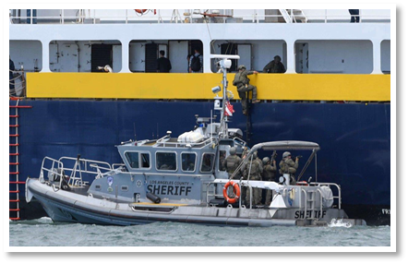
ANTX-CT24 Operational Construct
Module 1:
1.1: LASD FTX, maritime tactical operations in a cargo vessel hijacking scenario
1.2: MCMGRU 3 TTX, interagency command and control in a homeland defense scenario
1.3: NSWC PH FE, continuity of fleet support operations in a disaster scenario
1.4: Port of Hueneme FE, regional response and emergency management in a lithium battery fire scenario
1.5: VCSO FTX, bomb squad and search & rescue operations in a mass fatality scenario
Module 1.1
Primary Stakeholder:
Los Angeles Sheriff’s Department
Objectives:
Enhance operational readiness of local law
enforcement to respond to a vessel hijacking
Support Requirements:
Requires maritime venue
Requires large vessel target
Maritime Cadre, Special Enforcement Detail, Emergency Services Detail, Aero Bureau players
Requires OPFOR role-players
Willing to align with relevant enabling technologies
Coastal Trident 2019
Event ALPHA

Slide 16
ANTX-CT24 Operational Construct
Event ALPHA: Maritime hijacking FTX
Requires maritime venue
Requests large vessel target
Maritime Cadre, Special Enforcement Detail, Emergency Services Detail, Aero Bureau players
Requires OPFOR role-players
Willing to align with relevant enabling technologies
1.1: LASD FTX
1.2: MCMGRU 3 TTX
1.3: NSWC PH FE
1.4: Port of Hueneme FE
1.5: VCSO FTX
2.1: ECOncrete TD
2.2: GBL Systems TD
2.3: Mountain Horse Solutions, BCB TD
3.1: Atmo TD
3.2: Bedrock Ocean Exploration TD
3.3: Collins Aerospace TD
Module 2.3: Boat-stopping demonstration
Requires maritime venue
Requests representative end users to support (operators in the field doing things)
Requests OPFOR role-players
Relevant to law enforcement operations and terrorism scenarios
Module 3.1: Precision weather forecast demonstration
Requests representative end users to support
Relevant to law enforcement operations and terrorism scenarios
Module 3.3: Chemical detection demonstration
Requests representative end users to support
Relevant to law enforcement operations and terrorism scenarios

Slide 17
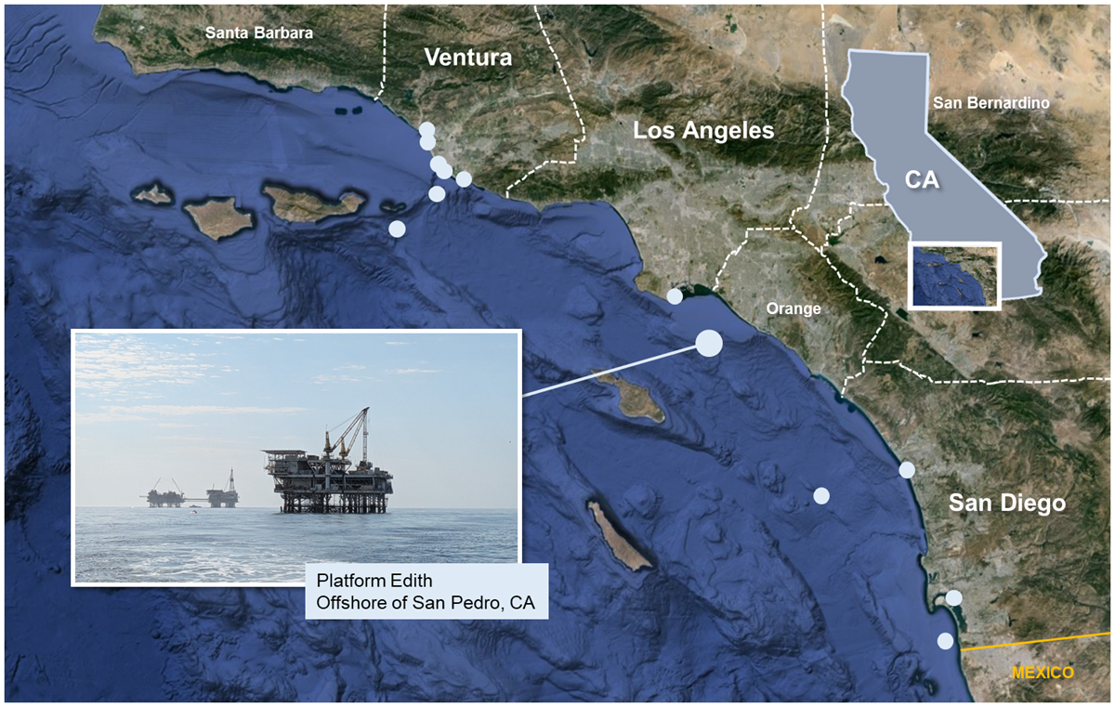
ANTX-CT24 Operational Construct
Event ALPHA
A FTX will be conducted to build individual and unit proficiency in the full spectrum of mission tasks associated with a cargo vessel hijacking in the Catalina Channel.
The exercise scenario will support an operational venue for technical demonstrations and field experiments by projects participating in ANTX-CT24.
Port and Maritime Incident Response
1.1: FTX, cargo vessel hijacking (LASD)
Port Security and Critical Infrastructure Protection
2.3: TD, non-lethal boat stopping (Mountain Horse Solutions, BCB International)
Asymmetric Threat Detection and Domain Awareness
3.1: TD, precision weather forecasts (Atmo)
3.3: TD, wearable chemical detection (Collins Aerospace)
3.12: FX, multi-spectral camera for standoff detection (Polaris Sensor Technologies)
Maintenance and Sustainment of Fleet and Expeditionary Combat Systems
4.16: FX, immersive training in VBSS (Street Smarts VR)
Decision Support and Information Dominance
7.3: FX, mobile app for interoperable information sharing (Global Maritime Werx)
Maritime Communications and Data Links
8.2: FX, on-body mesh networks (Bunker Supply)
8.5: TD, quantum encryption of communications (Insight Public Sector, Quantinuum)

Slide 18
ANTX-CT24 Operational Construct
Event ALPHA
A FTX will be conducted to build individual and unit proficiency in the full spectrum of mission tasks associated with a cargo vessel hijacking in the Catalina Channel.
The exercise scenario will support an operational venue for technical demonstrations and field experiments by projects participating in ANTX-CT24.
Project in bold is driving the operational environment
Port and Maritime Incident Response
1.1: FTX, cargo vessel hijacking (LASD)
Port Security and Critical Infrastructure Protection
2.3: TD, non-lethal boat stopping (Mountain Horse Solutions, BCB International)
Asymmetric Threat Detection and Domain Awareness
3.1: TD, precision weather forecasts (Atmo)
3.3: TD, wearable chemical detection (Collins Aerospace)
3.12: FX, multi-spectral camera for standoff detection (Polaris Sensor Technologies)
Maintenance and Sustainment of Fleet and Expeditionary Combat Systems
4.16: FX, immersive training in VBSS (Street Smarts VR)
Decision Support and Information Dominance
7.3: FX, mobile app for interoperable information sharing (Global Maritime Werx)
Maritime Communications and Data Links
8.2: FX, on-body mesh networks (Bunker Supply)
8.5: TD, quantum encryption of communications (Insight Public Sector, Quantinuum)
Additional projects leverage the operational environment in parallel, or integrated at the discretion of operational stakeholders

Slide 19
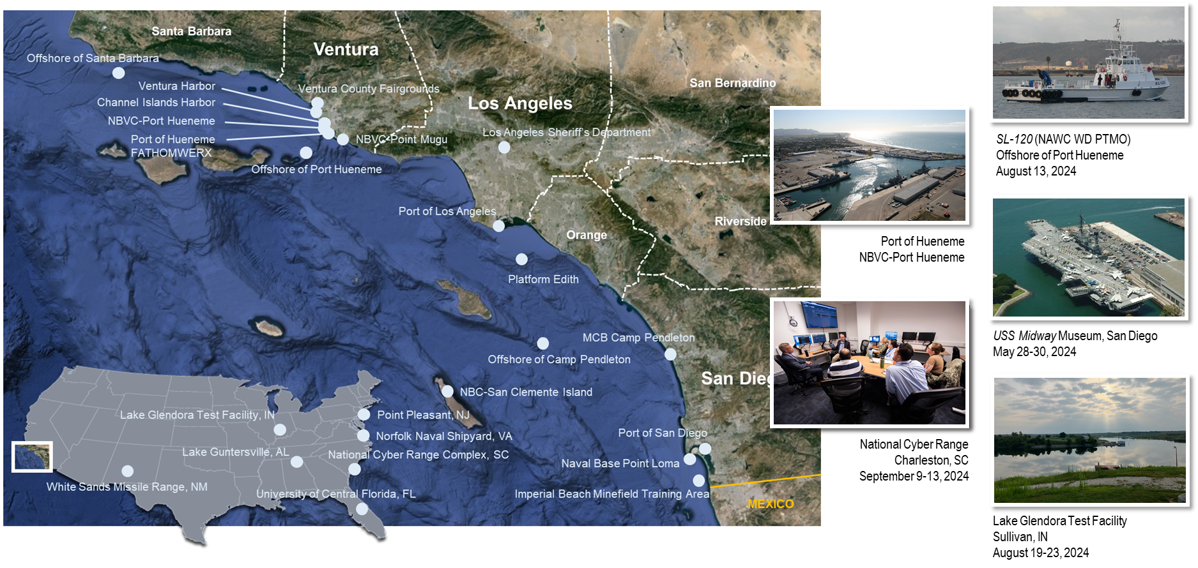
ANTX-CT24 Operational Construct

Slide 20
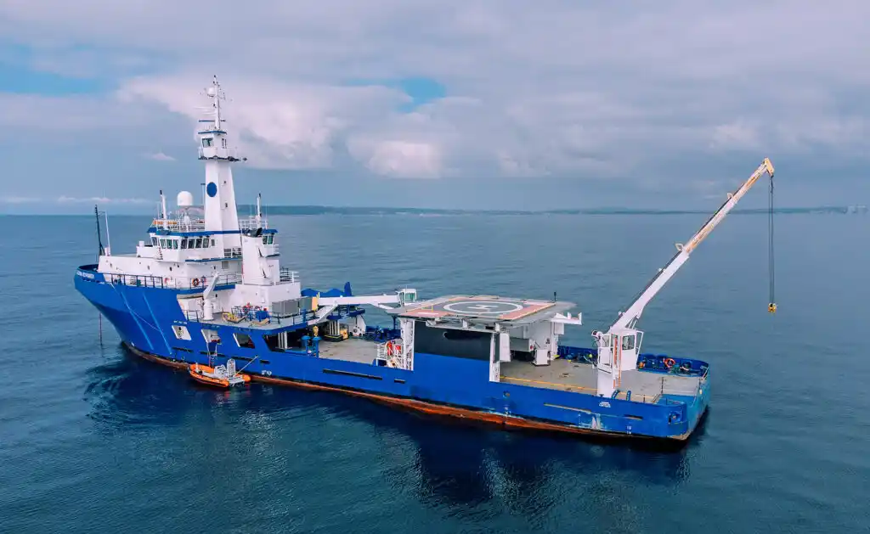
ANTX-CT24 Operational Construct
In order to maintain a low barrier-to-entry and accommodate a short planning timeline, the ANTX-Coastal Trident planning team maximizes use of “non-traditional” venues. This requires some planning flexibility and imagination but significantly increases access to relevant test environments
Example:
Instead of a Fleet combatant, the planning team might suggest experimentation aboard a commercial offshore support vessel or oil platform – an industrial structure on the water subject to environmental exposure, constrained footprint, infrastructure and communications austerity, but with boats to and from several times daily, potential for long-duration installations, and significantly reduced administrative burden
Seaward Endeavor
Coastal Trident 2023
Platform Edith, offshore of Huntington Beach, CA
Coastal Trident 2022

Slide 21
ANTX-CT24 by the Numbers
82 projects in 8 focus areas
6 projects supporting CRADA research
11 projects supporting S&T development
7 projects supporting EPA research
14 projects supporting SBIR
16 projects supporting NISE research
11 Navy Warfare Centers collaborated
NAWC Aircraft Division (2 field experiments with robotic IMUs, UUV/USV collaboration)
NAWC Weapons Division (vessel support offshore of Port Hueneme)
NAVFAC EXWC (2 field experiments, program support)
NIWC Atlantic (support planning cyber security experiments)
NIWC Pacific (5 experiments, vessel support and range planning offshore of San Diego)
NSWC Carderock (1 field experiment, lithium battery approvals)
NSWC Corona (SME support during field experiments)
NSWC Crane (range support at LGTF, EA/HPM/lithium battery approvals)
NSWC Philadelphia (field experiments with robotic IMUs)
NSWC Port Hueneme (program lead)
NUWC Keyport (program support)
36 events at 32 venues in 8 states
Southern California (Ventura, Los Angeles, San Diego)
White Sands, NM
Sullivan, IN
Lake Guntersville, AL
Point Pleasanton, NJ
Norfolk, VA
Charleston, SC
Orlando, FL
20 projects returned to ANTX-CT to build upon projects conducted in 2023

Slide 22
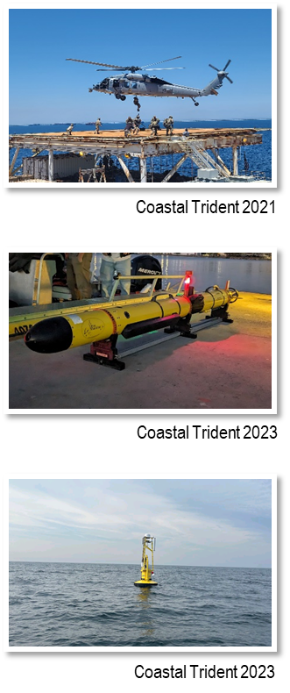
So What? … a Few Success Stories
Operational Training for Navy HSCs and UUVRON-1
As a result of several mishaps, Navy helicopters are not allowed to conduct training over commercial facilities unless participating in a formal Navy exercise program. This limits representative targets and impacts proficiency. Through participation in ANTX-Coastal Trident, Navy HSCs are able to train over passenger ferries, cargo vessels, and oil platforms.
Navy regulations prohibit operation of remotely-operated and unmanned underwater vehicles for training unless covered by an active environmental assessment. This limits opportunities for operators to train and maintain proficiency on a variety of mission essential systems. Through participation in ANTX-Coastal Trident, UUVRON-1 can leverage the investment by NSWC PHD in environmental approvals.
Unmanned Systems Procurements
As a result of participation in ANTX-Coastal Trident 2022 and 2023, Ocean Power Technologies was able to gain visibility with DHS and USN stakeholders. OPT PowerBuoys with surface and subsurface sensors were procured for follow-on experimentation by DHS S&T on the Southern Maritime Boundary and in the C5F AO for Fleet exercises (Phantom Scope) and experiments (TF-59).
Advanced Battery Research Agreements
As a result of participation in ANTX-Coastal Trident 2022 and 2023, Battery Streak was able to exhibit the advanced capabilities of its lithium battery pouches to improve charging speeds, endurance, and safety. NSWC Crane established a CRADA with Battery Streak to collaborate on improvements to power storage systems for untethered unmanned systems.

Slide 23
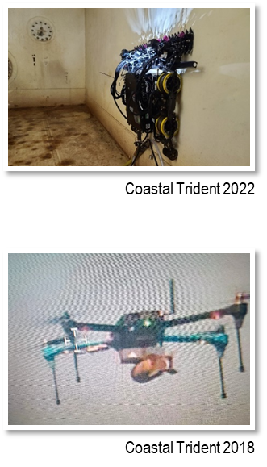
So What? … a Few Success Stories
Pilot Program for Naval Expeditionary Sustainment and Repair
ANTX-Coastal Trident 2021 was leveraged to support several pilot projects for a larger effort by NAVSEA 05 to conduct experiments with battle damage assessment and repair technologies. The success of these projects led to the establishment of the NESAR program (REPTX) during ANTX-Coastal Trident 2022 and the resulting engagement with 68 mature technologies for expeditionary sustainment and repair.
NESAR has since established itself as a standalone program, sponsored by NAVSEA 05 to conduct a series of experiments and transition efforts annually.
Addressing Urgent Needs to Counter UAS
Through NSWC PHD’s engagement with NAVSEA’s Technical Response to Operational Needs (TRON) program, the ANTX-Coastal Trident team became aware of an urgent need to demonstrate capability against a specific threat UAS. Planned experiments were updated to reflect a threat-representative target and demonstrate capability to counter-UAS stakeholders.
As a result of successful experiments, IXI EW’s SEMPRE counter-UAS system was referred to the TRON team as a technically mature option for rapid deployment of counter-UAS capabilities.

Slide 24
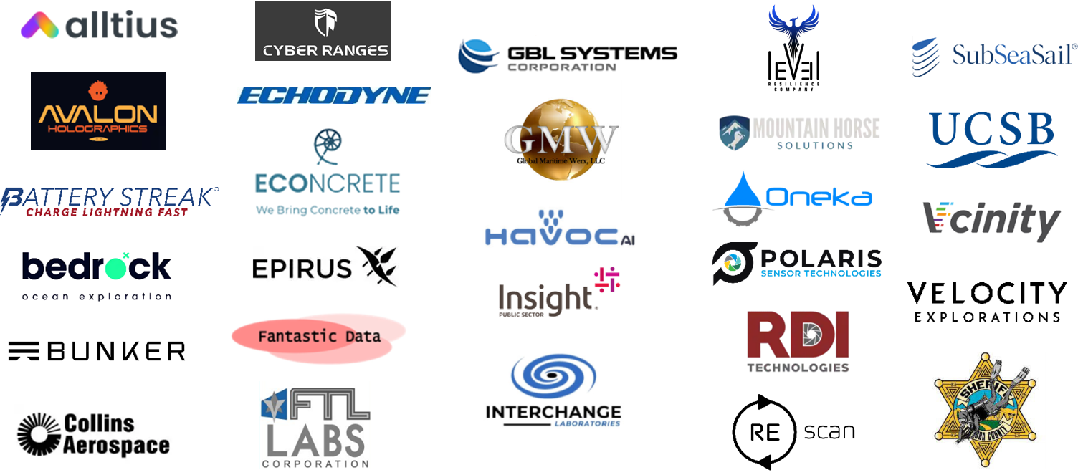
ANTX-CT24 Exhibitors
26 of 56 exhibitors at the FATHOMWERX Summit are ANTX-CT24 projects

