Slide 1
Department of the Navy (DoN) Small Business Innovation Research (SBIR) Experimentation Cell (DoN-SEC) Introduction to SEC and Naval Experimentation
September 2023

Slide 2
About Us
We are a team that connects SBIR with the DoN experimentation community to deliver innovative solutions for the warfighter.
Since establishment in 2020, our mission is to support the SBIR community by offering facilitation, mentoring, and training in all aspects of experimentation.
We highlight the benefits of using experimentation to explore and assess capabilities of emerging SBIR technologies.

Slide 3
About SEC
Mission:
Empower the SBIR community to more effectively utilize experimentation benefits.
Enhance SBIR Transitioning of technological innovations through effective and relevant experimentation efforts to solve warfighting problems and receive valuable feedback.
Increase awareness of experimentation opportunities for the SBIR community.
Simplify experimentation processes with informative guidebooks.
Experimentation can provide Objective Quality Evidence (OQE) to support transition

Slide 4
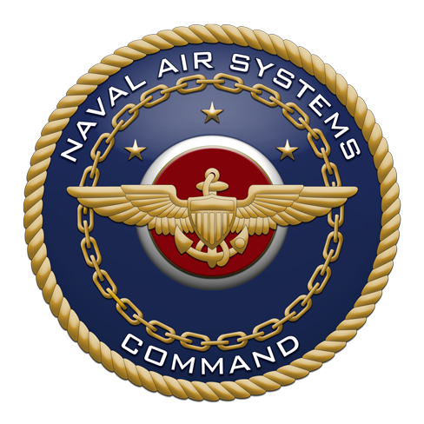
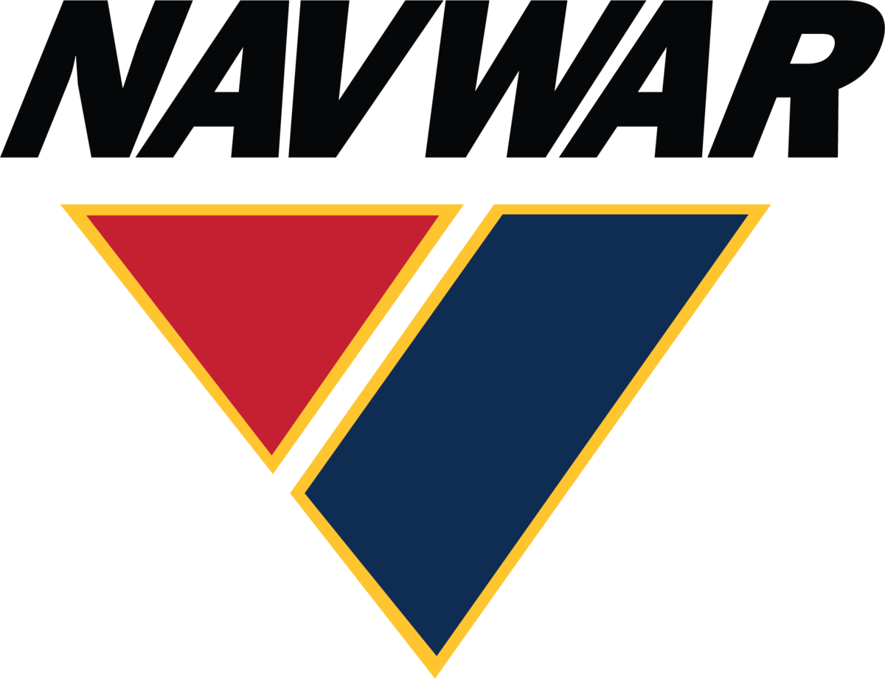
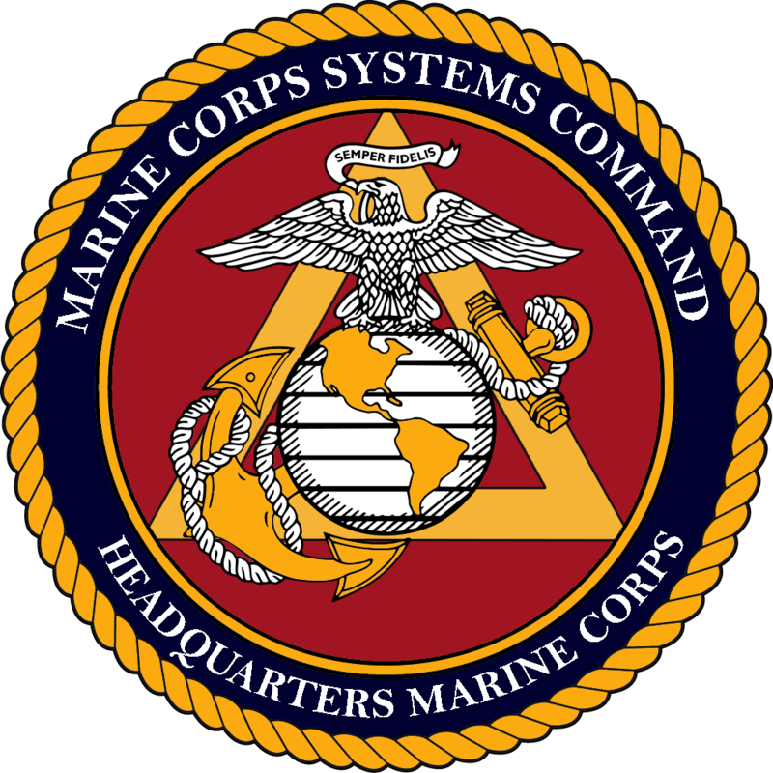
Current Status
Performers Supported
30+ Actively working towards experimentation
29 unique events including TCE-22, Alexander the Great, Archipelago Endeavor, ANTX CT, Trident Warrior 22, Camp Lejeune LOE, TOEE LOE 2/ACE 23.1, C4F LOE, and Trident Spectre
8 SYSCOMs supported, with NAVAIR, ONR, NAVFAC, and MCSC most active
Note that some initiatives have multiple outcomes/experimentation opportunities
Performers considered as “Not a Fit” had no current need for DoN-SEC services
46 Performers
2 Performers
6 Performers
42 performers
8 performers
4 performers
25 performers
Over 222 Initiatives Engaged Since Inception in 2020

Slide 5
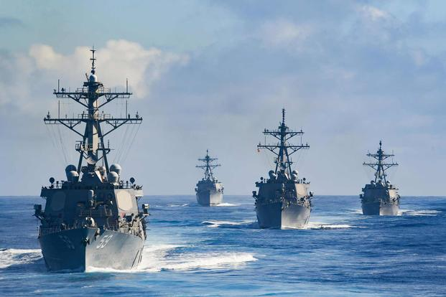
Why Experiment?
Solicit observations and Insights from fleet (USN/USMC) to discover objective based data to support transition decisions
Collect tactical and fleet representatives' observations to validate innovative technologies and/or reduce risk
Enable Build-Test-Build for future research and improvements
Complete an objective, test a theory, or measure a capability to impact a warfighter gap
Receive fleet and developmental feedback prior to acquisition testing and evaluation
“Experimentation, which involves a spectrum of activities including analyses, war games, modeling and simulation, small focused experiments, and large field events among other things, provides the means to enhance naval and joint force development.”
-The Role of Experimentation in Building Future Naval Forces, National Research Council
Experimentation can provide Objective Quality Evidence (OQE) to support transition

Slide 6
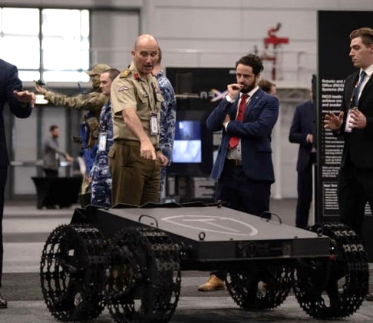
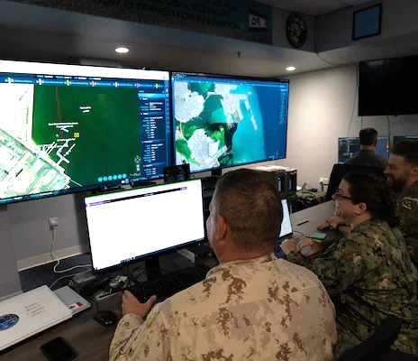
Key Differences
Demonstration
“Let me show you what I can do with…”
Previously conducted multiple times
Not measuring against standards
Known Outcome
The intent is to Share Knowledge
Experiment
“Let’s see what will happen when we …”
Not previously conducted / explored
Not measuring against standards
Unknown Outcome
The intent is to Learn What Works
Test and Evaluation
“Let’s prove or disprove whether it meets… “
May or may not have been conducted previously
Measuring against standards
Expected Outcome
The intent is to Determine if it Works the Way it is Intended to
Notes:
Experiments are exploring a theory about the technology.
T&Es are designed to determine if a technology meets specific standards.

Slide 7
Return on Investment (ROI)
SBIR/STTR performer can assess its innovative solutions to fit warfighter needs in an operational environment
Results-based OQE – ensure objectives are in coordination with acquisition
Increased Technical Readiness Level (TRL)
Connected and cultivated partnerships with relevant stakeholders
Other Government agencies or systems commands
Larger Companies with established contracts
New Opportunities
Frontline Sailors or Marines develop insights into on-the-deckplate needs and requirements
Performing innovators can utilize feedback and research for technology improvements and future iterations
Clear Way Forward
Lessons learned are captured in documentation, such as the Guidebook Library, and updated cyclically
Experimentation can provide Objective Quality Evidence (OQE) to support transition

Slide 8
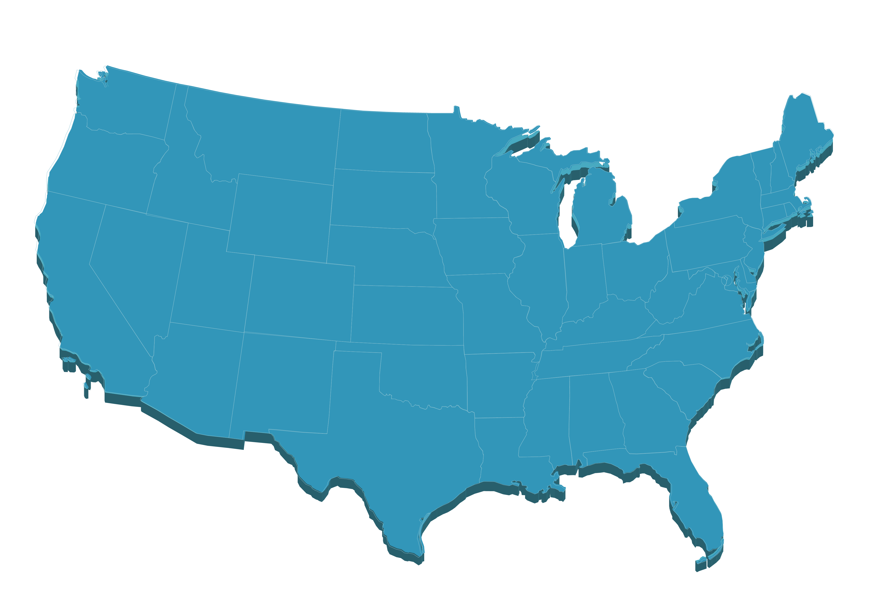
Pathways to Experimentation
ANTX Coastal Trident (CT)
Request for Project Information
Joint Interagency Field Experimentation (JIFX)
Request for Information (RFI)
Technology Operational Experimentation Exercise (TOEE)
RFI
PACIFIC SCOUT
RFI
Trident Spectre (TS)
Call for Submissions
Silent Swarm
SAM.Gov Special Notice
Trident Warrior (TW)
Commercial Area Announcement (CAA)
DoN-SEC
Facilitators for Navy SBIRs/STTRs
Tech Bridges
Connected network across the U.S. as well as Japan and the United Kingdom
Visit Navysbir.com/sec for more information and examples

Slide 9
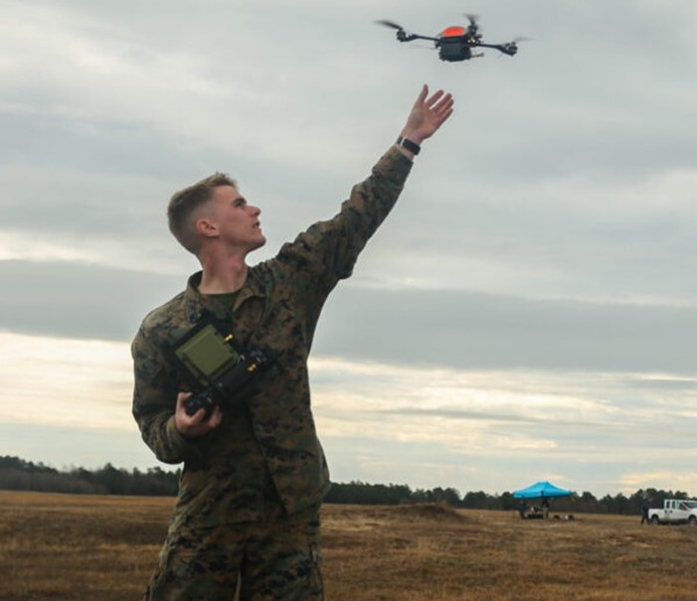
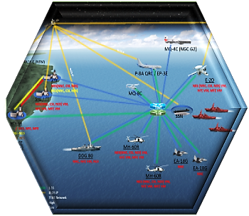
A Spectrum of Event Options
One size does not fit all, select based on your needs!
Smaller Scale Events:
More control of elements
Minimal entrance criteria
Limited resources and interactions
Limited exposure
Larger Scale Events:
Extensive interactions available
Large number of observers
Opportunity to study interaction/integration
Significant requirements for participation
LTE
ANTX
FLEX
TW
LSE
Fleet Integration and Exposure
Complexity and Planning Time
Note: Events listed are just a small sample from a large list of Naval events.
Notes:
Selecting the right event is critical for an experiment to be successful, because not all events are created equal.
Besides the obviously differences like the venue or the potential for international participants, a key difference in events is largely depending on the number of elements taking part, and the associated deconfliction that is required. As such, events can be categorized by their size. With only a few elements that need to be coordinated, small events can provide each experiment with a lot of latitude. Large events on the other hand need to deconflict the many elements and must keep closer control over experiments to ensure they don’t interfere with each other. The lack of flexibility associated with large events is offset by the fact that they often can provide a much wider exposure and have many more opportunity to integrate with other elements. Depending on what a particular technology or initiative needs one size event might be a better fit over others.
Establishing contract with Event staff, a developer team can try to determine if they will be a good match.

Slide 10
Thank You

