Slide 1
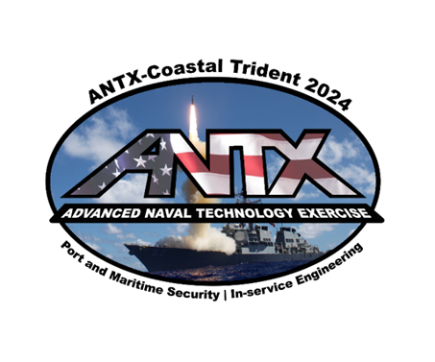
ANTX-Coastal Trident
2025 Concept Development
Brendan Applegate
Lead for Fleet Experimentation and Exercises
NSWC Port Hueneme Division
Office of the Chief Technology Officer

Slide 2

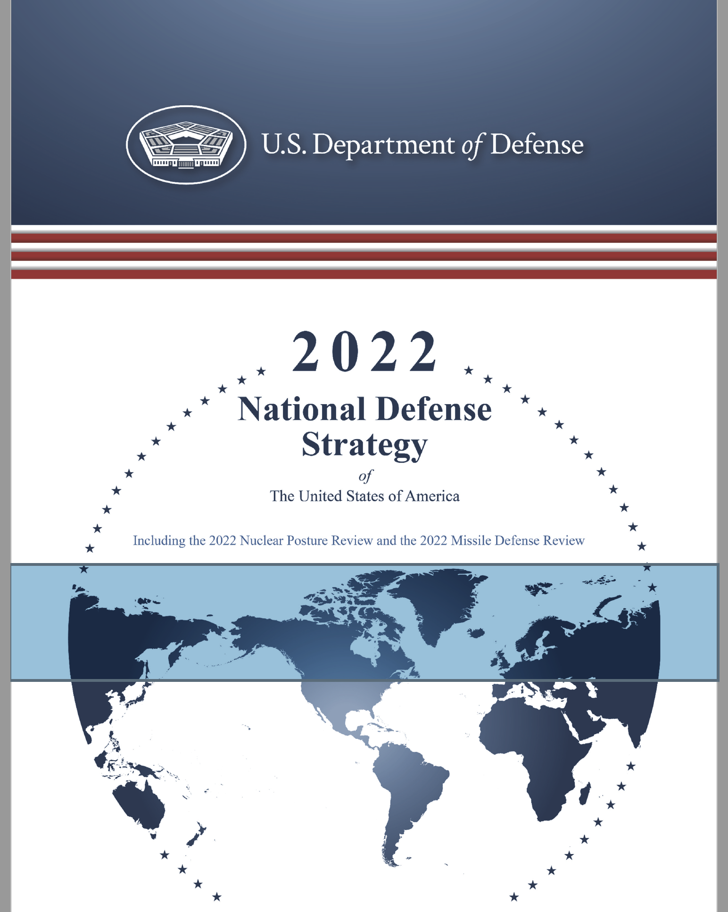
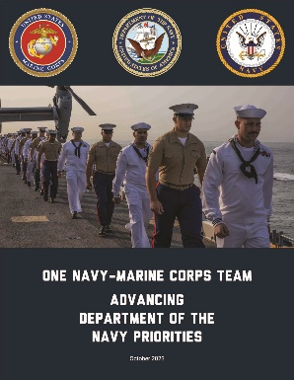
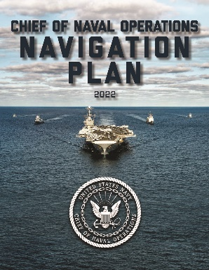
Strategic Priorities
Our focus for operational and technological priorities are guided from the top by the Navy’s chain of command:
National Security Strategy, updated in 2022 by the Biden-Harris Administration
National Defense Strategy, updated in 2022 by Secretary of Defense Lloyd Austin
One Navy Marine Corps Team: Advancing Department of the Navy Priorities, updated in 2023 by Secretary of the Navy Carlos Del Toro
CNO Navigation Plan, updated in 2022 by Chief of Naval Operations, Admiral Mike Gilday
“Faced with peer competitors and emerging disruptive technologies, the Navy needs to become more agile in developing and delivering our future force. Above all, our naval forces must be combat credible – measured by our ability to deliver lethal effects in contested and persistently surveilled battlespaces…
“In close collaboration with the other Armed Services, the Navy has prioritized the future capabilities we need to employ our warfighting concepts and maintain credible deterrence…
“As we build the future force, we can group these capabilities into six overarching Force Design Imperatives:
Expand distance
Leverage deception
Harden defense
Increase distribution
Ensure delivery
Generate decision advantage
“Our adversaries are investing heavily in emerging
technologies. In response, the Navy will adopt a more agile approach to experimentation and force modernization, leveraging partnerships with industry and academia.”
- CNO NAVPLAN 2022

Slide 3
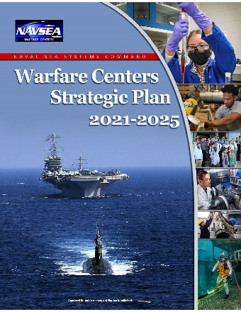
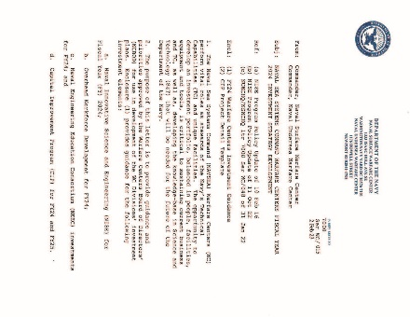
Strategic Priorities
… skip a couple of layers …
NAVSEA Warfare Centers Strategic Plan 2021-2025, updated in 2021 by RADM Kevin Byrne and Dr. Brett Seidle
FY 24 NAVSEA Warfare Centers Investment Guidance, updated in 2023 by Acting Commander, Naval Surface Warfare Center, D.M Costlow
“Additional guidance regarding the Naval Implementation Framework objectives most applicable to our enterprise are listed below:
Long Range Fires
Counter-Command, Control, Communications, Computers, Cyber, Intelligence, Surveillance, Reconnaissance, and Targeting (C-C5ISRT)
Terminal Defense
Contested Logistics
Live-Virtual-Constructive
Navy Operational Architecture
Artificial Intelligence/Machine Learning
Unmanned Systems
Ship/Submarine Maintenance
Readiness Requirement Analysis
End-to-End Supply Chain
“The most promising NIF-related technology investments are those that result in meaningful warfighting capabilities, enablers, and/or improve operational concepts. Addressing Fleet forces needs and advancing warfighter capabilities to expeditiously transition and integrate technology into the operating forces are a priority.”
- FY24 Warfare Centers Investment Guidance
“All investments in WC Divisions’ planned portfolio should align to one or more higher-level strategy documents…
“WC Divisions should also consider domain or mission specific guidance, communicated via Fleet needs… and capabilities with a strong Fleet forces pull…
“Particular attention shall be place don the CNO NAVPLAN 2022…”

Slide 4
Strategic Priorities
… skip a couple of layers …
NAVSEA Warfare Centers Strategic Plan 2021-2025, updated in 2021 by RADM Kevin Byrne and Dr. Brett Seidle
FY 24 NAVSEA Warfare Centers Investment Guidance, updated in 2023 by Acting Commander, Naval Surface Warfare Center, D.M Costlow
“Additional guidance regarding the Naval Implementation Framework objectives most applicable to our enterprise are listed below:
Long Range Fires
Counter-Command, Control, Communications, Computers, Cyber, Intelligence, Surveillance, Reconnaissance, and Targeting (C-C5ISRT)
Terminal Defense
Contested Logistics
Live-Virtual-Constructive
Navy Operational Architecture
Artificial Intelligence/Machine Learning
Unmanned Systems
Ship/Submarine Maintenance
Readiness Requirement Analysis
End-to-End Supply Chain
“The most promising NIF-related technology investments are those that result in meaningful warfighting capabilities, enablers, and/or improve operational concepts. Addressing Fleet forces needs and advancing warfighter capabilities to expeditiously transition and integrate technology into the operating forces are a priority.”
- FY24 Warfare Centers Investment Guidance
Some topics require high levels of Fleet integration or technical maturity, and are better suited for other experimentation/exercise programs
“All investments in WC Divisions’ planned portfolio should align to one or more higher-level strategy documents…
“WC Divisions should also consider domain or mission specific guidance, communicated via Fleet needs… and capabilities with a strong Fleet forces pull…
“Particular attention shall be place don the CNO NAVPLAN 2022…”

Slide 5
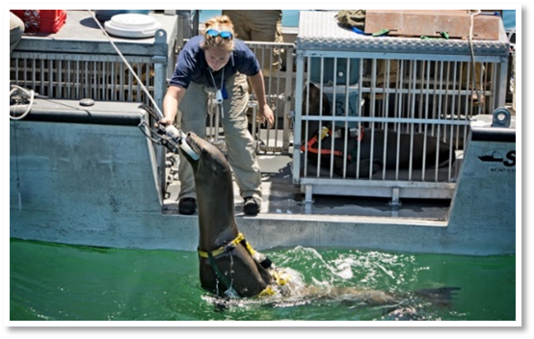
ANTX-CT24 Modules
Historical numbers for ANTX-CT
2018: 33 projects proposed
2019: 30 projects proposed
2020: 35 projects proposed
2021: 56 projects proposed
2022: 74 projects proposed
2023: 71 projects proposed
2024: 82 projects proposed
Module 1: Port and Maritime Incident Response
5 projects
Module 2: Port Security and Critical Infrastructure
Protection
3 projects
Module 3: Asymmetric Threat Detection and Domain
Awareness
15 projects
Module 4: Maintenance and Sustainment of Fleet
and Expeditionary Operations
16 projects
Module 5: Unmanned Systems Applications
15 projects
Module 6: Unmanned Systems Countermeasures
5 projects
Module 7: Decision Support and Information
Dominance
9 projects
Module 8: Maritime Communications and Data Links
14 projects
Coastal Trident 2013

Slide 6
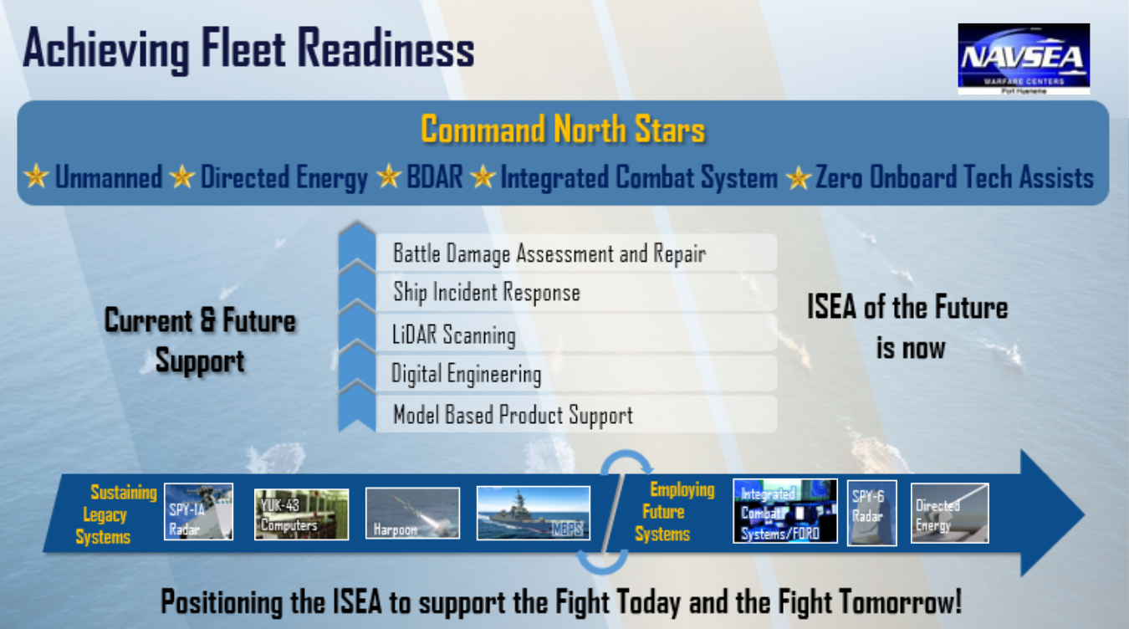
NSWC PH Priorities
NSWC PHE provides “‘cradle to grave’ engineering and sustainment support to ensure that combat system, weapon system, radars, air and surveillance systems work effectively to accomplish their mission throughout their life”
Technical priorities include:
Battle damage assessment and repair
Ship incident response
LiDAR scanning
Digital engineering
Model-based product support
NSWC PHE also provides NSWC with Knowledge
Point Champion support for ANTX and ISEA of
the Future focus areas
REPTX/NESAR (NAVSEA 05)

Slide 7
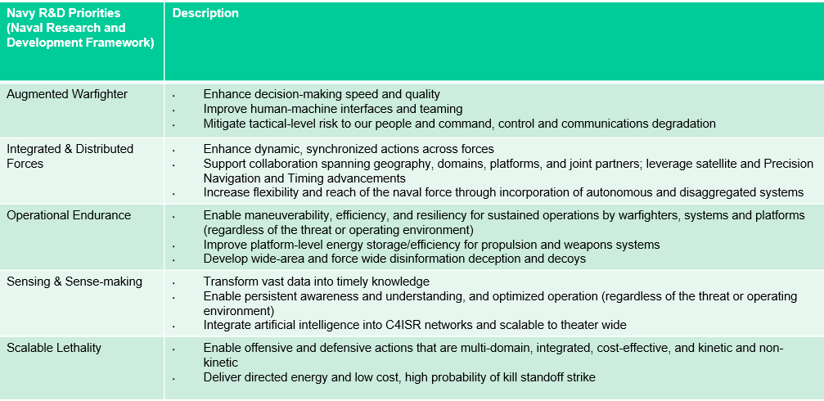
NAVFAC EXWC Priorities
NAVFAC EXWC provides “technology and unique, agile solutions for the warfighter that specifically focus on expeditionary, oceans, and shore needs from enduring bases to forward deployed expeditionary locations”
Technical priorities include:
Augmenting the warfighter to enhance
decision-making speed and quality
Integrating distributed forces to enhance dynamic,
synchronized actions
Improving operational endurance by enabling
maneuverability, efficiency, and resiliency
Improving sensing and decision support to
transform data into knowledge
Improving lethality by enabling offensive and
defensive actions
Trident Warrior, Integrated Battle Problem, Silent Swarm

Slide 8
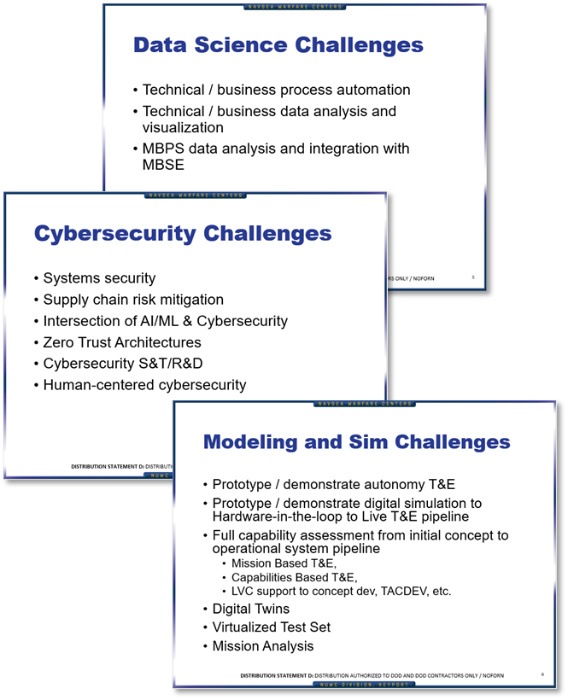
NUWC Keyport Priorities
NUWC Keyport provides “development and application of advanced technical capabilities to test, evaluate, field, and maintain undersea warfare systems and related defense assets”
NUWC Keyport Detachment San Diego provides ready support to Fleet operational forces in Southern California. It also supports FATHOMWERX and the Ventura and SoCal Tech Bridges
Technical priorities include:
Integration and demonstration of developmental sensors
Threat emulation
Underwater tracking
  Open ocean
  Non-interference tracking (separate modality from comms/sensors)
  Non-altered tracking (no equipment installed on tracked object)

Slide 9
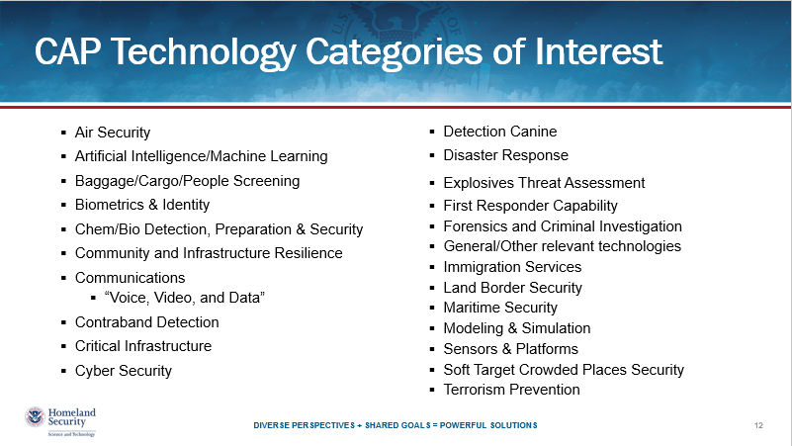
DHS S&T Priorities

Slide 10
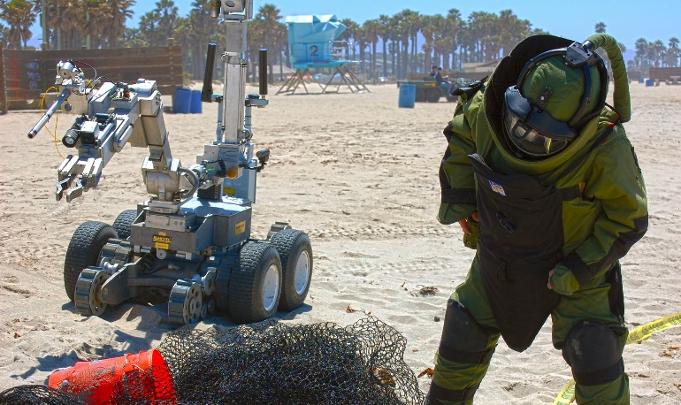
DHS S&T Priorities
Interagency partners play a key role in access to operational scenarios and representative end users during technical demonstration and field experimentation activities
… AND …
Interagency partners provide a number of capabilities in the port
and maritime domains that the Navy relies upon, but does not have responsibilities or authorities to maintain
… AND …
For interagency partners, ANTX represents an opportunity to leverage the Navy’s investment in technical innovation and experimentation
In the absence of dedicated S&T and R&D interfaces, the ability of local, state, and non-DoD federal organizations to gain awareness, access, and insight into developing technologies through these activities is key to acquisition efforts that would otherwise be limited to “off-the-shelf” (OTS) capabilities
Coastal Trident 2013

Slide 11
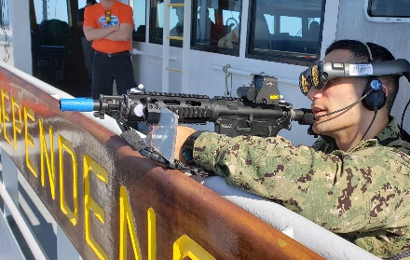
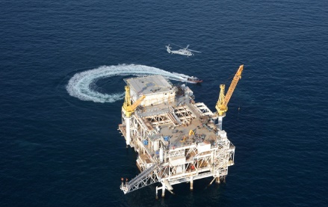
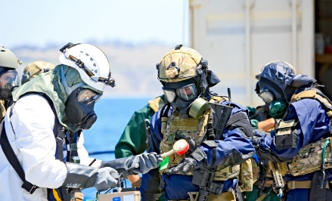
ANTX-CT25 Calendar
Planning Phase
Concept Development Meeting November 13, 2024
Request for Initial Project Information November 20, 2024
Project Proposals Due January 8, 2025
Initial Planning Meeting January 15, 2025
Mid-term Planning Meeting March 12, 2025
Final Planning Meeting May 14, 2025
Execution Phase
Field Experiments and Exercises June to September, 2025
(dates will be determined by project needs, supporting resources, and technical readiness)
ANTX-Coastal Trident Technology Open House September 23-24, 2025
(in coordination with the annual FATHOMWERX Summit)
Coastal Trident 2019
Coastal Trident 2013
Coastal Trident 2014

