Slide 2
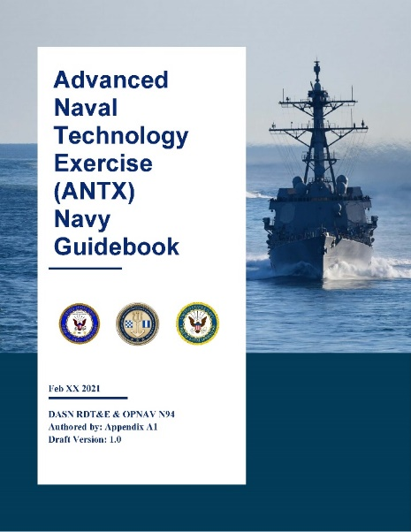
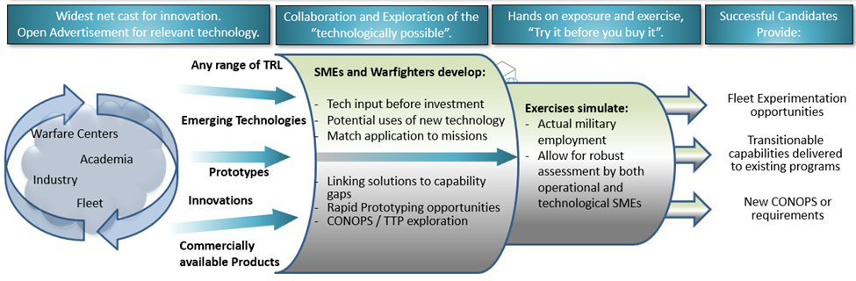
“With the rapidly changing threat environment, our National Defense Strategy and other guiding strategic documentation identify a need to adapt quickly and rapidly to take advantage of technological innovations.
To do this, technologists need a better understanding of the operational challenges and context, and warfighters need a better understanding of what the technological innovations can do for them. To gain this interaction, innovative organizations across industry, academia and government need forums to allow for technical and operational exchanges.
ANTXs allow for this type of interaction without much of the bureaucratic restrictions that typically limit interaction, speed to fleet, or stifle good collaboration.”
Inform and align innovation with operational needs
Venue for early demonstration and experimentation (TRL 6/7)
Identify transition pathways for high-value opportunities

Slide 3
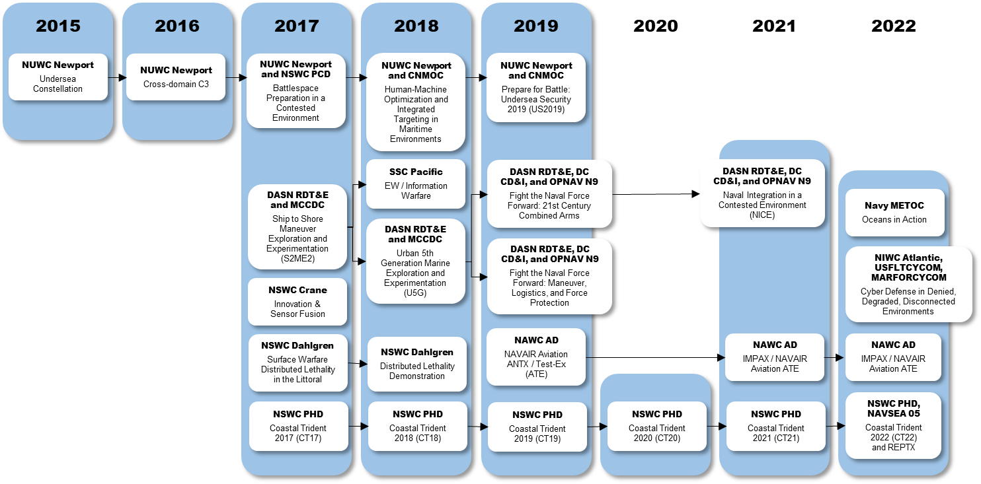
Transition and Implementation
ANTX is intended to accelerate knowledge associated with innovative enablers of needed capabilities.
High-value opportunities will be identified, with the objective of progressing in one of the following potential engagement areas:
Disruptive opportunity exploration
Transition into an existing program of record
Transition into greater Fleet experiment or exercise
Transition into collaborative S&T project
Transition into new NR&DE maturation project
ANTX-Coastal Trident is the longest sustained ANTX program in the ecosystem

Slide 4
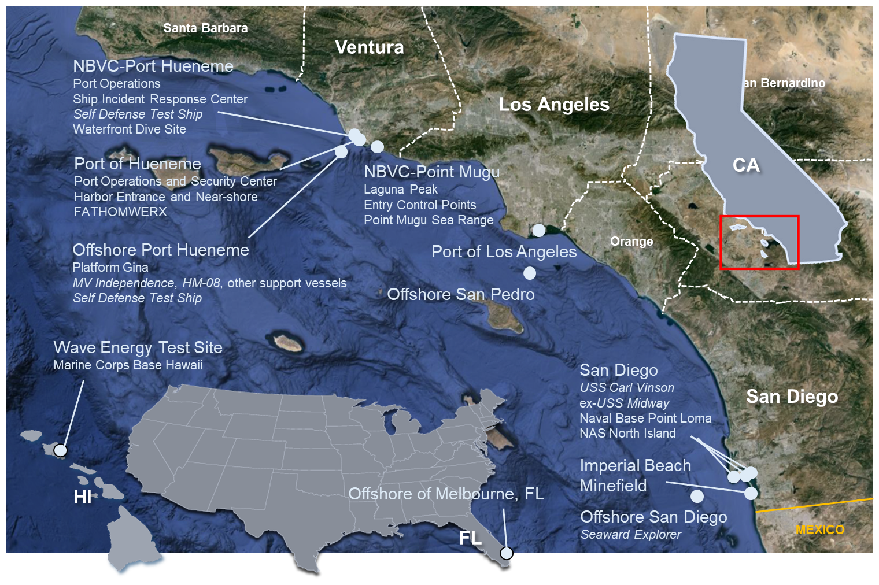
ANTX-CT22 is being conducted to evaluate operational and technical capabilities in the following areas:
In-service Engineering Agent (ISEA) of the Future, Repair and Sustainment
Sensor data fusion and information dominance
Multi-spectral imaging and digital engineering
Unmanned “anything” applications and countermeasures
ANTX-CT22 is comprised of 134 projects conducted in 23 locations and includes participation by more than 250 federal, state, local government, academic, and private sector organizations

Slide 5
