Slide 1
Department of the Navy (DoN) Small Business Innovative Research (SBIR) Experimentation Cell (DoN-SEC) Introduction
September 2022

Slide 2
About Us
We are a team that connects SBIR with the DoN experimentation community to deliver innovative solutions for the warfighter.
Since establishment in 2020, our mission is to support the SBIR community by offering facilitation, mentoring, and training in all aspects of experimentation.
We highlight the benefits of using experimentation to explore and assess capabilities of emerging SBIR technologies.

Slide 3
Mission
Program Goals:
Empower the SBIR community to become a more effective Transitioning agent for Naval technologies.
Enhance SBIR Transitioning of technological innovations through effective and relevant experimentation efforts to solve warfighting problems.
Increase awareness of experimentation opportunities for industry and naval research scientists.
Simplify experimentation processes with informative guidebooks.
Experimentation can provide Objective Quality Evidence (OBE) to support transition

Slide 4
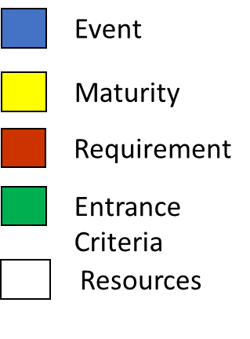
End-to-End Support
Engineering:
Ship Install – SHIPMAIN/NMP processes
Airworthiness Certification
Accreditation and Assessment (A&A)
Mission Readiness Assessment (MRA)
Application Integration (AI)
Lithium-Ion battery certifications
RMMCO processes
Operations:
Air/Water space management
Spectrum (GPS/EA/Allocation)
Environmental (PMAP/EIS)
Unmanned systems/DSD Waivers

Slide 5
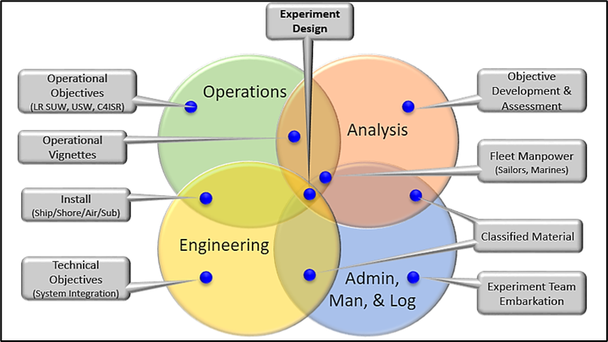
End-to-End Support (cont.)
Experiment Design:
Problem Statement
Hypothesis Development
Objective Development
DOD Architecture Framework (DODAF) Models
Liaison to event sponsors
Analysis:
Data Collection and Analysis
Schedule of Events (SOE)
Qualitative Analysis/Surveys
Reporting
End-to-End support – Experienced in all phases of experiment planning

Slide 6
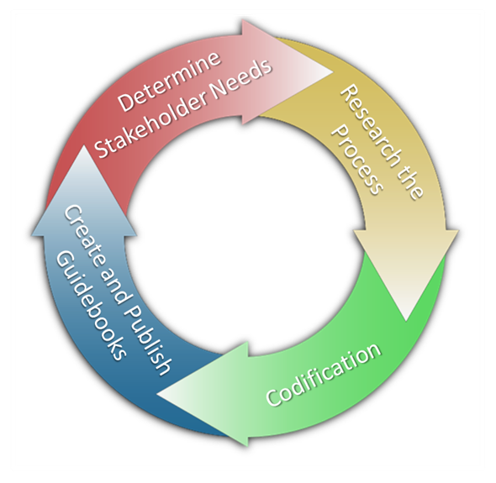
Methods
Guidebooks
SBIR 101 - Basics of Experimentation (tailored for SBIR community)
SBIR 102 - Ship Riders’ Guide
SBIR 103 - Installation and Engineering Processes
SBIR 104 - Experiment Analysis & Reporting
Facilitation - Lower the threshold for entry and input into experimentation communities
Mentoring - Develop relationships to increase knowledge and awareness
Training - Target towards government sponsors and venue owners

Slide 7
Effects
SBIR Initiatives become innovative solutions to fit warfighter needs
Maximize impact, communicate, and cross-pollinate data
Target premier technical experimentation environments and venues
Right venue, right event
“Take the load off” staff and amplify the return investment
More receptive TPOCs and event sponsors
Improve and Enhance
Do no harm, do not impede efforts

Slide 8
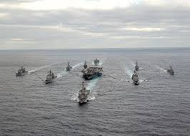
Points of Contact
DoN-SBIR website: https://www.navysbir.com/
DoN-SEC website: https://navysbir.com/sec/
For further information and support please contact Christopher Dillman, CTR, COMM: (619) 878-3782 Cell: (757) 270-6967, christopher.d.dillman.ctr@us.navy.mil, christopher.d.dillman@AUSGAR.com
Program Manager – Mr. Scott Bartlett
DoN-SEC/ PM, Office of Naval Research
scott.w.bartlett4.civ@us.navy.mil
Program Sponsor – Mr. Robert L. Smith
Director, DoN SBIR/STTR & Special Programs
robert.l.smith42.civ@us.navy.mil

