Slide 1
Navy STP
Now in its 23rd year, the Navy STP (SBIR/STTR Transition Program) has been a long-standing vehicle for connecting SBIR/STTR-funded technologies with warfighters, government acquisition and technical personnel, prime contractor, system integrators, and other potential partners/collaborators. The program takes a holistic approach to assisting selected small businesses transition their technologies through business mentoring, training, marketing material creation, and business development activities and promotion.

Slide 2
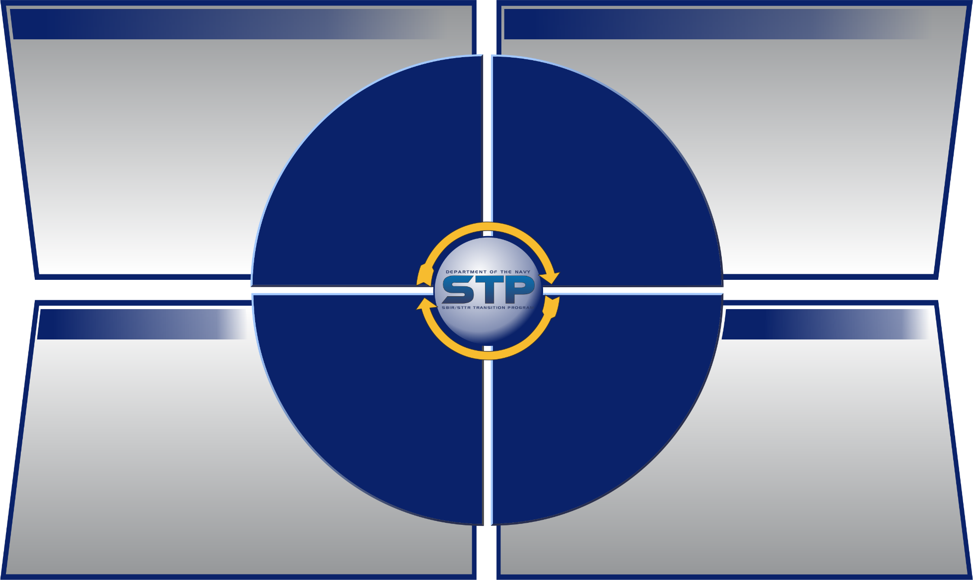
Navy STP Overview
WHY NAVY STP…
WHAT WE DO…
U.S. warfighters should never be caught in a fair fight.
We collaborate with small businesses to
increase technology transition and
commercialization by connecting
small businesses with the U.S. Navy,
other military branches, and DoD
primes to help solve technical
challenges for our warfighters
Collaborate with small businesses to develop impactful marketing materials
Provide educational resources
Provide technology market research
Offer transition guidance
Showcase technologies
Connect small businesses with potential customers to help with commercialization
WHY
WHAT
Warfighter
Navy STP
Services
HOW WE DO IT…
HOW
WHO
WHO WE ARE…
Provide one-on-one coaching
and mentoring for small
businesses focused on marketing
And business development
Host an online Virtual Transition
Marketplace to connect DoD and primes
With small business technology
Hold Navy FST Focused Technology Events at trade shows and Navy SYSCOMs
Navy funded program comprised of the following teams:
Business Consultants
Market Researchers
Event Planners
Communication Specialists
Data Management Specialists
Technical Writers
Navy STP Processes
Navy STP
Team

Slide 3
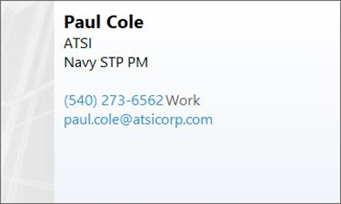
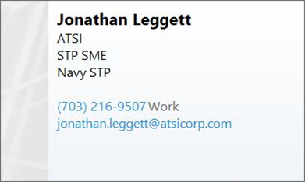
Navy STP Contact Info

