Slide 1
Department of the Navy SBIR Experimentation Cell (DON SEC)
Rob Boyd

Slide 2
Department of the Navy (DoN) Small Business Innovative Research (SBIR) Experimentation Cell (DoN-SEC) ANTX Coastal Trident 2024 FATHOMWERX Summit
17 SEP 2024

Slide 3
About Us
We are a team that connects SBIRs with the DoN experimentation community to deliver innovative solutions for the warfighter.
Since establishment in 2020, our mission is to support the SBIR community by offering facilitation, mentoring, and training in all aspects of experimentation.
We highlight the benefits of using experimentation to explore and assess capabilities of emerging SBIR technologies.

Slide 4
Who We Support
SBIR Programs
PMO
TPOC
Small Business
Entire Naval Enterprise
R&D Community
Acquisition Community
Operational/Fleet Community
OPERATIONAL COMMANDERS
Outreach
Focus Area Lead
Engineering
Analysis
IMKM
AML
TYPE COMMANDERS (TYCOMS)

Slide 5
Resident Expertise
Experiment Design:
Problem Statement
Hypothesis Development
Objective Development
DOD Architecture Framework (DODAF) Models
Liaison to event sponsors
Engineering:
Ship Install – SHIPMAIN/NMP processes
Airworthiness Certification
Accreditation and Assessment (A&A)
Mission Readiness Assessment (MRA)
Application Integration (AI)
Lithium-Ion battery certifications
RMMCO processes
Operations:
Air/Water space management
Spectrum (GPS/EA/Allocation)
Environmental (PMAP/EIS)
Unmanned systems/DSD Waivers
Analysis:
Data Collection and Analysis
Schedule of Events (SOE)
Qualitative Analysis/Surveys
Reporting
Experienced in all phases of experiment planning

Slide 6
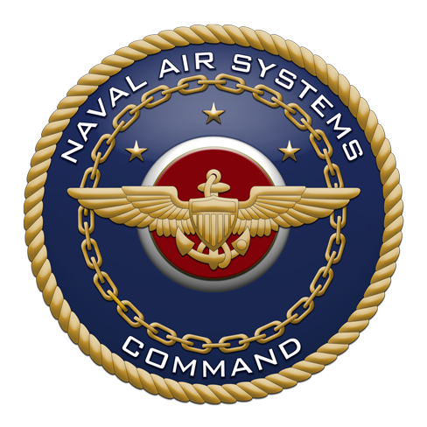
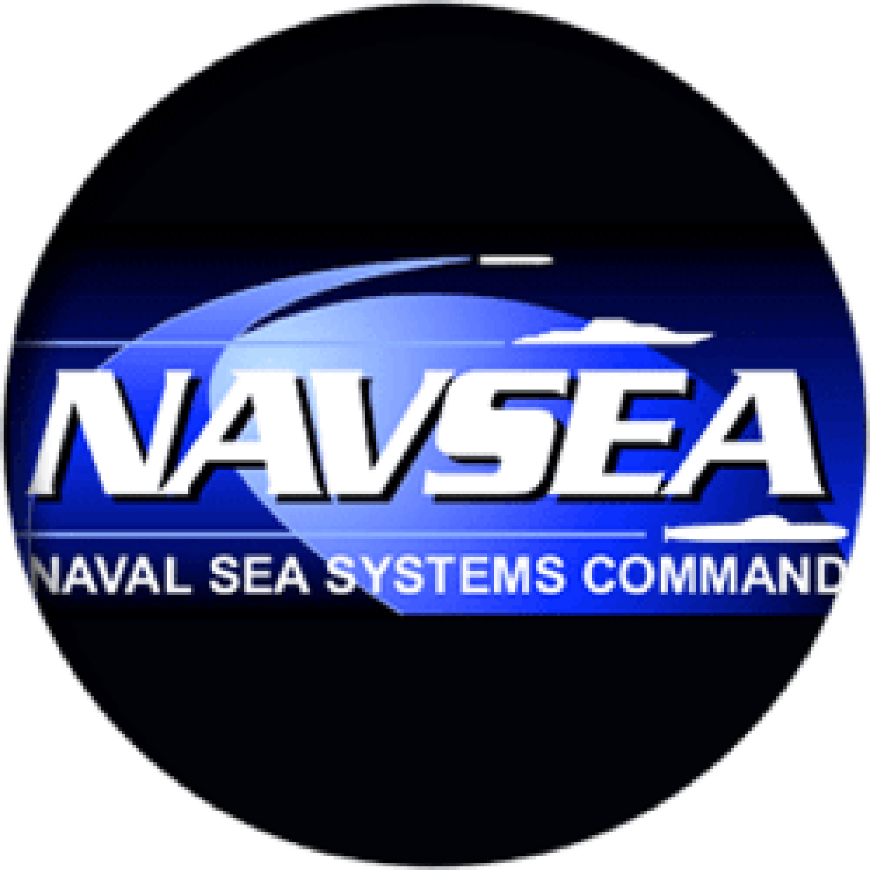
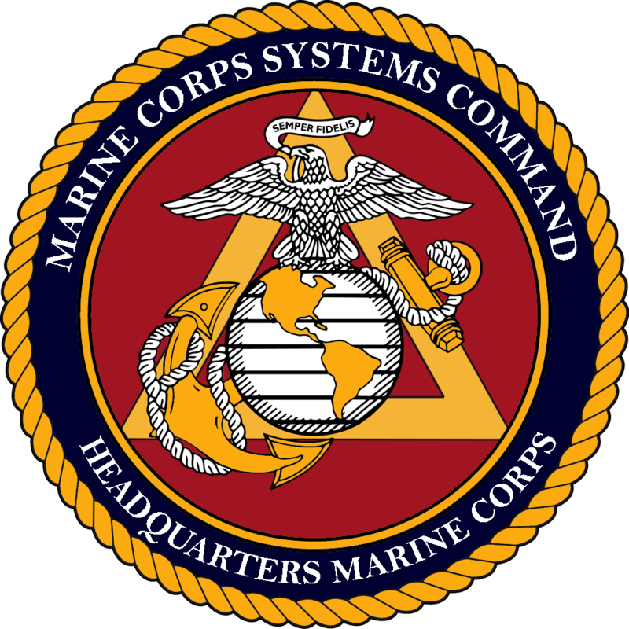
Current Status
Twelve Full Time Employees
1 Surge support (FLEX/LSS)
Performers Supported
93+ Actively working towards experimentation
38 event iterations including Alexander the Great, Archipelago Endeavor, ANTX CT, Trident Warrior, Camp Lejeune LOE, TOEE LOE 2/ACE 23.1, C4F/SEC LOE, TCE, IBP, and Trident Spectre
43 are Woman and/or Veteran-owned or fit into the HUBZone and Small Disadvantaged Business categories
8 SYSCOMs supported, with NAVAIR, ONR, NAVFAC, and MCSC most active
Note that some initiatives have multiple outcomes/experimentation opportunities
Performers considered as “Not a Fit” had no current need for DoN-SEC services
(+9 projected by end of 2024)
Over 400 Initiatives Engaged Since Inception in 2020
Small Business Technology Transfer (STTR)

Slide 7
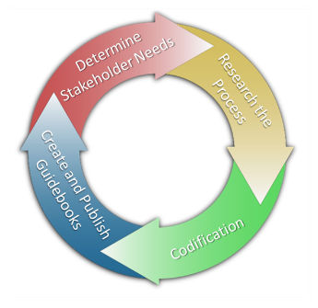
Methods
Guidebooks:
SBIR 101 - Basics of Experimentation (tailored for SBIR community)
SBIR 102 - Ship Riders’ Guide
SBIR 103 - Installation and Engineering Processes
SBIR 104 - Experiment Analysis & Reporting
Engineering and Operations Process Guides (EPG/OPG) – Lithium Battery Safety released, others in development
Facilitation: Lower the threshold for entry and input into experimentation communities
Mentoring: Develop relationships to increase knowledge and awareness
Training: Target towards government sponsors and venue owners

Slide 8
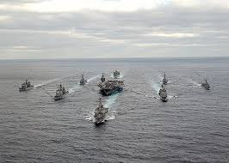
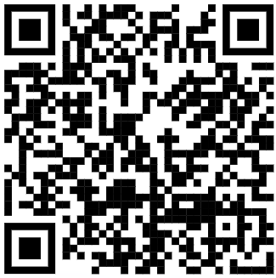
Points of Contact
DoN-SBIR website: https://www.navysbir.com/
DoN-SEC website: https://navysbir.com/sec/
Follow us on LinkedIn!
For further information and support please contact Kelly Carruthers, kelly.b.carruthers.ctr@us.navy.mil and Richard Weiss, richard.p.weiss.ctr@us.navy.mil
Program Manager – Mr. Scott Bartlett
DoN-SEC PM, Office of Naval Research
scott.w.bartlett4.civ@us.navy.mil
Program Sponsor – Mr. Brian Shipley
DoN SBIR/STTR & Special Programs
brian.r.shipley.civ@us.navy.mil

