Slide 1
Agenda
SBIR/STTR Program Overview
NAVSEA Structure
Broad Agency Announcement Schedule
Project Timeline
Preparing Your Phase I Proposal
Madison Lundberg
Madison.Lundberg@VTGDefense.com
Madison.n.Lundberg.ctr@us.navy.mil
Danielle Bailey
Danielle.Bailey@VTGDefense.com
Danielle.Bailey1.ctr@us.navy.mil
DISTRIBUTION STATEMENT A. Approved for public release; distribution unlimited

Slide 2
SBIR/STTR Program Overview
Navy SBIR/STTR
Addresses Department of Navy needs by commercializing innovative R&D
Produces better, faster, cheaper products and processes for Navy use
8 Navy SYSCOMs actively participate:
NAVSEA has 6 SBIR/STTR PEOs with a total budget exceeding $100M per year:
NAVSEA awarded the following amounts in FY 2018 through FY 2022:
NAVSEA | NAVWAR | NAVSUP | SSP
NAVAIR | NAVFAC | ONR | MCSC
HQ & Directorates | Team Ships | PEO IWS
Team Subs | PEO CV | PEO USC
FY 2018-22 | Phase 1 | Phase 2 | Phase 3
Amount | $109M | $504M | $2.4B
# of Businesses | 311 | 203 | 67
DISTRIBUTION STATEMENT A. Approved for public release; distribution unlimited

Slide 3
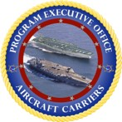
NAVSEA SBIR/STTR – PEO/Directorate Hierarchy
SBIR/STTR Working Group (SWG)
Contracting
TBD (PCO)
Program Manager
Jason Schroepfer
Business Process Mgr
Adrienne McClellan
Deputy PM - Operations
Jacob McElhaney
Deputy PM - Technical
Vince LoBosco
PEO CV
Derek Opel
PEO IWS
Douglas Marker
PEO USC
Jennifer Greenwood
Team SHIPS
Emily Novak
Team SUBS
Roberto Sanchez
HQ & DIR
Howard Franklin
Focuses on the design, construction and delivery, and life-cycle support of all aircraft carriers and the integration of systems into aircraft carriers.
Manages surface ship and submarine combat technologies and systems, and coordinates Navy Open Architecture across ship platforms.
Responsible for the design, development, build, maintenance, and modernization of unmanned maritime systems, mine warfare systems, and small surface combatants.
Manages acquisition and complete life-cycle support for all U.S. Navy non-nuclear surface ships.
Focuses on the design, construction, delivery, and conversion of submarines and advanced undersea and anti-submarine systems.
Focuses on the engineering, design, construction, and delivery requirements for NAVSEA HQ & Directorates, including Diving & Salvage Operations
DISTRIBUTION STATEMENT A. Approved for public release; distribution unlimited

Slide 4
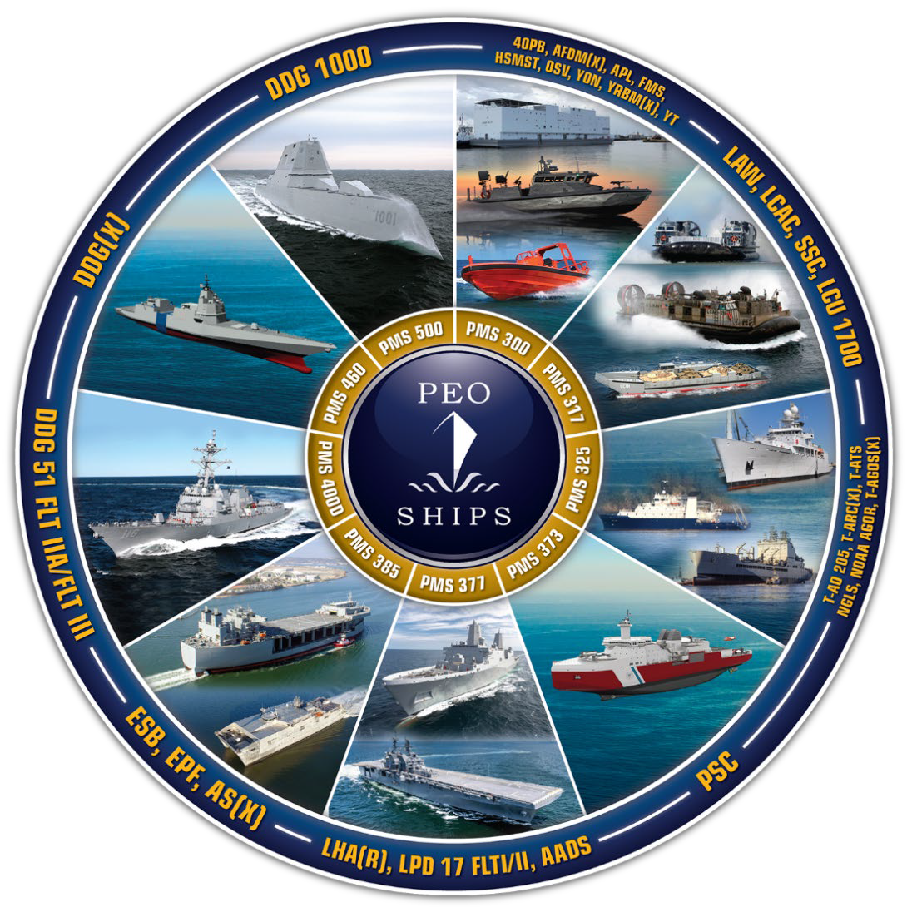
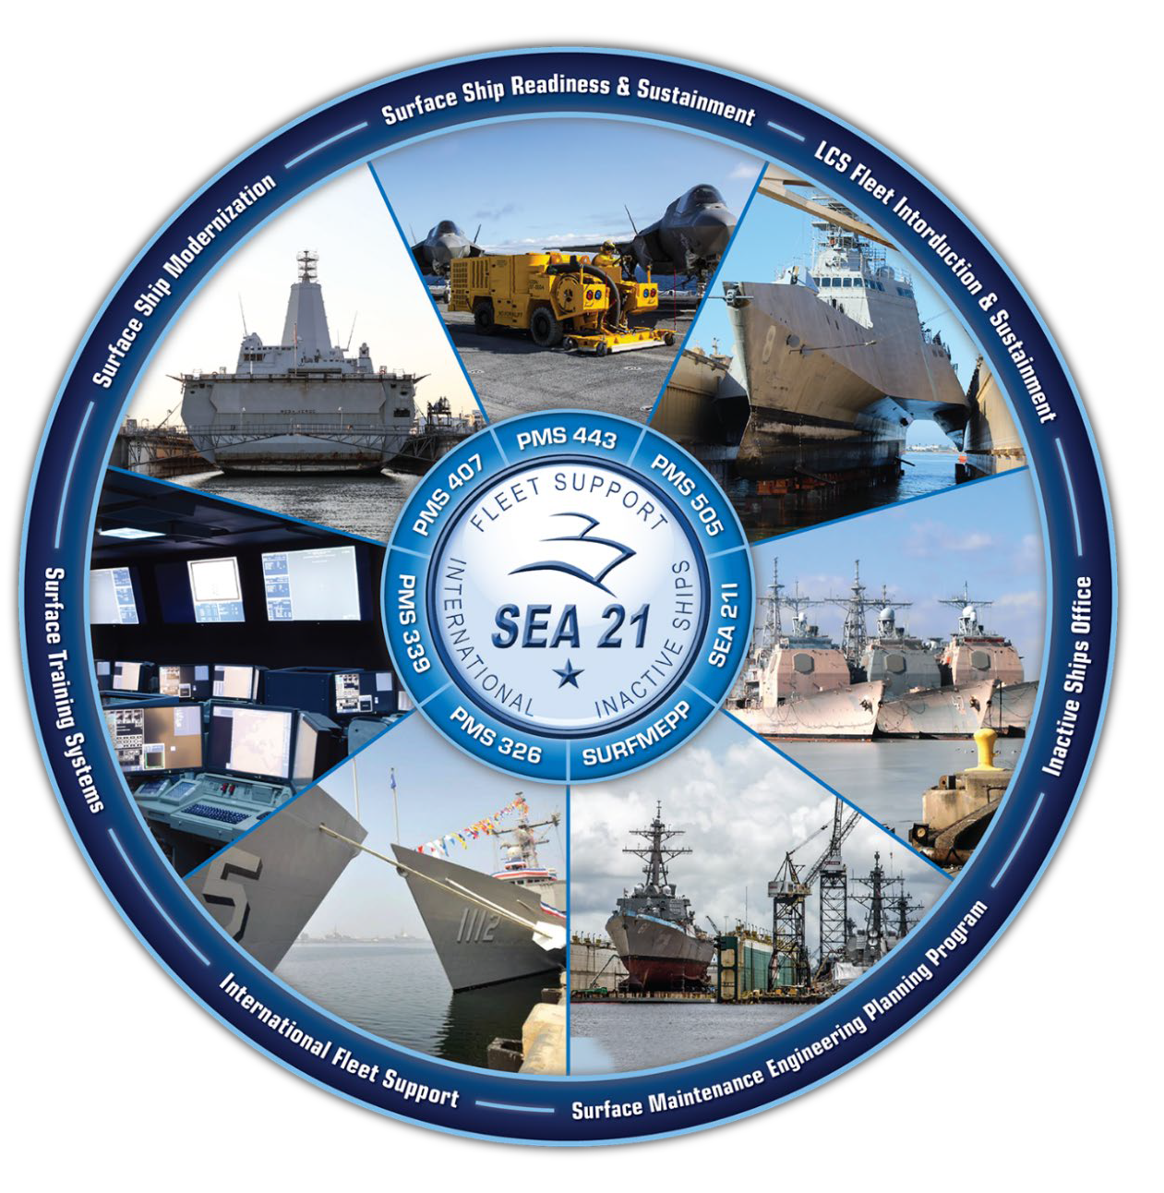
NAVSEA SBIR/STTR - Team Ships
Distro A: Approved for Public Release.
DISTRIBUTION STATEMENT A. Approved for public release; distribution unlimited
4

Slide 5
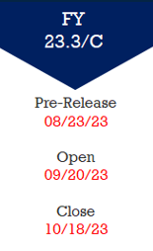
SBIR/STTR Traditional Solicitation Schedule
Traditional Solicitation Schedule
BAA
24.1/A
24.2/B
24.3/C
Pre-Release
29 NOV 2023
17 APR 2024
21 AUG 2024
Open
3 JAN 2024
15 MAY 2024
18 SEP 2024
Close
7 FEB 2024
12 JUN 2024
16 OCT 2024
Award
5 AUG 2024
9 DEC 2024
14 APR 2025
Broad Agency Announcements (BAAs) are released 3 times a year
A DoD Agency-wide announcement includes:
DoD Instructions
Service/Component Unique Instructions
SBIR/STTR Topics (SYSCOM-specific needs)
Topic Author
Complete requirements and detailed proposal submission guidelines are available on the DoD's Defense SBIR/STTR Innovation Portal (DSIP)
DISTRIBUTION STATEMENT A. Approved for public release; distribution unlimited
5

Slide 6
SBIR/STTR – Three Phase Program
Year 1
Year 2
Year 3-5
Year 6-8
Year 8+
Prototype Testing & Evaluation
Technology Demonstration & Validation
Topic
Development*/
BAA Process
Concept Dev. & Feasibility Demo
Technology Development/ Prototype Experimentation
Phase I: Concept Development & Feasibility Study
Phase II: Full Research, R&D to Prototype
Phase III: Commercialization
$240k Contract (SBIR/STTR Funds)
$140K base - 6 months
$100K option - 6 months
$1.8M Contract (SBIR/STTR Funds)
$600K base – 12 months
$600K option – 12 months
$600K option – 12 months
Commercialization Readiness Prog.
SBIR/STTR Transition Program (STP)
No Funding Caps (Non-SBIR/STTR $)
No limit on number of awards
Can be sole-sourced
Managed & Funded by the NAVSEA - SBIR/STTR Program Office
SBA adjusts cost ceilings each year for inflation
Selected, Funded, and Awarded by Navy PMOs & Contracting Orgs
SBIR / STTR Buys Research and Development, Not Parts and Services
DISTRIBUTION STATEMENT A. Approved for public release; distribution unlimited

Slide 7
Preparing Your Phase I Proposal
Each Service and agency is different. Read and follow announcement instructions
Know your customer. Make sure your approach is relevant
Take advantage of the pre-release. Contact the Topic Author to ask questions
Emphasize your innovative approach. Articulate how it compares to the state of the art
Clearly and concisely answer who, what, when, where, how, and importantly, why
If there are technical barriers…address them!
Provide a work plan and schedule with tasks that flow smoothly
Ensure that the proposed solution is reasonable, realistic, and feasible
Check spelling and grammar. Proposals can be difficult to read due to poor grammar
Don’t underestimate commercialization. State your plan NOW!
READ AND FOLLOW ANNOUNCEMENT INSTRUCTIONS!!
DISTRIBUTION STATEMENT A. Approved for public release; distribution unlimited

