Slide 1
NavalX Overview
Patrick Cantwell, PhD
Deputy Director, NavalX
https://www.secnav.navy.mil/agility/Pages/default.aspx

Slide 2
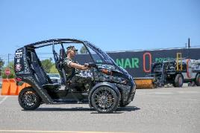
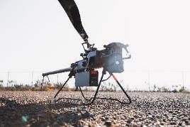
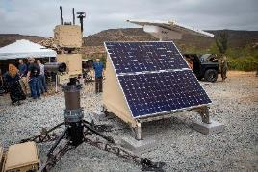
NavalX Mission & Vision
Mission
Guide naval stakeholders to rapidly deliver capabilities to the warfighter
Serve as the platform that connects Naval needs and challenges with expert solution providers across industry, academia, and DoD
Encourage and foster culture change across the DoN to make the USN a more agile, learning, and adaptable organization.
Serves as the home to DON and ONR accelerator programs, including SBIR/STTR, T2, RIF, and NIPA
NavalX's vision is to inspire and empower the naval workforce to rapidly deliver high-impact capabilities at the speed of relevance in connection with defense ecosystem partners.
Notes:
In addition to being an innovation incubator, NavalX serves as the home to DON and Office of Naval Research (ONR) accelerator programs including, but not limited to:
Small Business Innovation Research (SBIR)
Rapid Innovation Fund (RIF)
Technology Transfer (T2)
Naval Innovation Process Adoption (NIPA)

Slide 3
Chief of
Naval Research
Assistant Secretary of the Navy for Research, Development & Acquisition
NavalX
Director
NavalX Accelerator
NavalX Agility
Deputy Director &
Technical Director
NavalX
Reserve Component
Deputy Director &
Chief of Staff
DoN Tech Transfer (T2)
Tech Bridges
Mission
Liaisons
Strategic
Communications
DoN
Rapid Innovation Fund
Naval Innovation
Process Adoption Fund
Special
Projects
Naval Junior Officer Counsel
Small Business Innovation Research / Small Business Technology Transfer
Centers for Adaptive Warfighting
Workforce Agility
Special Programs (TANG, MISR-T, NextSTEP)
Digital Agility
Innovation
Navigators
Private Capital
OSD/ASN Innovation Protection Policies

Slide 4
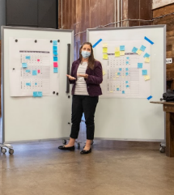
NavalX Agility
Centers for Adaptive Warfighting: Adapt industry best practices to increase warfighting, individual & collective, competitive advantage
Workforce Agility: in house consulting team that Navy units bring in for problem facilitation
Digital Agility: help guide the Navy AND Industry in adopting new tools
Innovation Navigators: Teaches and reinforces HOW to guide stakeholders to delivering capability faster
Mission Liaisons: NavalX "Solution Engineers" assigned to select commands to assist in their innovation efforts (TF-59, UTF, SCOUT)
NJOC: Naval Junior Officer Council (JO professional network)
Strategic Communications: Sharing DoN wins, how to connect across the innovation ecosystem
Private Capital: Leveraging private capital for innovative solutions
“We are evolving our tactics to meet the needs of our customers and
continue our number one goal: guide stakeholders in delivering capability to the warfighter.” CAPT Benjamin "Nut" Van Buskirk, NavalX Director
Notes:
In addition to being an innovation incubator, NavalX serves as the home to DON and Office of Naval Research (ONR) accelerator programs including, but not limited to:
Small Business Innovation Research (SBIR)
Rapid Innovation Fund (RIF)
Technology Transfer (T2)
Naval Innovation Process Adoption (NIPA)

Slide 5
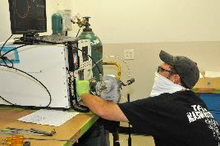
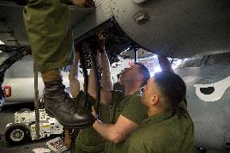
NavalX Accelerator
Rapid Innovation Fund: technology transition program designed to accelerate tech into military systems
Bridge over the “Valley of Death”
RIF is a small business preference program (statute)
Project awards are a result of full and open competition under an annual Broad Agency Announcement
Naval Innovation Process Adoption:
Based on a method called H4X, methodology designed to solve problems facing naval organizations, from contracts to warfare centers
H4X was built as an evidence-based, data-driven, disciplined process for solving the world’s toughest challenges at speed and scale
Tech Transfer (T2): Establish policy and assign responsibility for DoN domestic technology transfer
Cultivate collaboration between DoN science and technology communities, industry, and academia to promote DoN T2 efforts
SBIR/STTR:
Competitive, three phase, awards-base programs advance innovations, with the goal to transition tech to the fleet and commercialize in private markets
Notes:
In addition to being an innovation incubator, NavalX serves as the home to DON and Office of Naval Research (ONR) accelerator programs including, but not limited to:
Small Business Innovation Research (SBIR)
Rapid Innovation Fund (RIF)
Technology Transfer (T2)
Naval Innovation Process Adoption (NIPA)

Slide 6
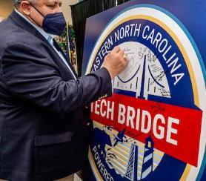
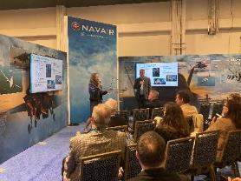
Tech Bridges
Overview
Tech Bridges connect, reinforce and sustain existing efforts that make the DoN more agile, capable and efficient
Tech Bridges are a connected network that enhance collaboration among Navy labs and warfare centers, industry, academia and other branches of the military
Results
Generated over $50 million Tech Bridge projects to include prize challenges and small business innovation research projects
Signed and funded 11 Partnership Intermediary Agreements (PIA) to support Tech Bridge outreach to small business, host events, tech scouting operations and provide low-barrier-to- entry meeting spaces
London Tech Bridge Undersea Challenge led to submission of 50 abstracts
Fourteen full proposals were requested
Three winning teams were selected to receive prizes of $50K GBP ($70k) each
Six-month development work with demonstration at NATO REPMUS exercise in Portugal Fall 2021
Northwest Tech Bridge regional partnerships with AFWERX, NSIN, the JAIC, and DIU have led to NSIN investing $900K in a shared collaboration space in Seattle
Notes:
In addition to being an innovation incubator, NavalX serves as the home to DON and Office of Naval Research (ONR) accelerator programs including, but not limited to:
Small Business Innovation Research (SBIR)
Rapid Innovation Fund (RIF)
Technology Transfer (T2)
Naval Innovation Process Adoption (NIPA)

Slide 7
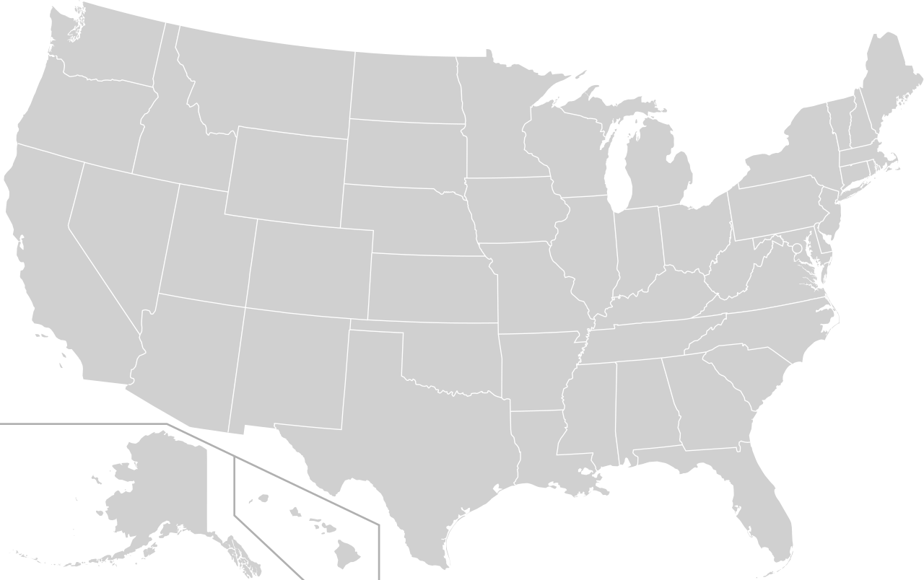
Northwest
Washington State Department of Commerce
DOE Pacific Northwest National Lab
University of Washington
Impact Washington
Olympic College
Amazon
Boeing
Microsoft
NSIN
TECH BRIDGE LOCATIONS & PARTNERS
Polaris MEP
401 Tech Bridge
RI Commerce
URI
CARI
RITIN
RI DLT
Japan
ANSYS
OR MEP
Washington State University
Impact Dakota
ME MEP
Japan
MMEC
VMEC
NHMEP
CAW-Okinawa
TechHelp
Enterprise Minnesota
NSIN
NY MEP
MassMEP
TEDCO
CIT
MD, VA & DC PTACs
MD Dept of Commerce
Montgomery County EDC
NSIN
DIU
AFWERX
ONR Global
MD MEP
TMAC
CAW-East
SD MTS
WCMP
CONNSTEP
Northeast
MMTC
NJMEP
ACI
PA MEP
NSIN
NVIE
UUMEP
Manufacturing Works
AVX
CIRAS
NSIN
Notre Dame
Capital
Fathomwerx
EDC-VC
The Port of Hueneme
Matter Labs
RDP-21
NE MEP
Purdue University
DEMEP
NSIN
IMEC
OH MEP
Southern
18 Global Tech Bridges with
+1000 industry & academic partners
DIU
NSIN
Manufacturer’s Edge
Purdue MEP
WVMEP
Central Coast
Midwest
IN3
S2MARTS
Indiana University
Maryland
KS Manufacturing Solutions
NSIN
Mid-Atlantic
Norfolk Naval Shipyard
757 Accelerate
Gangplank VA
NASA Langley
ACC Langley
Jefferson Labs (DOE)
ONR Science Advisor
NECC
AFWERX
Missouri Enterprise
AKA
GENEDGE
Ventura
NSIN
NCMEP
United Kingdom
CMTC
Inland Empire
OK Manufacturing Alliance
UT CIS
ONR Science Advisor
ONR Global
Royal Navy
OCTO
MARCAP
NavyX
NATO MUSIC^2
NATO MUS IAB
MoD DASA
NSIN
Imperial College London
US Embassy in London ODC
NATO Allied Maritime Command
UK Defence Solutions Centre
Her Majesty’s Gov Dept of Int’l Trade
SoCal
NM MEP
SCMEP
Arizona State University AZ MEP
AEDC-MS
UofSC
SC Dept of Commerce
AEDC-MS
GaMEP
Palmetto
Riverside County Economic Alliance
DoD PTAC
ExCITE Startup Incubator
EPIC SBDC
Riverside County WDB
Greater Riverside Chambers of Commerce
Corona Chamber of Commerce
Riverside MAC
UCR
CBU
Cal Poly Pomona
CSUSB
RCCD
Norco College
Science and Technology Education Partnership
SANDAG
UCSD
Qualcomm
Verizon
CBP
NSIN
City of San Diego
ONR Science Advisor
CAW-West
South Carolina Research Authority (SCRA)
SC Business Incubator Association
Trident Technical College
DOE Savannah River
SAIC
IBM
Microsoft
ATN MEP
MMA-MEP
ONR Science Advisor
NSIN AFWERX
MEPOL
MSET
Gulf Coast
Central Florida
Hawaii
NDSTC
NOAA
FSU
Bay Defense Alliance
DefenseWerx
UCF
Team Orlando
PEO STRI
AFAMS
FloridaMakes
SOFWERX
AK MEP
London
ONR Science Advisor
Innovate Hawaii
HTDC
University of Hawaii
Notes:
We have a network of 18 Tech Bridges spread out across the United States and 2 overseas. They work with over 1000 industry and academic partners connecting them to science and engineering centers throughout the Navy. NavalX is the membrane between these industry partners and the vast network of engineering centers and the warfighter.
Results
Made more than 20k connections: 21% government, 67% industry, 11% academia
Generated over $50 million Tech Bridge projects to include prize challenges and small business innovation research projects
Signed and funded 11 Partnership Intermediary Agreements (PIA) to support Tech Bridge outreach to small business, host events, tech scouting operations and provide low-barrier-to- entry meeting spaces
London Tech Bridge Undersea Challenge led to submission of 50 abstracts
Fourteen full proposals were requested
Three winning teams were selected to receive prizes of $50K GBP ($70k) each
Six-month development work with demonstration at NATO REPMUS exercise in Portugal Fall 2021
Northwest Tech Bridge regional partnerships with AFWERX, NSIN, the JAIC, and DIU have led to NSIN investing $900K in a shared collaboration space in Seattle

Slide 9
NAUTILUS: NavalX + DefenseWerx PIA

Slide 10
Way Ahead
Near-Term Opportunities
Key Focus Areas
Feedback
Expand Mission Liaisons: PEOs, OPNAV
Leveraging Reservists
DoN Private Capital Initiative
NAUTILUS (in partnership with Defensewerx)
Leveraging new authorities (SBIR, T2, etc.) ISO strategic initiatives
NavalX 2.0 Integrated value stream and future strategy.
Agile contracting / financing
Outcome metrics: Define success
Leveraging PIA partners
Build partnerships w/ industry, academia, other DoD innovators
Breaking down DoN internal silos
Strategic Communications & Engagement
Current efforts/value
Areas to improve
How we could better support you
“Everyone wants to have an innovation cell and be cool by association. That’s just innovation theater. Change must be driven from the CEO and adopted by through core of the
organization to be successful.”
– Satya Nadella, Microsoft CEO

Slide 11
Questions & Discussion

