Slide 1
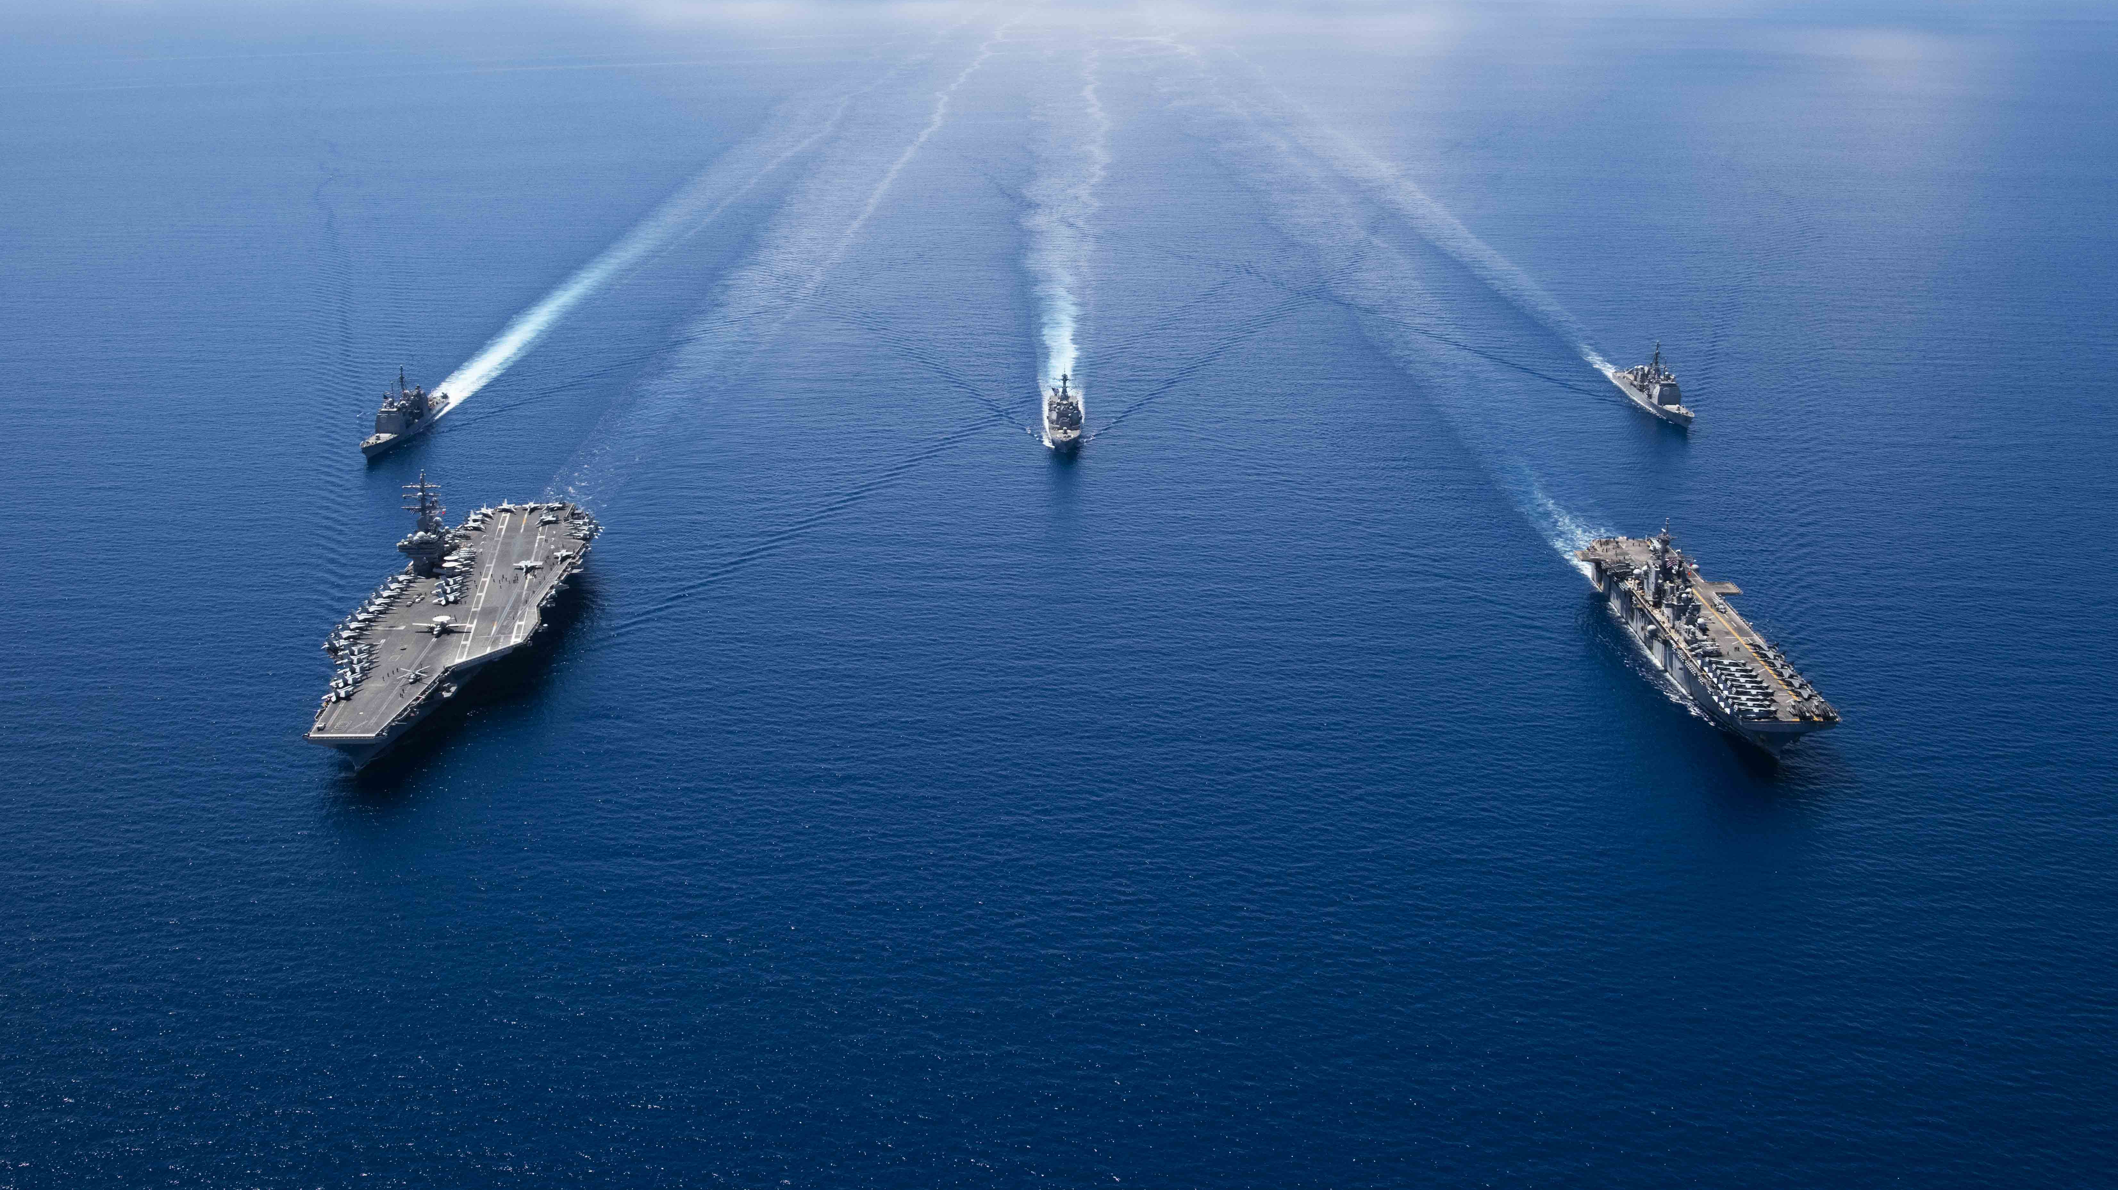
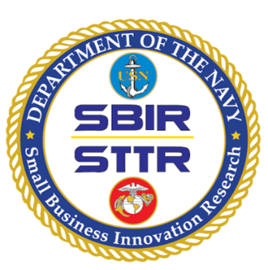
DEPARTMENT OF THE NAVY
Small Business Innovation Research (SBIR)
Small Business Technology Transfer (STTR)
Mr. Robert L. Smith
Director, DON SBIR/STTR & Special Programs
robert.l.smith42.civ@us.navy.mil
The DON SBIR/STTR programs provide opportunities for domestic small businesses and start-ups to deliver solutions to meet naval needs through Federal Research/Research and Development (R/R&D). These competitive, three phase, awards-based programs advance innovations with an aim toward transitioning the resulting technologies to the Force/Fleet and commercialization in private markets.

Slide 2
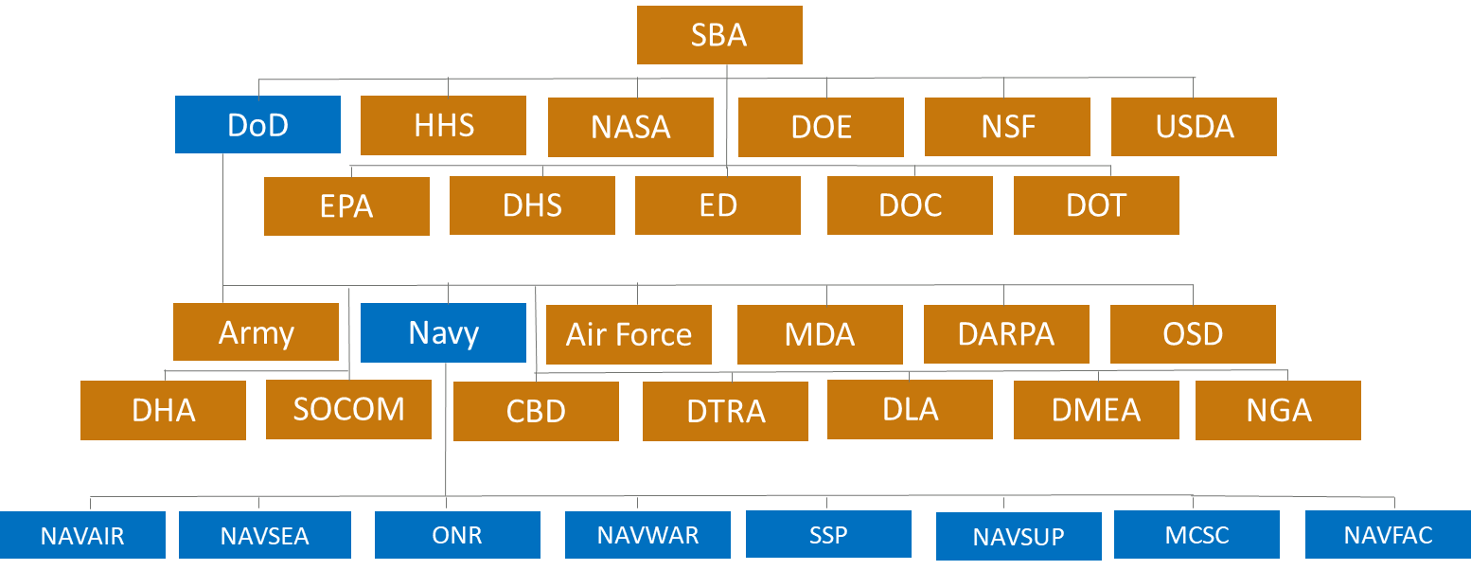
Federal SBIR/STTR Org Chart
NAVY points of contact are available at www.navysbir.com/poc.htm
DISTRIBUTION STATEMENT A. Approved for public release: distribution unlimited.
Notes:
Almost 4-billion-dollar investment in innovation
Who is your best partner
Who align better with your technology

Slide 3
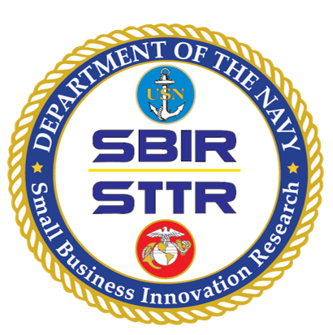
Technology Transition Ecosystem
Small
Business
Project Team
Navy SBIR/STTR Support
Team
Fleet and Force
The Primes OEMs
Research Institutions
Resource Sponsors
NR&DE PMs/PEOs TWHs
TPOCs
Goal: Agreed Upon and Timely Tech Development, Transition, and Insertion Plans
DISTRIBUTION STATEMENT A. Approved for public release: distribution unlimited.

Slide 4
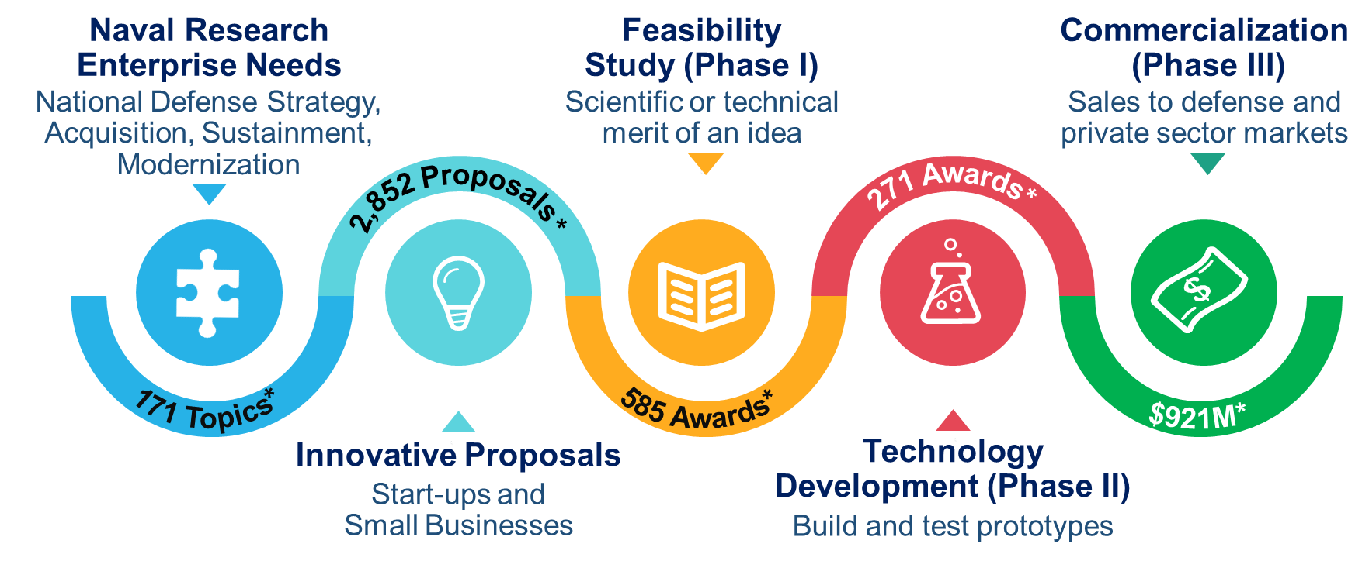
Delivering Innovation to the Warfighter
*FY21 Data
More information at www.navysbir.com
DISTRIBUTION STATEMENT A. Approved for public release: distribution unlimited.
Notes:
Each service do it slightly differently
This is the Navy path to Commercialization
Let’s start from the right

Slide 5
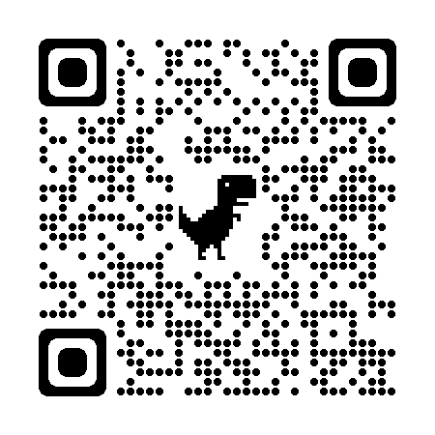
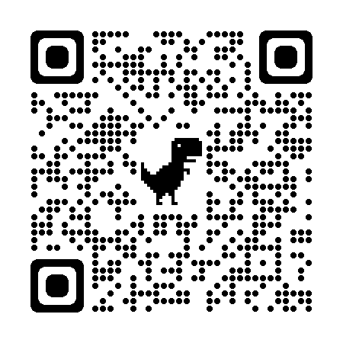
How Small Businesses Participate
Determine eligibility
https://www.sbir.gov/faqs/eligibility-requirements
1
Research topics consistent with their business strategies
https://www.dodsbirsttr.mil/submissions/login
2
Read and understand the DoD Broad Agency Announcement (BAA) and Component-specific BAA instructions https://www.dodsbirsttr.mil/submissions/login
3
Use templates as instructed by BAA and submit a proposal that meets the stated need of the topic https://www.dodsbirsttr.mil/submissions/login
4
DISTRIBUTION STATEMENT A. Approved for public release: distribution unlimited.

Slide 6
When to Participate DoD FY22-23 BAA Schedule*
PROGRAM
PRE-RELEASE
OPEN
CLOSE
DoD SBIR/STTR 2022.1/A
12/01/2021
1/12/2022
2/10/2022
DoD SBIR/STTR 2022.2/B
4/20/2022
5/18/2022
6/15/2022
DoD SBIR/STTR 2022.3/C
8/24/2022
9/21/2022
10/19/2022
DoD SBIR 2022.4
7/12/2022
8/11/2022
9/13/2022
NEXT
DoD SBIR/STTR 2023.1/A
11/22/2022
1/4/2023
2/8/2023
Or scan the
QR Code
*Dates subject to change. More information available at the Defense SBIR/STTR Innovation Portal at: dodsbirsttr.mil/submissions/login
DISTRIBUTION STATEMENT A. Approved for public release: distribution unlimited.

Slide 7
Phase I and II Evaluation and Selection
Evaluation Criteria
Technical merit [the most important evaluation criteria]
Followed by personnel qualifications and commercialization potential [of equal importance]
Evaluation Team
Technical Point of Contact for the topic
Two to three other technical experts
Selection Percentages
Phase I – 20% selection rate (average 15 proposals per topic with 1, 2 or 3 selected)
Phase II – 33-50% selection rate (usually only one firm selected)
Moving from Phase I to Phase II
Progress toward meeting milestones in the Phase I Statement of Work
Technical merit, proposed personnel, and commercialization potential of proposed Phase II approach
Keep lines of communication open with the TPOC to understand your progress toward meeting milestones in the Phase I Statement of Work
DISTRIBUTION STATEMENT A. Approved for public release: distribution unlimited.

Slide 8
Other Phase II Types
Sequential Phase II
Immediately follows the initial Phase II
Used to complete research and development of initial Phase II
Subsequent Phase II
Allows a firm that received a Phase I/II award from one agency to receive a Phase II award from another agency
Must be within scope of original topic
No timetable; process is requirements driven
For more information, please visit www.navysbir.com/phaseii
DISTRIBUTION STATEMENT A. Approved for public release: distribution unlimited.

Slide 9
Transition Best Practices
Pre-Proposal:
Post-Award:
Research transition potential of the topic before you even propose
Talk to the TPOC during BAA pre-release
Request Technical and Business Assistance (TABA)
Develop a relationship with your TPOC and/or Sponsor
Get feedback from public and private sector markets; dual-use?
Engage with different types of buyers (user and purchaser)
Understand the VALUE of your technology, not just the features
Understand the funding you will need to advance and transition; don’t rely just on SBIR/STTR funding
Make sure that you have the right team (personnel and partners) for transition
DISTRIBUTION STATEMENT A. Approved for public release: distribution unlimited.

Slide 10
Phase III
Non-SBIR/STTR funding from Government or private sector
Derives from, extends, or completes Phase I or II work
Any time after Phase I award is issued
Ultimate goal of all SBIR/STTR projects; transition/deployment is DON goal
Awarded via a competitive or statutorily authorized non-competitive process
SBIR/STTR funding cannot be included on a Phase III contract; otherwise the whole contract would be a Phase II award
Phase III Guidebook is available at
https://navysbir.com/docs/DON-SBIR_STTR_Phase-III_Guidebook_V2-2020.pdf
DISTRIBUTION STATEMENT A. Approved for public release: distribution unlimited.

Slide 11
Navy SBIR Differentiators
Transition-Driven Topics
Topic Workshops
Faster Awards
Larger 1st Payment
Tailored Transition Support
DISTRIBUTION STATEMENT A. Approved for public release: distribution unlimited.

Slide 12
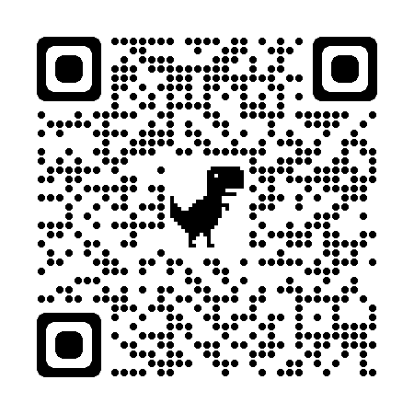
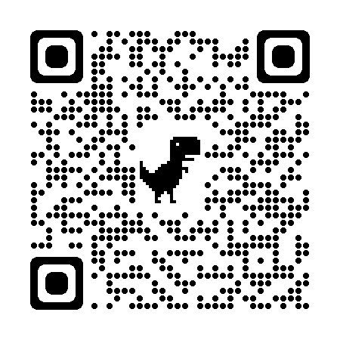
Tailored Transition Support
SBIR/STTR Transition Program (STP)
Services to facilitate transition of technology; Navy funded
Business mentoring, education, and networking
Promote technologies on the Virtual Transition Marketplace (VTM) − an online, searchable showcase
Exhibiting and Tech Talks at Forum for SBIR/STTR Transition (FST) and focused technology events
SBIR Experimentation Cell (DON SEC)
Connecting SBIR innovators with the DON experimentation community
Navy funded service; testing and support paid by Phase II contract
https://navysbir.com/sec
Commercialization Accelerator
Opportunity and growth outside traditional defense market
https://navystp.com/
NEW
DISTRIBUTION STATEMENT A. Approved for public release: distribution unlimited.

Slide 13
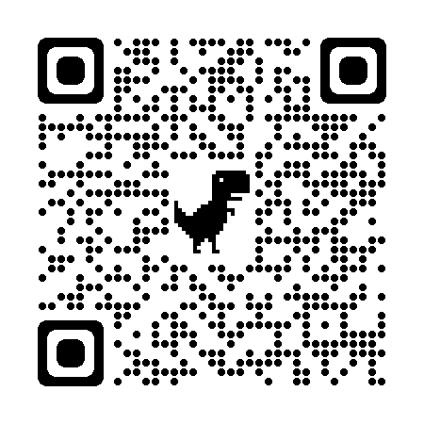
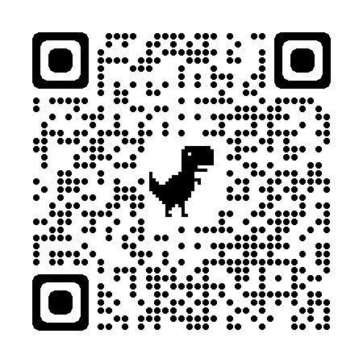
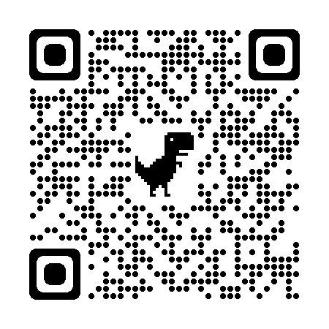
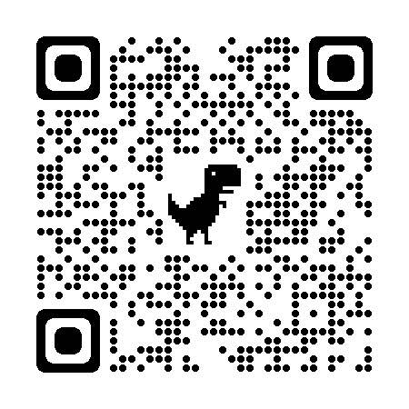
Online Resources Other Useful Websites
Stay in Touch
https://www.navysbir.com
Official website of the DON SBIR/STTR programs that includes information about BAAs, topics, selections, program specifics, success stories, outreach events, points of contact (POCs), and useful links & forms.
navy-sbir-sttr@navy.mil
www.navysbir.com
https://navysbirsearch.com
Navy SBIR search site for contextual searches of all DoD SBIR/STTR awards to obtain information on topics, success stories, and company summary reports.
www.linkedin.com/company/donsbir
@donsbir
Subscribe to SBIR SOUNDINGS E-Newsletter using the QR code and receive updates delivered to your inbox!
https://www.sbir.gov
Official website of the Federal-wide SBIR/STTR programs that includes links to all BAAs, topics, and access to program-wide policy information.
https://www.aptac-us.org/
Official website of the Association of Procurement Technical Assistance Centers (PTACs), a nationwide network of professionals working to help local businesses compete successfully in the Federal Government marketplace.
Read SBIR/STTR Transitions Newsletter using the QR code or the link below
https://navystp.com/transitions-newsletters/
DISTRIBUTION STATEMENT A. Approved for public release: distribution unlimited.

