Slide 1
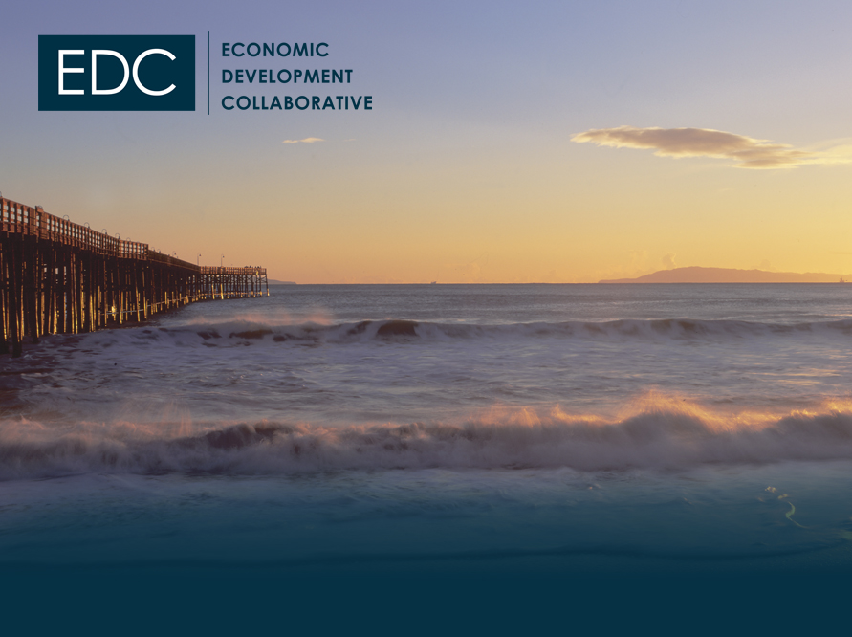
Strategic Partnerships & Engagement
Fathomwerx Summit
September 15, 2022

Slide 2

Context, Our Regional Story
What are the purposes we serve?
  Promoting & securing regional quality of life, defined by
    economic competitiveness,
    broadly shared prosperity,
    environmental balance & sustainability
What are the strategies to deliver on our purpose?
  Building & retaining skills, efficient education pipeline
  Optimizing & networking our human,
  industry & capital assets
  Enabling our regional
    entrepreneurial ecosystem
    Business retention
    Business attraction
Notes:
Virtually all of this agenda is dependent on regional collaboration, partnerships

Slide 3
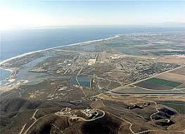
Public/Private Partnerships for a Purpose
Fathomwerx
  Multi-party MOU:
    Port of Hueneme, NSWC-PHD, NAVFAC, Matter Labs, EDC
      R&D and prototyping laboratory
      Events, showcases, exercises
      Education
Economic Development Collaborative
  Economic analysis, focus on
    Key drivers of the economy
  Central coast regional networking
  Direct service delivery
    Business technical assistance
    Access to capital
    Startup, entrepreneurship
Notes:
Approach topic of partnerships from two angles.
One specific, Fathomwerx, the other our role, at EDC,
Both strategically, intentionally public/private partnerships

Slide 4
Regional Assets for Engagement
  Quality of life, www.businessforwardvc.com
    USDA Natural Amenities Index: VC #1 in the nation out of 3,111 counties, for physical characteristics that enhance location as a place to live, “the absolute most desirable place to live in America”
  Globally Connected: Brookings Institute ranks Ventura County #22 of top 100 U.S. metros for export share of metro output
    Primary driver is Port of Hueneme
  Manufacturing generates some 17% of the region’s GDP
    Rank 7th in the nation for diversity of mfg subsectors with a high concentration (not single subsector dependent)
    Higher density of mfg jobs in Ventura County than in both CA and US
  Naval Base Ventura County, over $2 billion in regional economic benefit
    Over 20,000 jobs in the region, direct & indirect
  County’s entrepreneurial ecosystem ranks 9th among CA’s 58 counties, on mix of startup density & connectivity, resource fluidity & economic diversity
Notes:
As noted in prior, none of these can be achieved or are sustainable absent a collaborative partnership mindset.

Slide 5
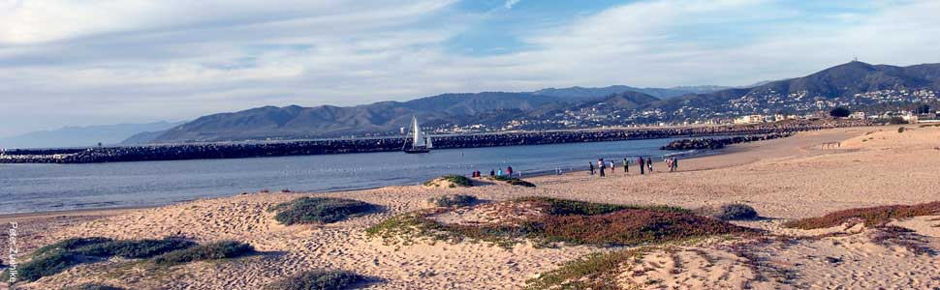
Sharing Three EDC Strategies
Digital Upskilling
  Jaime Fall, Director of Workforce & Economic Strategies
Cultivate & Ignite Technology Program
  Ray Bowman, Small Business Development Center Director
Focus throughout on Outcomes in Diversity, Equity & Inclusion
  Alondra Gaytán, Director of Strategic Relations
Notes:
Approach topic of partnerships from two angles.
One specific, Fathomwerx, the other our role, at EDC,
Both strategically, intentionally public/private partnerships

Slide 6

The Need For Digital Skills
Without digital skills, people can’t:
Search for, apply for, and interview for a job
Enjoy the flexibility of being able to work remotely
Earn the higher wages given to middle skills workers
Access payroll systems, workplace benefits, and work schedules
Avoid cybersecurity threats and scams
Communicate with a boss, coworker, friend, or a child’s teacher
Reserve an airline ticket, hotel room, table at a restaurant, or even a picnic table at a park
People without the digital skills and resilience to do these tasks are in danger of being left further behind as digitalization continues to expand.
NOVICE DIGITAL SKILLS LEARNER who need basic digital skills to get a well-paying job.
Notes:
Here is an example of using an icon.

Slide 7
Digital Upskilling Initiative
  Assembly member Jacqui Irwin developed the project idea and secured $5 million in the 2021-2022 State Budget for a Digital Upskilling pilot in Ventura County
  3-year initiative (2022-Dec 2024), with funding coming through LWDA and CWDB
  Training programs for 3 categories of trainees
  Some participants receive a stipend during the training program, along with a new laptop and internet access
“Providing job seekers with the skills they need to thrive and employers with the skilled employees they need to grow.”
Notes:
FREE short-term program that increases the digital skills of job seekers, current workers and small businesses in Ventura County in order to increase their earning potential and economic mobility.

Slide 8



3 Digital Upskilling Cohorts
NOVICE DIGITAL SKILLS LEARNERS who need basic digital skills to get a well-paying job.
CURRENT WORKERS
who already have some basic digital skills but need training and/ or specific industry certifications to qualify for more opportunities.
SMALL BUSINESSES, entrepreneurs and employers who need to modernize their business and implement ecommerce to grow and stay competitive.

Slide 9
Digital Upskilling Initiative Goals
400 people in Ventura County complete training
    200 novices learn basic digital skills
    100 small businesses & entrepreneurs learn digital skills to enhance and expand their businesses
    100 current workers receive upskilling in ICT related occupations
Develop sustained capacity to prepare workers at all levels for digital skills employment opportunities across sectors
Develop a sustainable and replicable digital upskilling pilot that strengthens the workforce system in Ventura County
Increase the earning potential of all program completers
Place 100-200 people in higher-paid jobs
Notes:
ASK: What secondary goals could we achieve with this initiative?

Slide 10
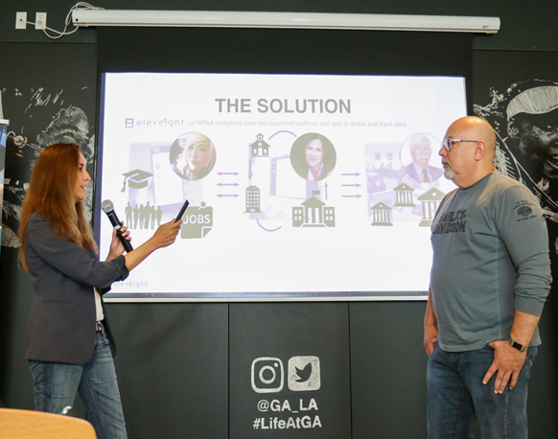

Cultivate & Ignite Technology Program
The EDC CITP creates a pathway to connect early-stage firms to:
expert advising
training sessions
pitch panels
industry panels
pitch competitions
local accelerators and
resources in key tech development areas
Notes:
As noted in prior, none of these can be achieved or are sustainable absent a collaborative partnership mindset.

Slide 11
Areas of Advising
Training Sessions
QUESTIONS???
Access to 30+ Industry Experts providing no-cost advising in Key Pillar Areas:
Product
Revenue
Team
Systems
Fundraising
Operations
Marketing
Logistics
etc.
Access to monthly virtual and in-person training sessions such as:
Ideation
Business Start Creation
Business Startup Launch
Scaling Your Business
Positioning Your Company for Funding
etc
Notes:
**Regional training/programming
** Dream Fund for startups

Slide 12
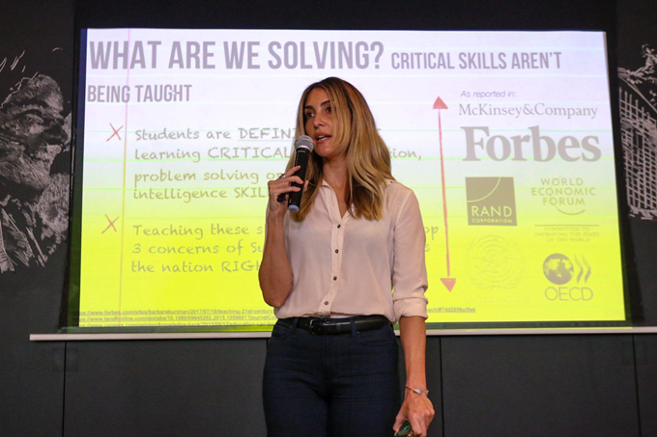
Pitch Panels
Formal presentation followed by a rigorous question and answer segment from an internal panel of EDC business advisors.
Panel evaluation forms are analyzed, resulting in detailed feedback reports intended to help the entrepreneurs and firms sharpen their business plans and pitches.
Notes:
As noted in prior, none of these can be achieved or are sustainable absent a collaborative partnership mindset.

Slide 13
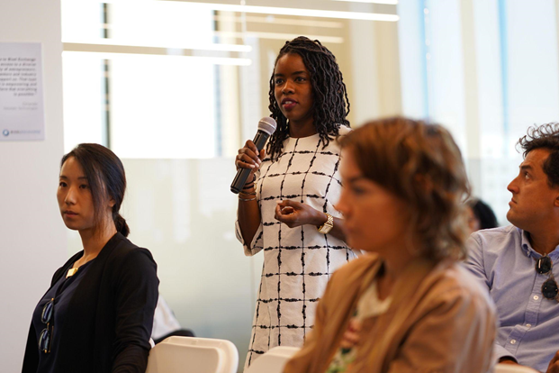
Industry Panels
A panel of local industry leaders. Each panel is customized to assure industry and topical expertise. Panel members complete a rigorous evaluation of the presentation and business plan.
Panel evaluation forms are analyzed, resulting in detailed feedback reports intended to help the entrepreneurs and firms sharpen their business plans and pitches.
Notes:
As noted in prior, none of these can be achieved or are sustainable absent a collaborative partnership mindset.

Slide 14
Diversity/Equity/Inclusion
Diversity/Equity/Inclusion, Why Now?
Diversity is Our Shared Reality
  By Race: 53% White, 5.8% Black, 1.5% Native American/Hawaiian/Alaskan, 15.5% Asian, 18.3% Other, 5.7% Multi-Racial (CA data)
  By Ethnicity
    41% Hispanic/Latino, 59% Non-Hispanic/Latino (California)
    45% Hispanic/Latino, 55% Non-Hispanic/Latino (Ventura County)
    49% Hispanic/Latino, 51% Non-Hispanic/Latino, 25% White Alone Non-Hispanic/Latino (LA County)
Equity Defined
  Equity is our process of service and to outcomes achieved by each client we serve; every client is served fair and receives customer service tailored to the individuals needs and circumstances.
Inclusion is a Necessity
  It is the practice and policy of providing equal access and pathways to opportunities and resources to underserved communities.
Notes:
As noted in prior, none of these can be achieved or are sustainable absent a collaborative partnership mindset.

Slide 15
Continuous Improvement through Strategic Planning
One Example, Our EDC SBDC:
  Diversity is an essential element of our EDC SBDC strategic plan; we update and adjust our model as we move forward.
  The Focus Area is a constant. The Goals are updated regularly.
Focus Area I: Historically Under-represented Groups
  Goal A: Effectiveness. Develop and reinforce our process for ensuring that our service for under-represented groups is as effective as the service we offer to all clients.
  Goal B: Determine What Areas As an Organization Are Under-represented. Recruit business advisors or create the training/capacity building to diminish any under-represented areas (internal and external).
  Goal C: Spanish Speaking Clients. Document and implement our process for retaining Spanish speaking clients.
  Goal D: Marketing to Under-represented Groups. Provide and track marketing through appropriate media, customized for results.
10

Slide 16
Profile of Business Ownership/Mgmt
Diversity Increasing in Business Ownership
    Though business ownership and management diversity lags the population as a whole
    Our task isn’t just reaching and serving business diversity, but also contributing to increasing ownership through entrepreneurship
Sectoral Considerations
  Need to improve share of “minority” ownership across all sectors, business types and models
Neighborhood/Geographic Representation, Presence
  It’s not only about who owns or has opportunity to own and manage businesses, but it’s equally critical to assure geographic distribution, neighborhood access
Technology Considerations/Digital Equity
  Data shows that access to computers and internet connections—essential for education, health, community engagement and business success—is dramatically under-represented by income, race, ethnicity and neighborhood
Notes:
Virtually all of this agenda is dependent on regional collaboration, partnerships

Slide 17
DEI Summary
D/E/I is not a trend, it is an emergence an urgency that has been a long time coming, brought to the forefront by the COVID crisis
What You Know & What You Measure, Influences What You Do
D/E/I Concentration Enhances Overall Effectiveness, Not Hinders
  Improved staff & partner contributions
  Improved identification of motivated clients & customers (both job-seekers and employers)
  Primary means for securing positive outcomes is by effectively connecting motivated job-seekers with the right opportunity
Our role is stewardship of that constructive environment
13
Notes:
Approach topic of partnerships from two angles.
One specific, Fathomwerx, the other our role, at EDC,
Both strategically, intentionally public/private partnerships

Slide 18
Summary: New Dimensions for Economic Recovery
All about Automation, Digitization, Remote (live, work & play)
Proactive attention to land use & public policy
  Transportation behavior changes, decentralization
  Broadband deployment and adoption, digital equity
  Strategic re-thinking of our relationship to the built environment
  Urgency & opportunity to invest in sustainable energy
Progressive policy attention to social equity, upward mobility
    Pressure for better protection & pay for front line workers, particularly in groceries, food service, education & health care
    Investing in re-training especially for low-income workers in occupations that are being eliminated
    Opportunity for optimizing new investments in early child education
  Successful regions will excel at leadership in skills enhancements, smart globalization, entrepreneurship & innovation
Notes:
As noted in prior, none of these can be achieved or are sustainable absent a collaborative partnership mindset.

Slide 19

Contact
Bruce Stenslie, President/CEO
Economic Development Collaborative
4001 Mission Oaks Blvd, Suite A1
Camarillo, CA 93012
805-409-9155
bruce@edcollaborative.com
www.edcollaborative.com

