Slide 1
FATHOMWERX SUMMIT KEYNOTE SPEAKER ANTX Coastal Trident + NavalX Agility Summit 14 Sep 2022
Kail Macias
NAVFAC EXWC TD
Notes:
Before I get started, I want to thank the team of NSWC PHD, Naval Air Warfare Center Weapons Division (NAWC WD), Port of Hueneme, EXWC, Matter Labs, EDC and our gracious sponsors and members of industry
Special Thanks:
Navy:
Mr. Brendan Applegate; NSWC PHD; Principal Investigator of the ANTX/Coastal Trident Program for the last 16 years
Ms. Ling Tang: NUWC KPT det San Diego; Provided all of the signage, A/V support, programs, advertising, and much of the behind-the-scenes work to combine the ANTX/CT Technology Open House and the NavalX Agility Summit to create the first FATHOMWERX Summit.
Mr. Nick Willis: NSWC PHD; FATHOMWERX Lab Manager
Port of Hueneme:
Mrs. Kristin Decas:; CEO (out with COVID) and Port Operations and Maintenance Staff
Mrs. Christina Birdsey; Chief Operations Officer (COO)
Mr. Mike Morrison; Operations Manager
The entirety of the Port’s Maintenance Staff!!!

Slide 2
Overview
Why
2022 National Defense Strategy (NDS)
2022 Navigation Plan Implementation Framework (NIF)
Importance of Technology Transfer (T2)
Examples
Wrap up
Notes:
Be sure to address acronyms. Some/most of the companies will be unfamiliar

Slide 3
Why – NDS 2022 (NDS Fact Sheet 28 Mar 2022)
The Defense priorities are:
Defending the homeland, paced to the growing multi-domain threat posed by the PRC
Deterring strategic attacks against the United States, Allies, and partners
Deterring aggression, while being prepared to prevail in conflict when necessary, prioritizing the PRC challenge in the Indo-Pacific, then the Russia challenge in Europe
Building a resilient Joint Force and defense ecosystem
The Department will advance our goals through three primary ways: integrated deterrence, campaigning, and actions that build enduring advantages
Notes:
It is our North Star
The landscape has changed. We now have near and peer adversaries.
Today’s security environment is characterized by the rapid pace of innovation. Strategic competitors and non-state actors are gaining access to cutting-edge technologies that enable them to threaten national security. Artificial intelligence, ubiquitous sensors, unmanned systems, and long-range precision weapons are proliferating globally, making contested spaces more transparent and more lethal, and transforming how navies will fight in the future.
Climate change threatens coastal nations with rising sea levels and more extreme weather. Melting sea ice opens the Arctic to growing maritime activity and increasing competition. COVID-19 demonstrates how rapidly some threats can become global in scope, generating worldwide political and economic instability. Competition over offshore resources, including protein, energy, and minerals, fuels international tensions. All these trends create vulnerabilities for adversaries to exploit and volatility that can erupt quickly into crisis.
The Department will act urgently to sustain and strengthen deterrence, with the People’s Republic of China (PRC) as our most consequential strategic competitor and the pacing challenge for the Department.
Russia poses acute threats, as illustrated by invasion of Ukraine. We will collaborate with our NATO Allies and partners to reinforce robust deterrence in the face of Russian aggression.
The Department will remain capable of managing other persistent threats, including those from North Korea, Iran, and violent extremist organizations. Changes in global climate and other dangerous transboundary threats, including pandemics, are transforming the context in which the Department operates. We will adapt to these challenges, which increasingly place pressure on the Joint Force and the systems that support it
Integrated deterrence entails developing and combining our strengths to maximum effect, by working seamlessly across warfighting domains, theaters, the spectrum of conflict, other instruments of U.S. national power, and our unmatched network of Alliances and partnerships. Integrated deterrence is enabled by combat-credible forces, backstopped by a safe, secure, and effective nuclear deterrent.
Campaigning will strengthen deterrence and enable us to gain advantages against the full range of competitors’ coercive actions. The United States will operate forces, synchronize broader Department efforts, and align Department activities with other instruments of national power, to undermine acute forms of competitor coercion, complicate competitors’ military preparations, and develop our own warfighting capabilities together with Allies and partners.
Building enduring advantages for the future Joint Force involves undertaking reforms to accelerate force development, getting the technology we need more quickly, and making investments in the extraordinary people of the Department, who remain our most valuable resource.

Slide 4
Why – Navigation Plan (NFOSES Mar 2022)
Notes:
Get Real requires Navy leaders to ruthlessly self-assess; be honest, humble, and transparent about their capabilities and limitations; challenge their beliefs using data, facts, and diverse input; and “embrace the red”—acknowledge shortcomings—by being curious and taking pride in finding and fixing problems.
Get Better requires Navy leaders to deliberately self-correct; find and fix small problems before they become larger, systemic issues; fix the root causes, not just symptoms; apply critical problem-solving tools and best practices to shift from more activity to better outcomes; set clear accountability; work collaboratively; and quickly identify and remove barriers to progress, elevating problems to higher leadership, if necessary.
SECNAV – 4Cs and leverage our industry partners to the greatest extent possible
CNO – GRGB is a strategic Imperative. Focus is on readiness, modernization, capacity…in that order
VCNO – Build a little, test a little, learn a lot and do it again.
Commandant – Stretch ourselves intellectually..always. CL is the pacing element.
N1 – Diversity is presence of differences (not limited to race, gender, ethnicity), includes thought, background experience.
Get Real Get Better – it is about not being content with the status quo.

Slide 5
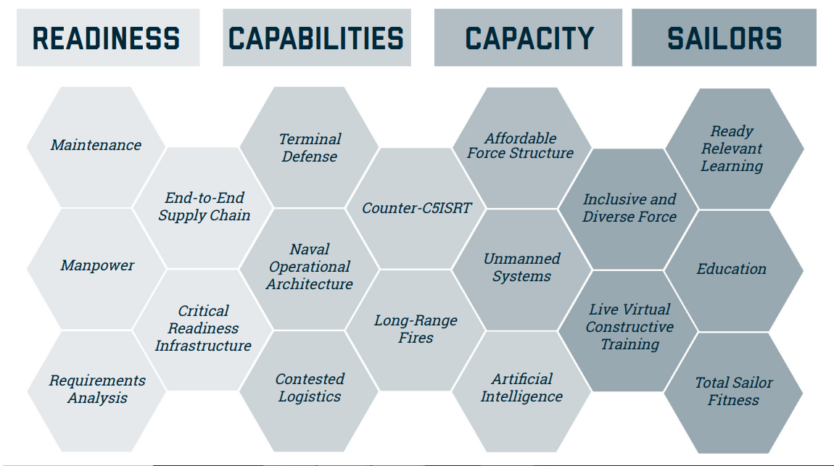
Why – NIF (NAVPLAN Implementation Framework – 26 Jul 2022)
Notes:
To deliver today, tomorrow, and the future fleet, we will continue to focus on four priorities: Readiness, Capabilities, Capacity, and our Sailors.
In support of our Force Design Imperatives, we have prioritized four Capability objectives for alignment, integration, and acceleration: Long-range Fires (how we shoot), Counter-C5ISRT (how we maneuver), Terminal Defense (how we defend), and Contested Logistics (how we resupply).
Supporting these NIF objectives are four enabling objectives: Live, Virtual and Constructive Training; Naval Operational Architecture; Artificial Intelligence, and Unmanned Systems.
Discuss how the various technologies displayed over the next two days and in the ANTX support all four capability areas.
Water generation both readiness and contested logistics
Unmanned systems across readiness, capabilities and capacity
Sensors and networking across readiness, capabilities and capacity

Slide 6
Importance of Technology Transfer
Advance the state of the art with both traditional and non-traditional partners
Industry and Small Business
Academia
DOD Labs and Warfare Center
Federal Funded Research Centers
Accelerate technology development by the sharing of resources
Bringing solution providers closer to our problems
Economic development resulting from increased reliance on non-government partners for R&D and commercialization of technologies
Notes:
Reiterate importance of diversity for innovation and finding the best solutions
Sharing of resources can range from dollars, equipment, infrastructure, to intellect
Utilizing both Federal Acquisition Regulation and NonFAR vehicles creates that inclusive environment and team
If successful can be a win-win for all

Slide 7
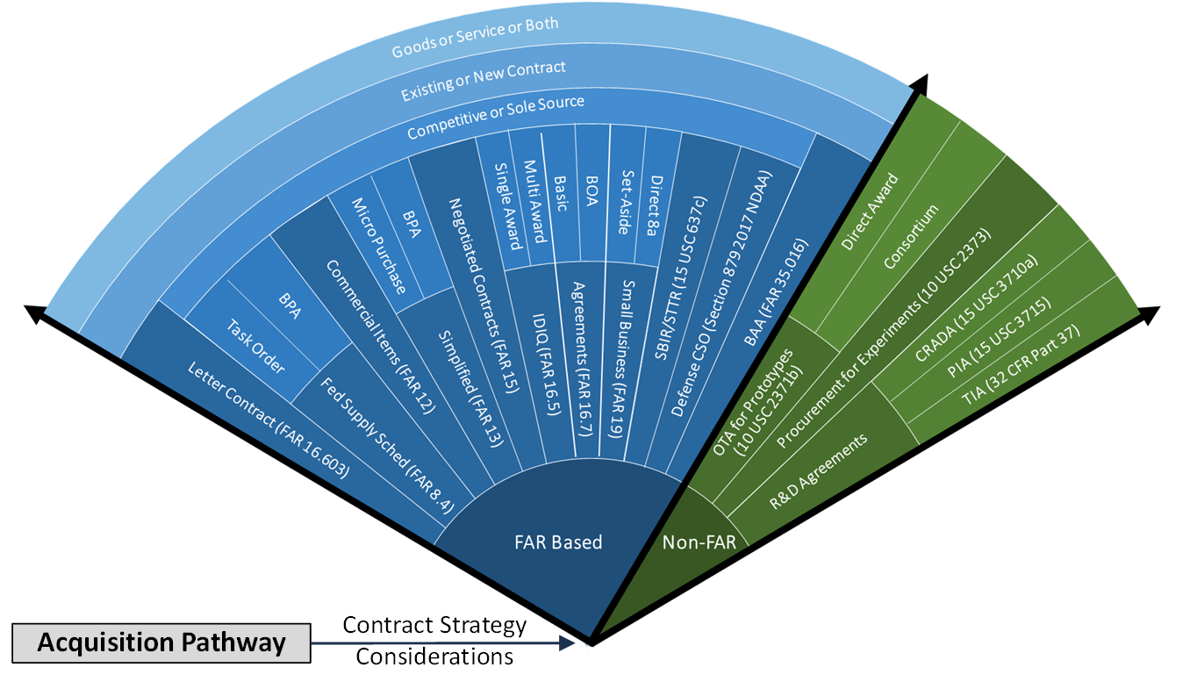
FAR/Non-FAR
Notes:
DOD Warfare Center and Labs utilize many of the tools, both FAR and NonFAR.
From a GRGB perspective, we can do more on both sides of the fan
As with a skilled carpenter, knowing when to use the right tool for the specific application
I have seen some tremendous successes on both sides
Letter Contract IFAR 16.603 (DSFP)
Procurement for Experiments – Rapid prototyping

Slide 8
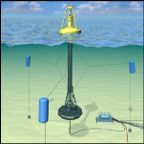
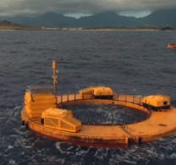
Technology Transfer Examples
WETS
Wave Energy Test Site
Purpose: Advance the US state of technology in Marine Hydrokinetic Energy
Utilizes a combination of IDIQs, UARC, DOE Grants, and CRADAs
Incudes DON, DOE, Academia, and Industry
X-10 Spindle Lock Tool
Developed by DoD/PLA with Lockmasters, Inc.
Tool resolves improper spindle installation avoiding critical lockout failures ”Estimated total cost avoidance: First four years: $2,388,000
Extrapolated savings for 30-years container Life at with 0.02% failure rate: $17,910,000
Notes:
WETS is an example of utilizing both FAR and NonFAR tools. Also illustrates technology coming in from Industry and non traditional partners
X-10 is an example of a DOD invention that was commercialized via nonfar mechanisms

Slide 9
Wrap-up
We must build enduring advantages in a complex, rapidly changing threat environment
Accelerate getting technology more quickly to the warfighter
Leverage industry and academia partners to the greatest extent possible
Culture focused on continuous improvement - GRGB is a strategic imperative
ANTX Coastal Trident + NavalX Agility Summit is aligned and provides an opportunity to learn and exchange ideas
“Build a little, test a little, learn a lot and do it again”
“Stretch ourselves intellectually… always”
Notes:
ANTX also promote significant exchange with local government entities (DAVDS testing and evaluation with Navy, County, Coast Guard divers) – this makes FATHOMWERX and ANTX/CT entities / collaborators so important to our future endeavors

Slide 10
Thank You

