Slide 1
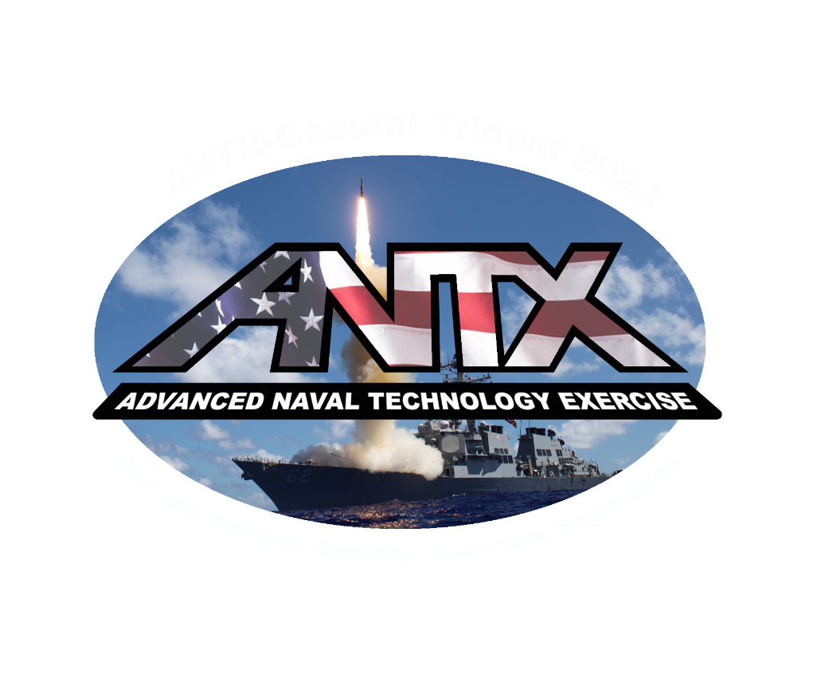
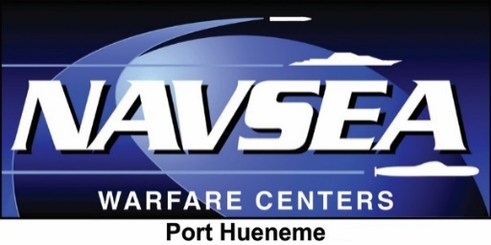
ANTX-Coastal Trident Program
Brendan Applegate
Lead for Fleet Experimentation and Exercises
NSWC Port Hueneme Division
Email: brendan.j.applegate.civ@us.navy.mil
Phone: (619) 616-5667

Slide 2
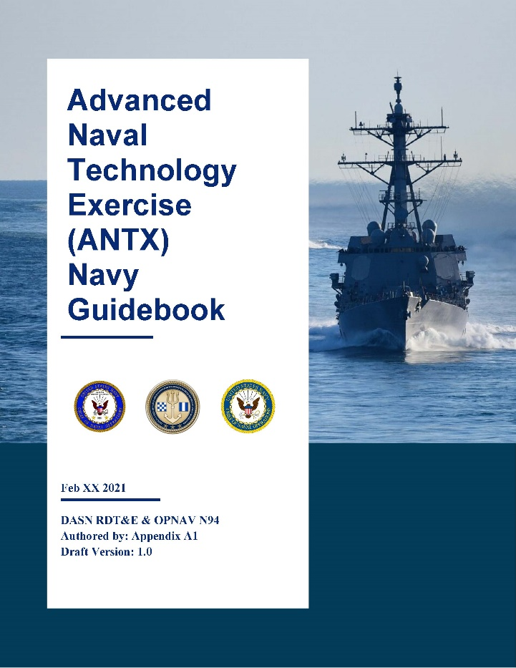
What is ANTX?
“With the rapidly changing threat environment, our National Defense Strategy and other guiding strategic documentation identify a need to adapt quickly and rapidly to take advantage of technical innovations.”
Technologists need an understanding of the operational challenges
Warfighters need an understanding of developing technological opportunities
The Navy uses focused experimentation and exercise programs to maintain awareness of the leading edge and create opportunities for engagement

Slide 3
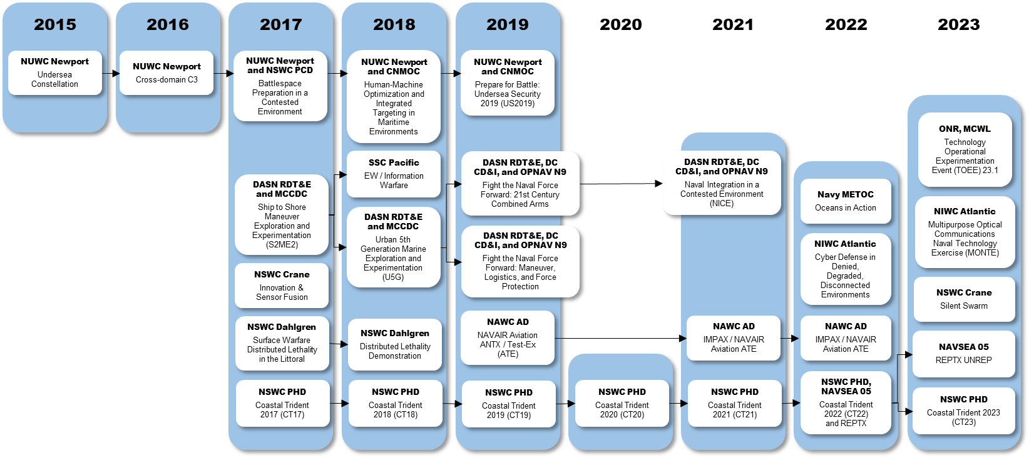
What is ANTX?

Slide 4
What is ANTX?
ANTX was established to accelerate the identification of high-value opportunities for the Navy, larger joint force, and interagency partners
Assessment is based on observation of ANTX activities, with the objective of facilitating progress in one of the following potential engagement areas:
Disruptive opportunity exploration (demonstration or experiment)
Transition into a formal fleet experiment or exercise
Transition into a collaborative S&T project (CRADA)
Transition into a new NR&DE maturation project (NISE project)
Transition into an existing program of record
Some projects will not warrant recommendations to these transition pathways

Slide 5
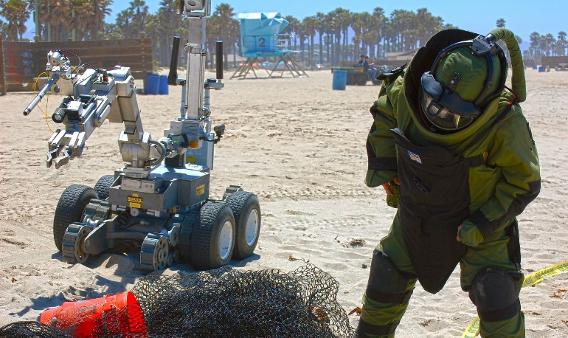
What is ANTX?
ANTX was established to accelerate the identification of high-value opportunities for the Navy, larger joint force, and interagency partners
Assessment is based on observation of ANTX activities, with the objective of facilitating progress in one of the following potential engagement areas:
Disruptive opportunity exploration (demonstration or experiment)
Transition into a formal fleet experiment or exercise
Transition into a collaborative S&T project (CRADA)
Transition into a new NR&DE maturation project (NISE project)
Transition into an existing program of record
Some projects will not warrant recommendations to these transition pathways
For non-DoD stakeholders, ANTX represents an opportunity to leverage the Navy’s investment in technical innovation and experimentation
In the absence of dedicated S&T and R&D interfaces, the ability of local, state, and non-DoD federal organizations to gain awareness, access, and insight into developing technologies is otherwise limited to “off-the-shelf” capabilities

Slide 6
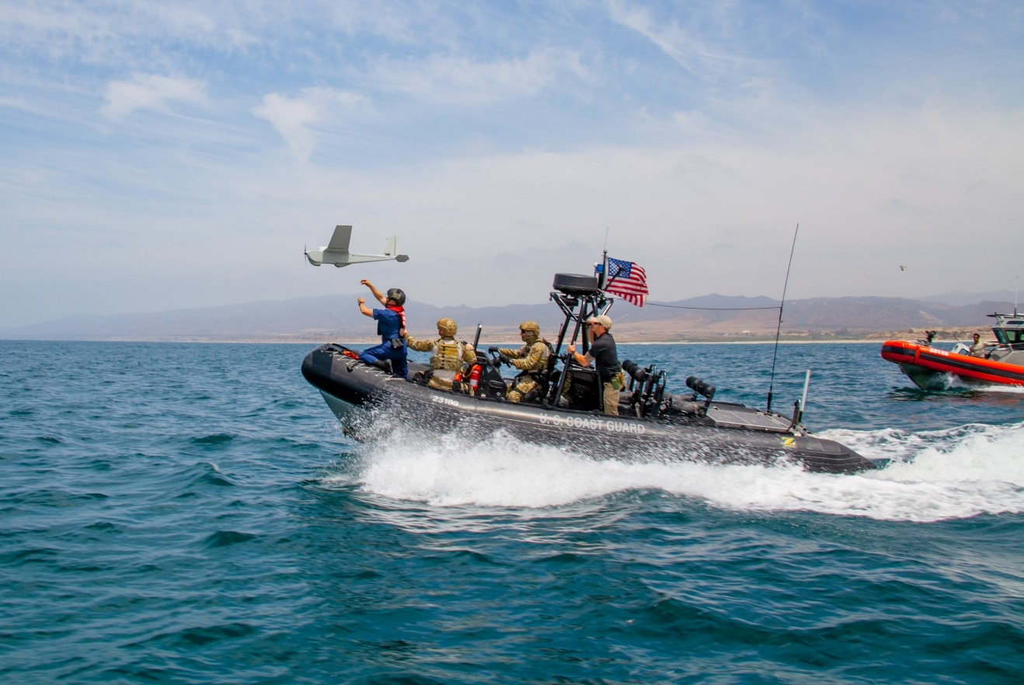
What is ANTX?
ANTX was established to accelerate the identification of high-value opportunities for the Navy, larger joint force, and interagency partners
Assessment is based on observation of ANTX activities, with the objective of facilitating progress in one of the following potential engagement areas:
Disruptive opportunity exploration (demonstration or experiment)
Transition into a formal fleet experiment or exercise
Transition into a collaborative S&T project (CRADA)
Transition into a new NR&DE maturation project (NISE project)
Transition into an existing program of record
Some projects will not warrant recommendations to these transition pathways
Think…
“experiment”
“exploratory exercise”
“what is possible?”
“will this work?”
Stop short of …
“how would we?”
“how well does this?”

Slide 7
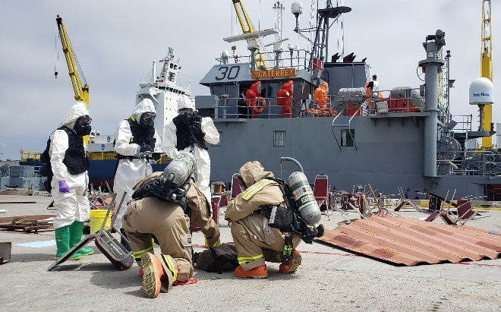
Alignment with Coastal Trident
Coastal Trident is an operational research program conducted annually to address threats to port and maritime security
Reinforce federal, state, local government, and private sector strategic partnerships in port and maritime domains
Strengthen existing capabilities to support safe and effective port and maritime operations
Explore CONEMP and accelerate access to developing and transitional technologies
Coastal Trident is designed to meet the needs of a wide variety of stakeholders and emphasizes a “whole of society” strategy for port and maritime security

Slide 8
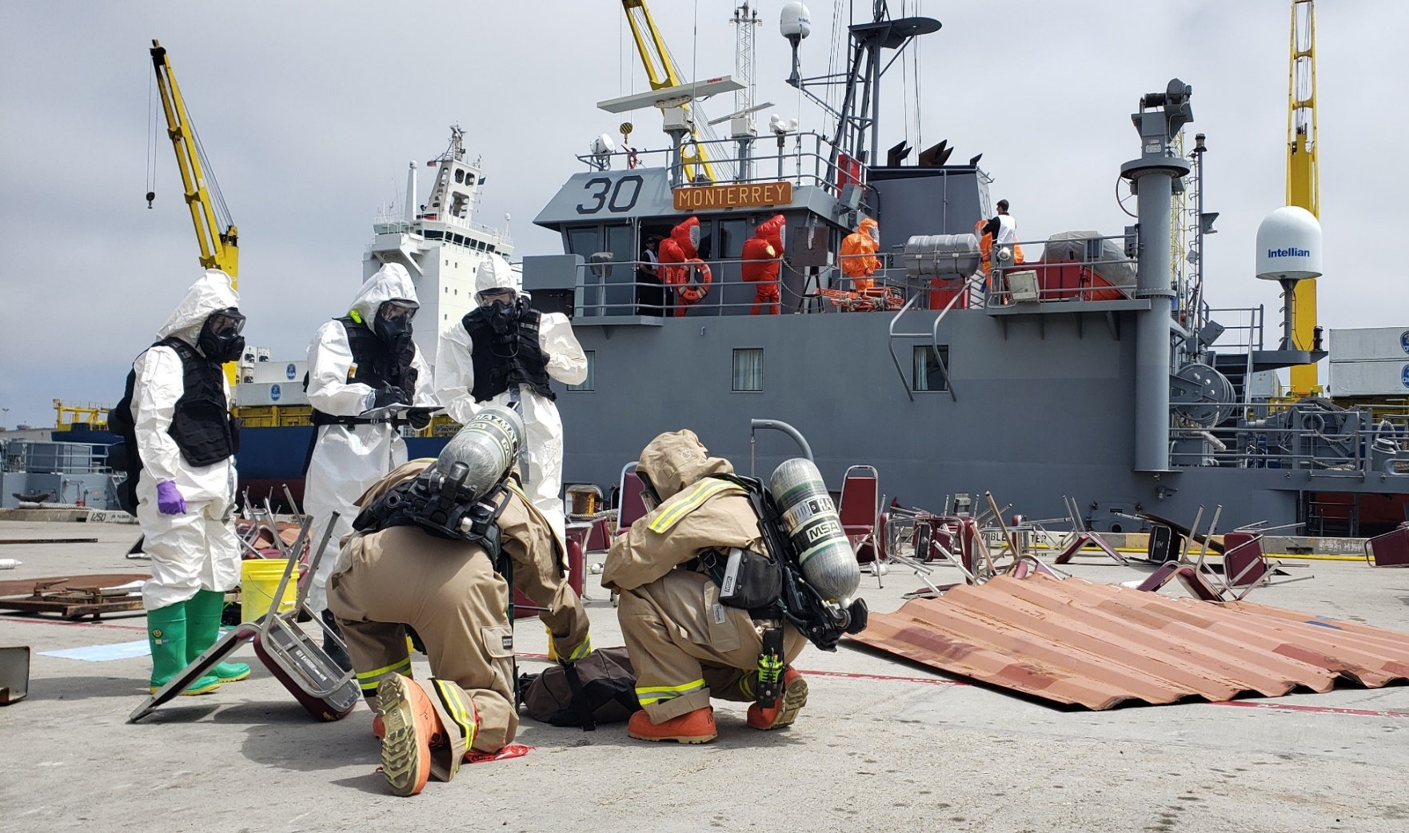
Alignment with Coastal Trident
Coastal Trident is an operational research program conducted annually to address threats to port and maritime security
Reinforce federal, state, local government, and private sector strategic partnerships in port and maritime domains
Strengthen existing capabilities to support safe and effective port and maritime operations
Explore CONEMP and accelerate access to developing and transitional technologies
Coastal Trident is designed to meet the needs of a wide variety of stakeholders and emphasizes a “whole of society” strategy for port and maritime security
Coastal Trident 2019 exercise activities epitomize the collaborative learning environment that the program strives to achieve. In this photo, FBI and county fire department personnel assess an incident scene constructed by a Navy underwater construction team, while county bomb squad and city fire department personnel search an Army vessel docked at a commercial port.

Slide 9
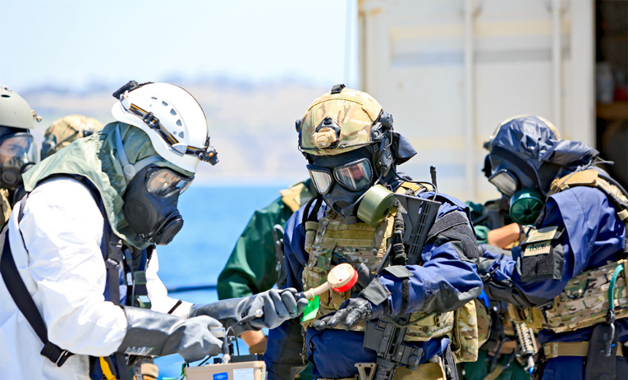
Alignment with Coastal Trident
ANTX is aligned with Coastal Trident to provide access to unique resources not otherwise accessible to experimenters
Scenario-based, operationally relevant test environments
SMEs and representative end users from Navy and interagency partners
Alignment with Coastal Trident maximizes feedback
and expands awareness of technical solutions
Examine novel CONEMP and CONOPS
Acknowledge multi-agency nature of port and maritime security operations
Facilitate engagement, collaboration, and innovation

Slide 10
Alignment with FATHOMWERX
The NavalX Ventura Tech Bridge, or “FATHOMWERX,” supports a regional ecosystem to innovate, collaborate, and accelerate adoption of technologies
FATHOMWERX stakeholders provide unique venues for prototyping, demonstration, and experimentation to small businesses and low-TRL technologies targeting operational gaps and challenges
NSWC Port Hueneme Division
NAWC Weapons Division-Point Mugu
NAVFAC Engineering and Expeditionary Warfare Center
NUWC Keyport-Det San Diego
Port of Hueneme
EDC-Ventura County and Matter Labs (PIA partner)

Slide 11
Alignment with FATHOMWERX
Alignment of ANTX with FATHOMWERX expands access to technology developers and innovators that might not be engaged with the Navy through traditional acquisition pathways
ANTX serves as a key vehicle in the “Scan” and “Validate” phases of the NavalX innovation pipeline
ANTX facilitates low barrier-to-entry demonstration and engagement of capabilities early in the development cycle

Slide 12
Program Design
ANTX-Coastal Trident is conducted as a series of technical demonstrations, field experiments, discussion-based and operations-based exercises
A modular construct facilitates control over project interactions and limits program risk
Limit impact of real-world operational commitments
Limit impacts of technical delays or cancellations
Allow differing priorities, levels of proficiency, and technical maturity to leverage program resources
Establish a more focused training environment or allow participants
to push operational and technical capabilities to failure

Slide 13
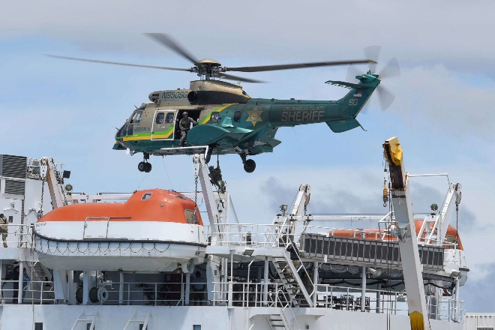
Program Design
Under its modular design, ANTX-Coastal Trident projects are organized administratively where there is a common focus
Modular alignment assists the planning team in coordinating reviews/approvals and communicating program scope
Operationally, projects are “plugged-and-played” where participants, scenarios, supporting resources are common, or OPSEC/INFOSEC is a factor
Sponsored projects and operational stakeholder priorities drive the operational environments
Technical demonstrations and field experiments may leverage these environments in parallel or integrate at the discretion of operational stakeholders

Slide 14
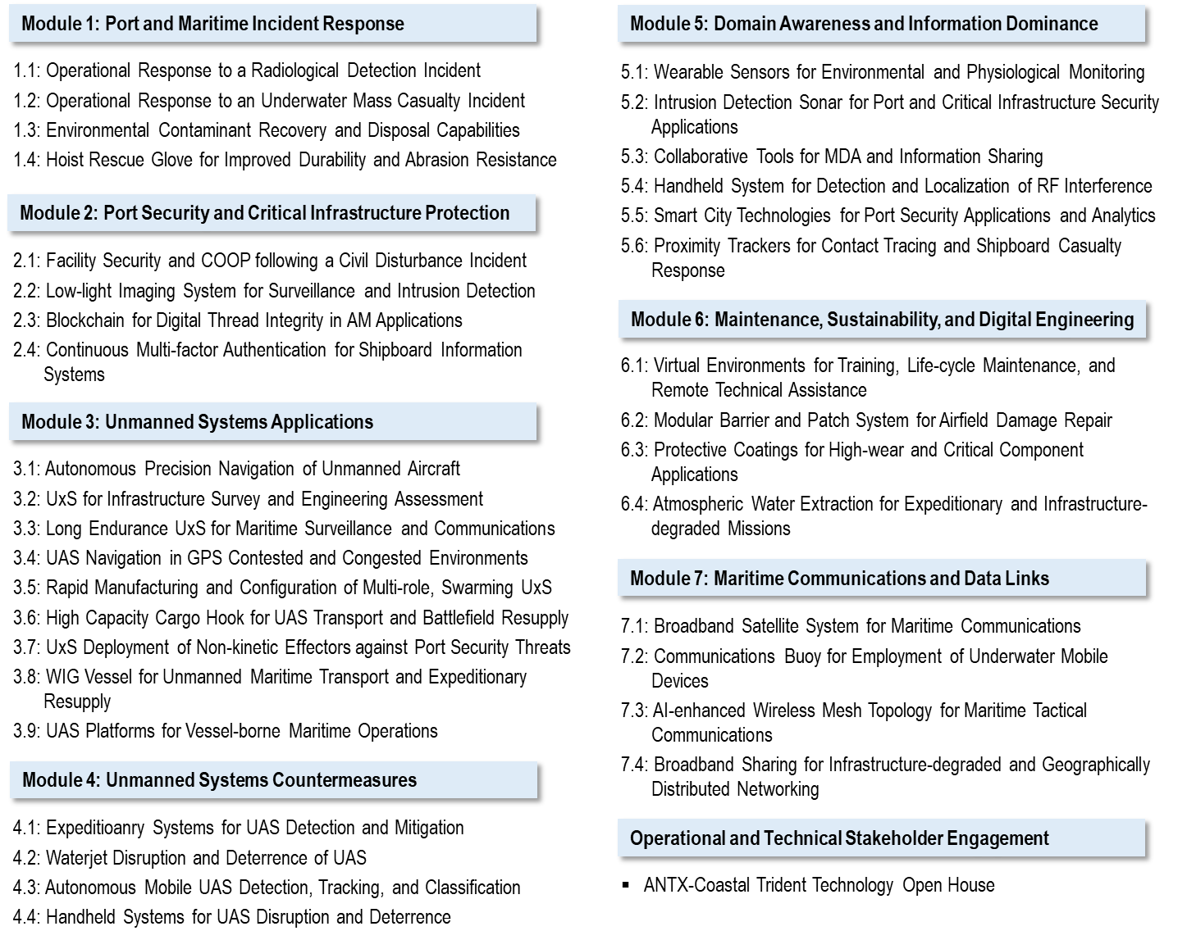
ANTX-Coastal Trident 2021 Administrative Construct

Slide 15
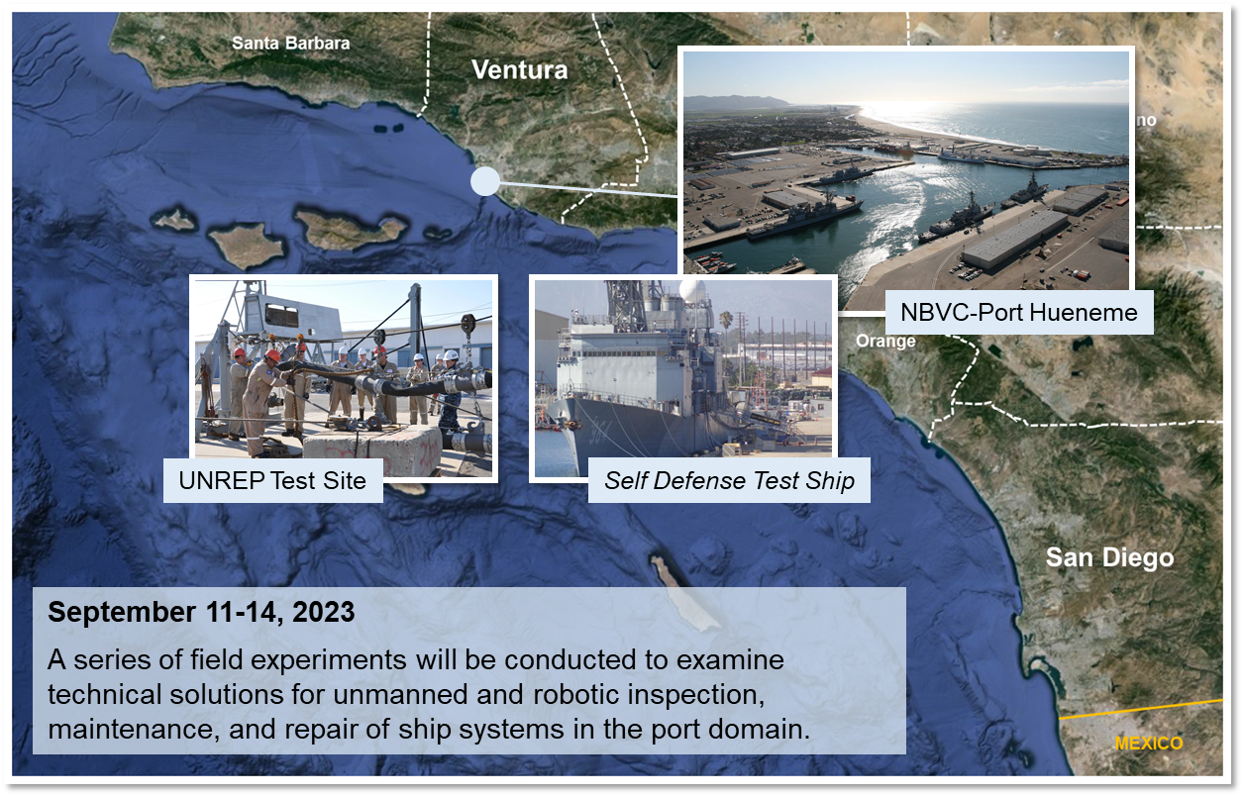
Event OSCAR
ANTX-Coastal Trident 2023 Operational Construct

Slide 16
Event OSCAR

Slide 17
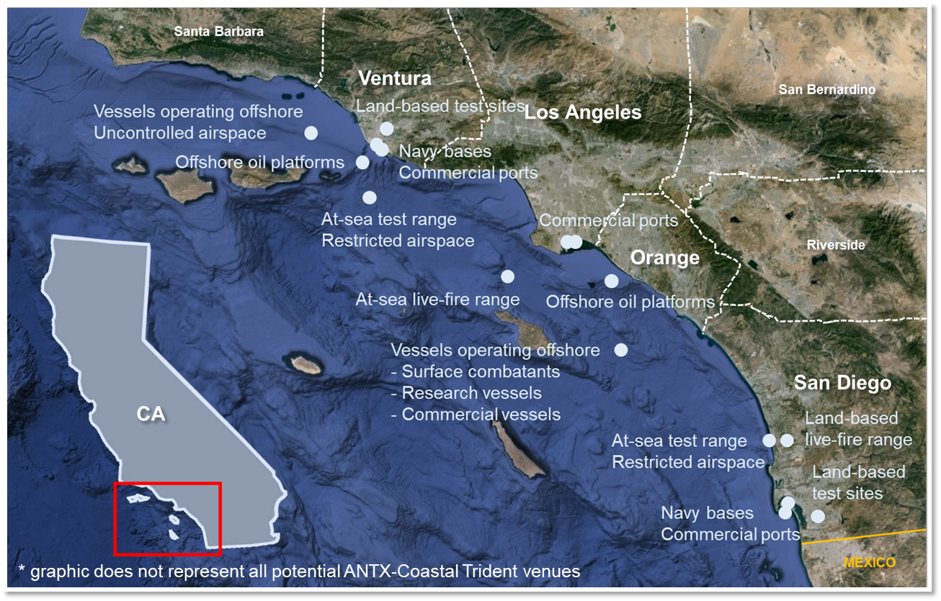
Area of Operations*

Slide 18
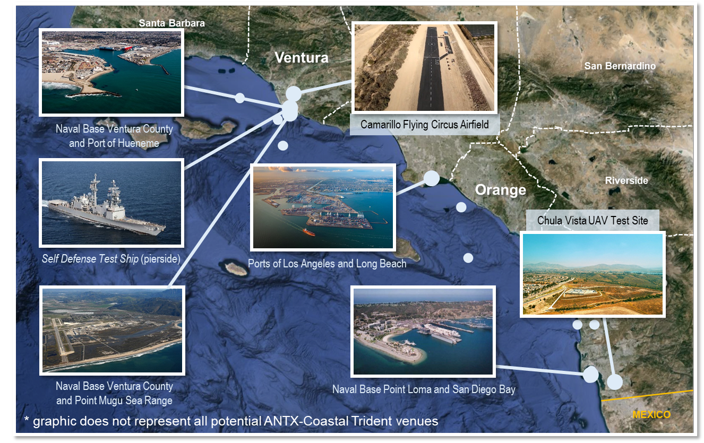
Land-based and Waterside Venues*

Slide 19
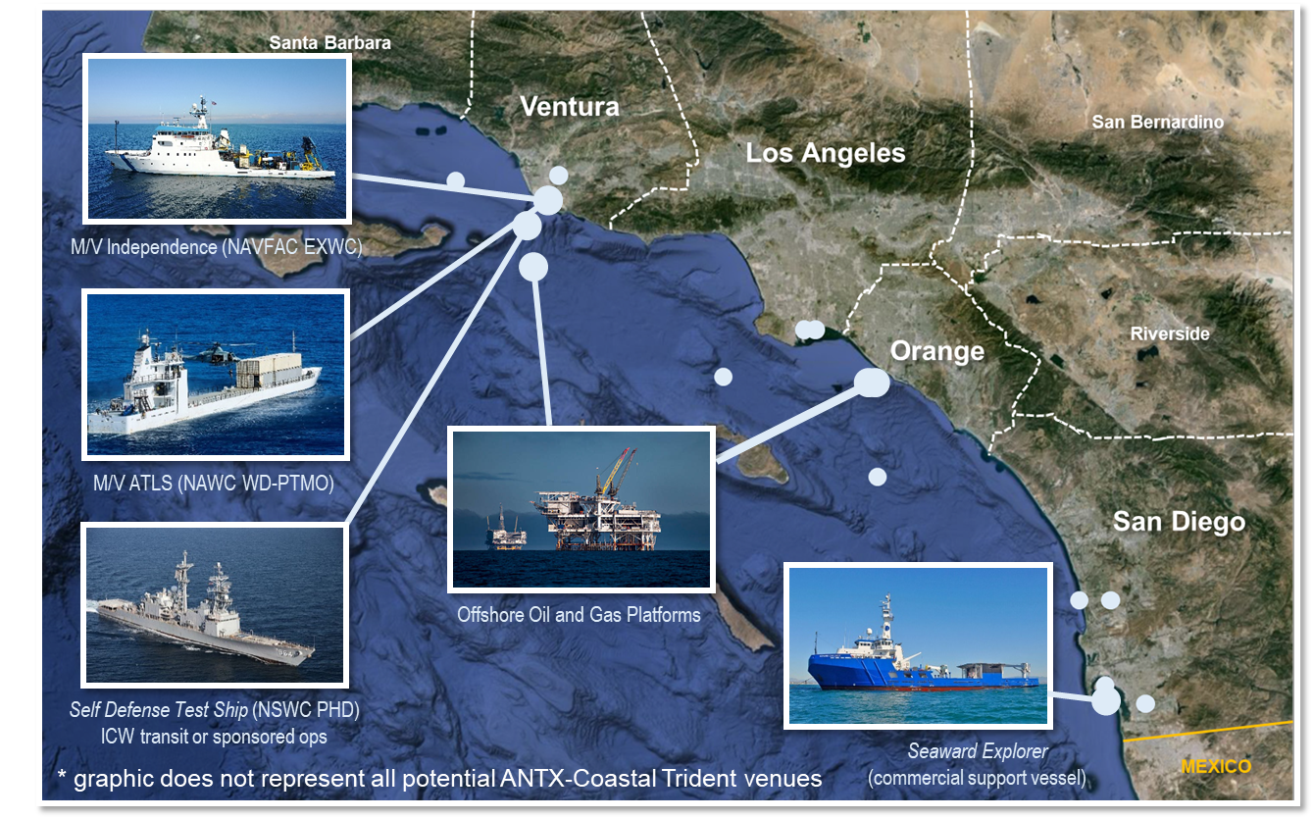
Waterborne Venues*

Slide 20
Waterborne Venues*
In order to maintain a low barrier-to-entry, Coastal Trident maximizes use of non-traditional venues. This requires some planning flexibility and imagination but significantly increases access to relevant test environments
Example:
Instead of a Fleet combatant, the planning team might suggest experimentation aboard an offshore support vessel or oil platform – an industrial structure on the water subject to environmental exposure, constrained footprint, infrastructure and communications austerity, but with boats to and from several times daily, potential for long-duration installations, and significantly reduced administrative burden

Slide 21
ANTX-CT23 Modules
Module 1: Port and Maritime Incident Response
4 projects planned
Module 2: Port Security and Critical Infrastructure
Protection
5 projects planned
Module 3: Asymmetric Threat Detection and Domain
Awareness
8 projects planned
Module 4: Maintenance and Sustainment of Fleet
and Expeditionary Operations
14 projects planned
Module 5: Unmanned Systems Applications
15 projects planned
Module 6: Unmanned Systems Countermeasures
2 projects planned
Module 7: Decision Support and Information
Dominance
14 projects planned
Module 8: Maritime Communications and Data Links
9 projects planned

Slide 22
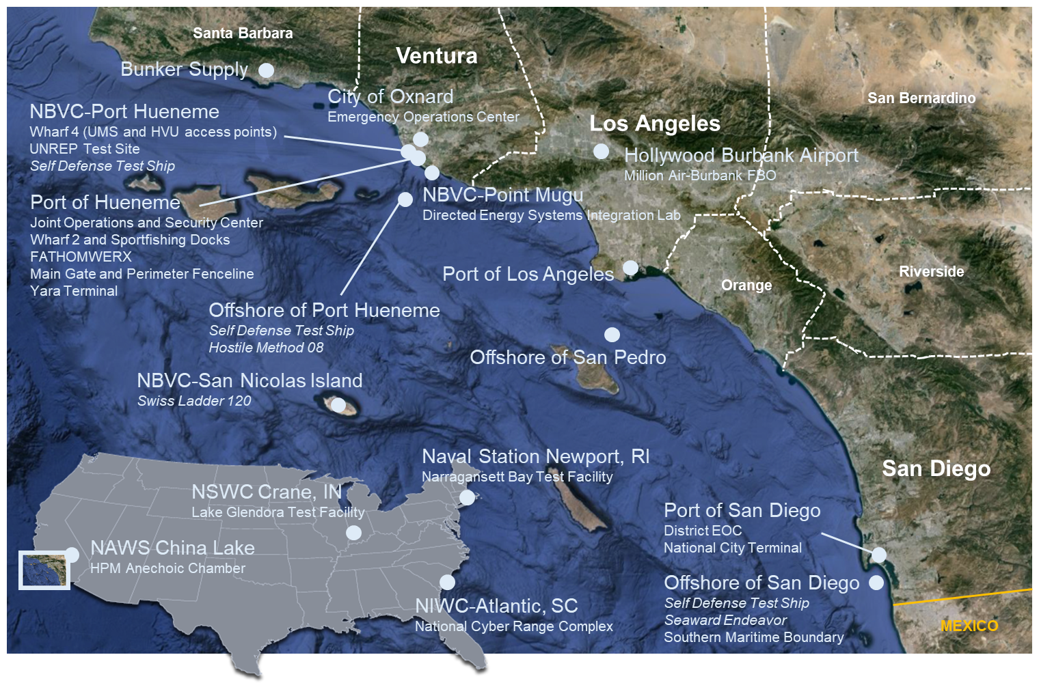
ANTX-CT23 Area of Operations

Slide 23
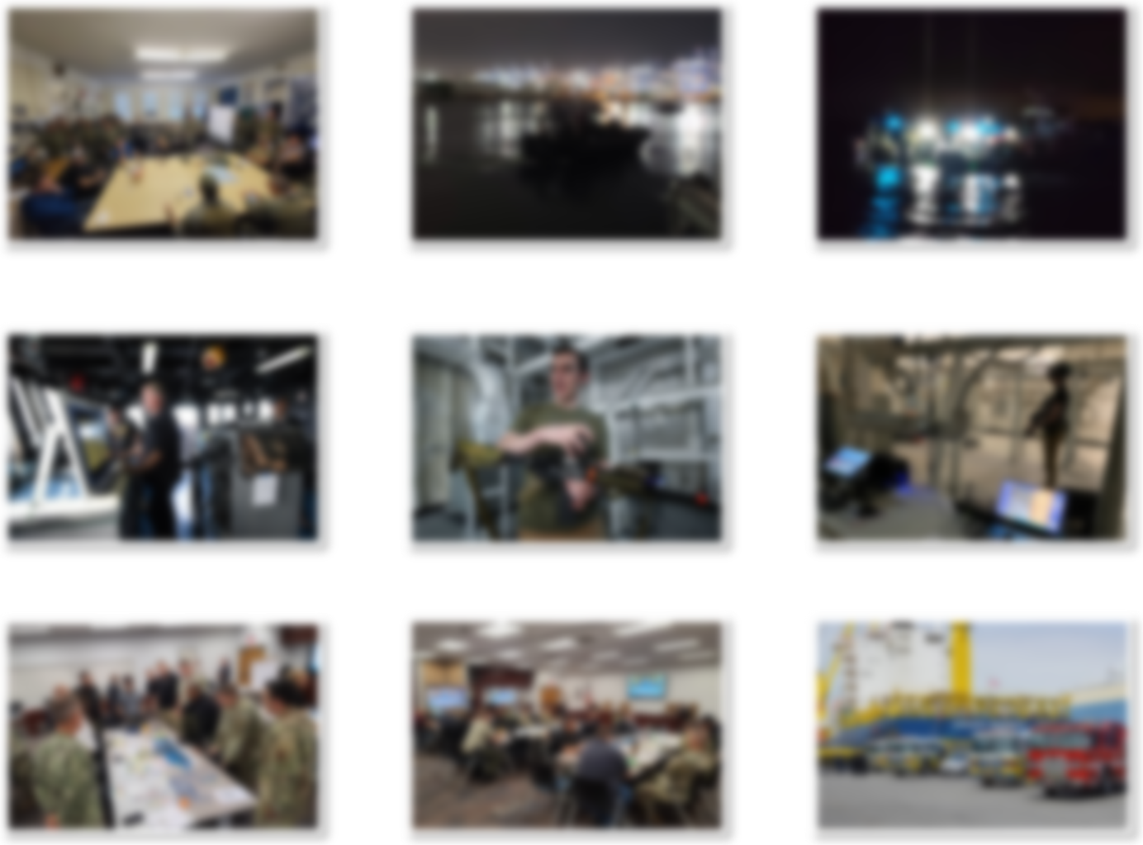
ANTX-CT23 Project Activities
Look around and enjoy the day!

